Slide 1
ß - THALASSEMIA
DR. PRAHALAD SHARMA
MD

Slide 5
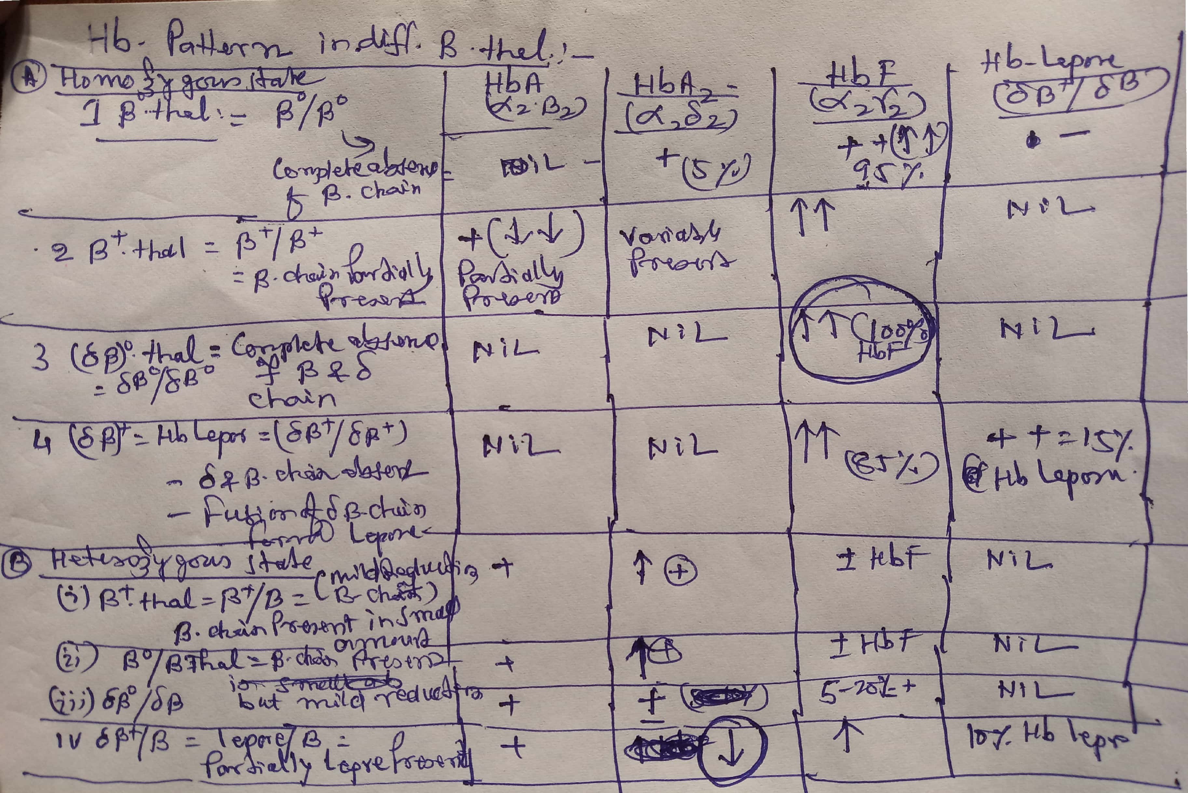

Slide 11
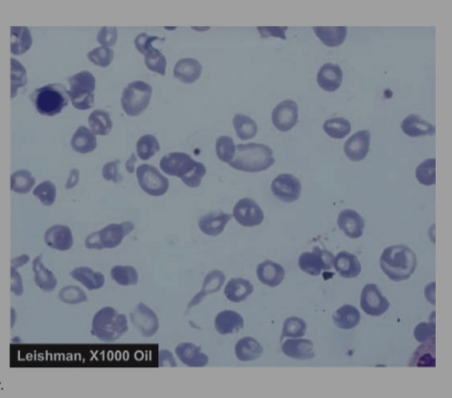

Slide 18
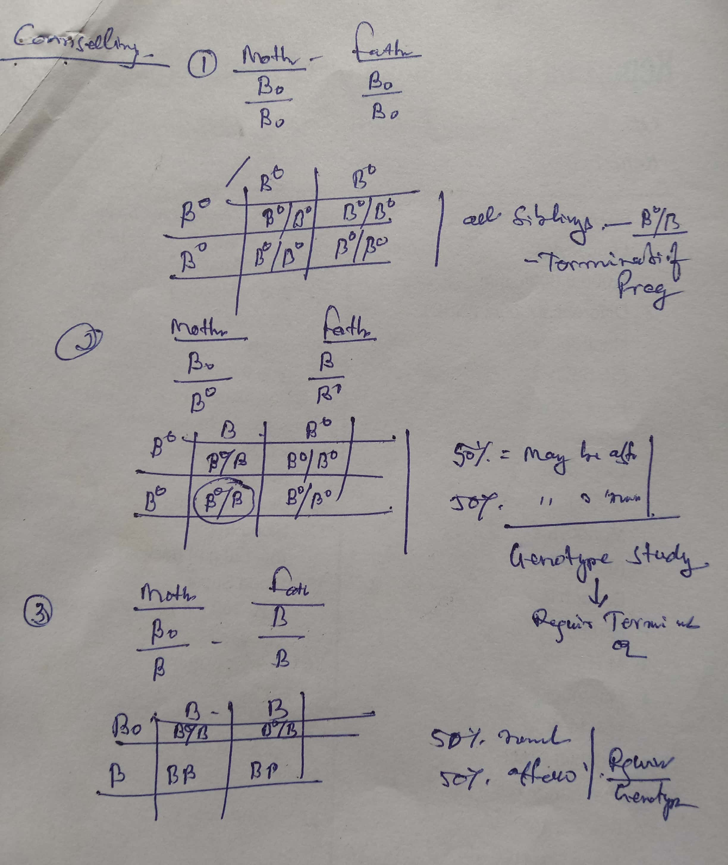

Slide 19
