Slide 1
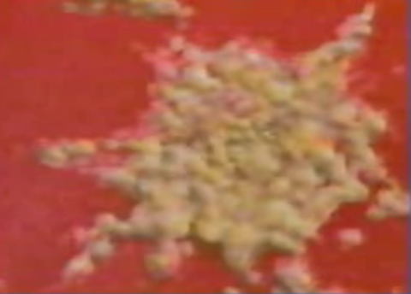
Neoplasia
Dr. Pankaj Kr. Patel
Associate professor
Dept. of Pathology
SKMCH, Muzaffarpur

Slide 2
Definition
Nomenclature
Characteristics of Benign and Malignant Neoplasms
Epidemiology
Molecular Basis of Cancer
Carcinogenic Agents and Their Cellular Interactions
Clinical Aspects of Neoplasia

Slide 3
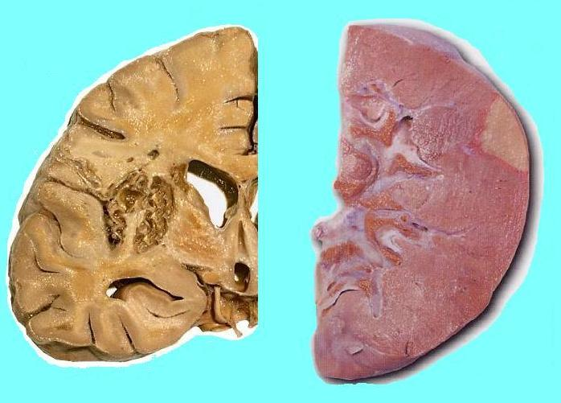
What?

Slide 4
The word “pathology “ is derived from two Greek words ---
Pathos – meaning suffering
Logos – meaning study

Slide 5
Study of Disease:
Epidemiology
Etiology - Causes
Pathogenesis - Evolution
Morphology - Structural Changes
Clinical Significance – Functional Changes
Management
Complications
Prevention
Pathology

Slide 6
. The core of pathology:
The four aspects of a disease process that
form the core of pathology :
(1) Etiology: causes of the disease
(2) Pathogenesis: the mechanisms of its development
(3) Morphologic changes: the structural alteration
induced in the cells and organs of the body.
(4) Clinical significance: the functional
consequences of the morphologic changes.

Slide 7
Text of Pathology:
(1) General pathology:
concerned with the basic reaction of cells and tissues to abnormal stimuli that underlie all diseases.
(2) Systemic pathology :
describe the specific responses of specialized
organs and tissues to defined stimuli.

Slide 8
Subdivisions of clinical Pathology:
Histopathology
Cytopathology
Haematology
Microbiology
Immunology
Chemical Pathology
Genetics
Toxicology
Forensic Pathology
Histopathologist
Cytologist
Haematologist
Microbiologist
Biochemist
Geneticist
Toxicologist
Forensic Pathologist
Molecular Biologist

Slide 9
Sample Case:

Slide 10
Clinical Details:
34 year male
Neck swelling, 2-3 months,
Fever, weight loss,
no other lymphadenopathy
Lymphnode biopsy done

Slide 11
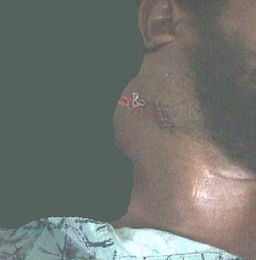
Right neck mass

Slide 12
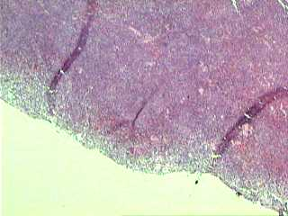
Lymphnode Biopsy
Diffuse tumour
Capsule

Slide 13
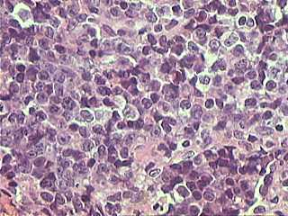
Lymphnode Biopsy
Large cells
Mitotic figures

Slide 14
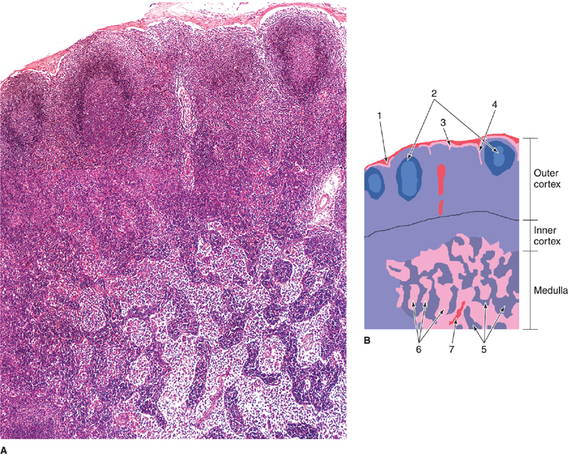
Section of a lymph node showing the cortex and the medulla 1 Capsule;2 lymphoid nodule with germinative center 3
subcapsular sinus; (4) intermediate sinus; (5) medullary cords; (6) medullary sinus; (7) trabecula.
(Courtesy of PA Abrahamsohn.)

Slide 15
Key Facts
Cancers figure among the leading causes of death worldwide
About 30% of cancer deaths are due to the five leading behavioral and dietary risks:
High body mass index,
    Low fruit and vegetable intake,
    Lack of physical activity,
        Tobacco and Alcohol use.

Slide 16
British oncologist Willis :
“A neoplasm is an abnormal mass of tissue, the growth of
which exceeds and is uncoordinated with that of the
normal tissues and persists in the same excessive manner
after cessation of the stimuli which evoked the change.”

Slide 17
Limitations of Willis’ definition

Slide 18
NEOPLASIA
Neo ---- New
Plasia ----Growth

Slide 19
All tumors, benign and malignant, have two basic component : -
Tumor cells : Proliferating clonal neoplastic cells that constitute parenchyma
Tumor stroma : Supporting framework
- made up of connective tissue and blood vessels

Slide 20
Desmoplasia :
Hyperplasia of fibroblasts and formation of abundant collagen in the stroma as a reaction to infiltration by tumor cells is labelled as desmoplasia.
Cancer of the female breast are stony hard or scirrhous
Desmoplastic reactions are commonly seen in pancreatic adenocarcinoma and cholangiocarcinoma

Slide 21
Excessive fibro-collagenous stroma formation within tumor is called as –
A) Anaplasia
B) Metaplasia
C) Dysplasia
D) Desmoplasia

Slide 22
Desmoplastic response is seen in –
A) Hepatocellular carcinoma
B) Ovarian carcinoma
C) Pancreatic carcinoma
D) Renal cell carcinoma

Slide 23
Nomenclature:
Neoplasms are named based upon two factors
• on the histologic types : mesenchymal and epithelial
• on behavioral patterns : benign and malignant neoplasms

Slide 24
MESENCHYME (mesenchymal)
Largely derived from mesoderm:
structural and functional elements of the body- “connective tissue” (cartilage, bone, collagen, nerve, blood vessels, etc...)

Slide 25
EPITHELIUM (epithelial)
Derived from ectoderm or endoderm:
- the protective, absorptive and secretory lining of
the body :
Externally --- (e.g. skin) and
Internally----- (e.g. lining of colon, pancreatic glands)
Common types of epithelium are: squamous and columnar/glandular

Slide 26
Nomenclature
  Benign tumors:
    prefix + suffix
    Type of cell + (-oma)

Slide 27
CONNECTIVE TISSUE NEOPLASMS
Smooth muscle: Leiomyoma
Fibrous tissue: Fibroma
Bone: Osteoma
Cartilage: Chondroma
Fat: Lipoma
Nerve: Neurofibroma
Nerve sheath: Neurilemmoma
Glial cells: Glioma

Slide 28
Nomenclature of benign epithelial tumor is more complex
Epithelial benign tumors are classified on the basis of :
  The cell of origin
  Microscopic pattern
  Macroscopic pattern

Slide 29
  Adenoma :
  benign epithelial neoplasms producing gland pattern….OR … derived from glands but not necessarily exhibiting gland pattern
  Papilloma :
  benign epithelial neoplasms growing on any surface that produce microscopic or macroscopic finger-like pattern

Slide 30
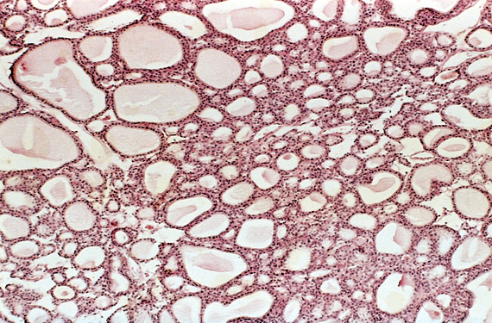

Slide 31
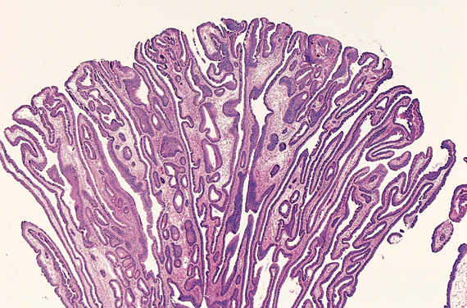
Papilloma of colon with finger like projection

Slide 32
Cystadenoma : Large cystic masses, as in the ovary
Papillary cystadenoma : papillary patterns that protrude into cystic space

Slide 33
Polyp :
a mass that projects above a mucosal surface to form a macroscopically visible structure.
e.g. - colonic polyp
- nasal polyp

Slide 34
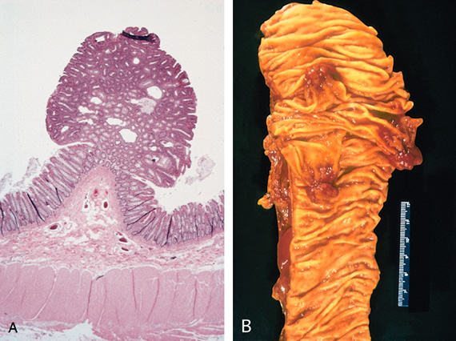

Slide 35
Nomenclature - Malignant Tumors
Malignant neoplasm nomenclature essentially follows the same scheme used for benign neoplasm with certain additions.
Malignant neoplasms arising from mesenchymal tissues are called sarcomas (Greek sar =fleshy).
Thus, it is a fleshy tumour

Slide 36
CONNECTIVE TISSUE NEOPLASMS
Smooth muscle: Leiomyosarcoma
Bone: Osteosarcoma
Fibrous tissue: Fibrosarcoma
Cartilage: Chondrosarcoma
Fat: Liposarcoma
Nerve: Neurofibrosarcoma
Nerve sheath: Neurilemmosarcoma

Slide 37
Nomenclature - Malignant Tumors
Malignant neoplasms of epithelial cell origin derived from any of the three germ layers are called carcinomas.
Ectodermal origin: skin (epidermis - squamous cell carcinoma, basal cell carcinoma)
Mesodermal origin: renal tubules (renal cell carcinoma).
Endodermal origin: linings of the gastrointestinal tract (colonic carcinoma)

Slide 38
Carcinomas can be furtherly classified :
Those producing glandular microscopic pictures are called - Adeno carcinomas
Those producing recognizable squamous cells are designated as squamous cell carcinoma etc .
furthermore, when possible the carcinoma can be specified by naming the origin of the tumour such as renal cell adenocarcinoma etc

Slide 39
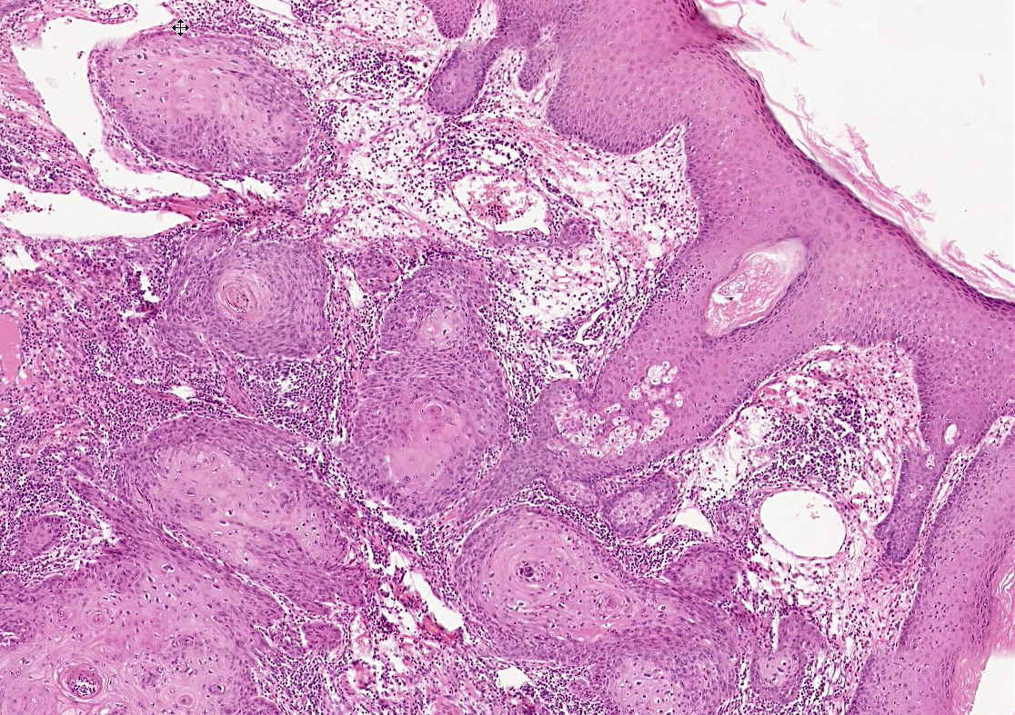
Notes:
This view shows the transition from normal squamous epithelium into invasive carcinoma.

Slide 40
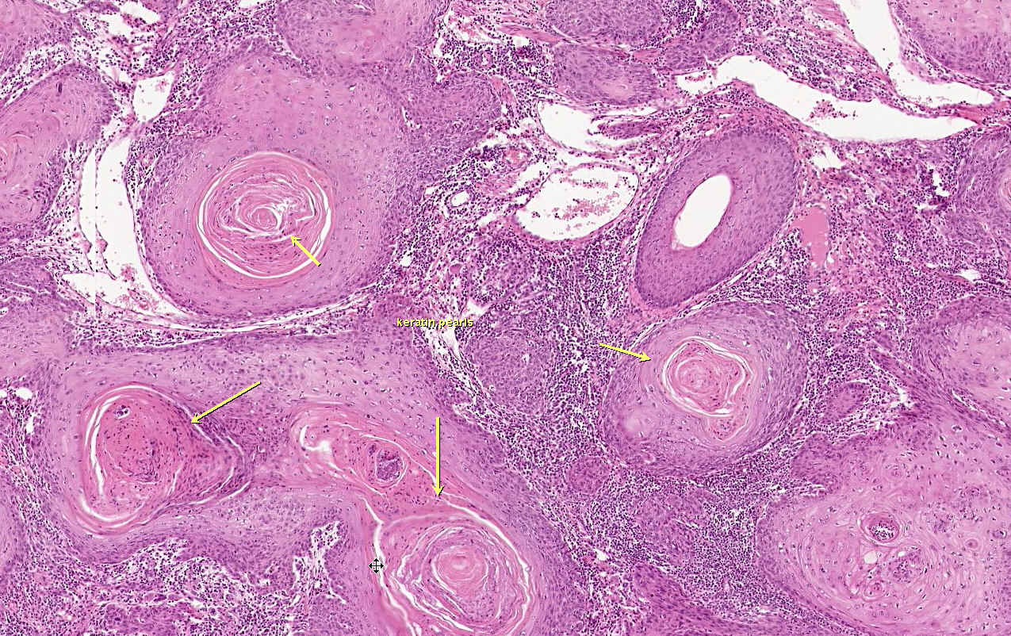
Notes:
A hallmark of well differentiated squamous cell carcinoma is that the nests of invading cells still attempt to make keratin which then gets deposited in the center of the nests, resulting in a keratin "pearl".
From the Iowa Collection

Slide 41
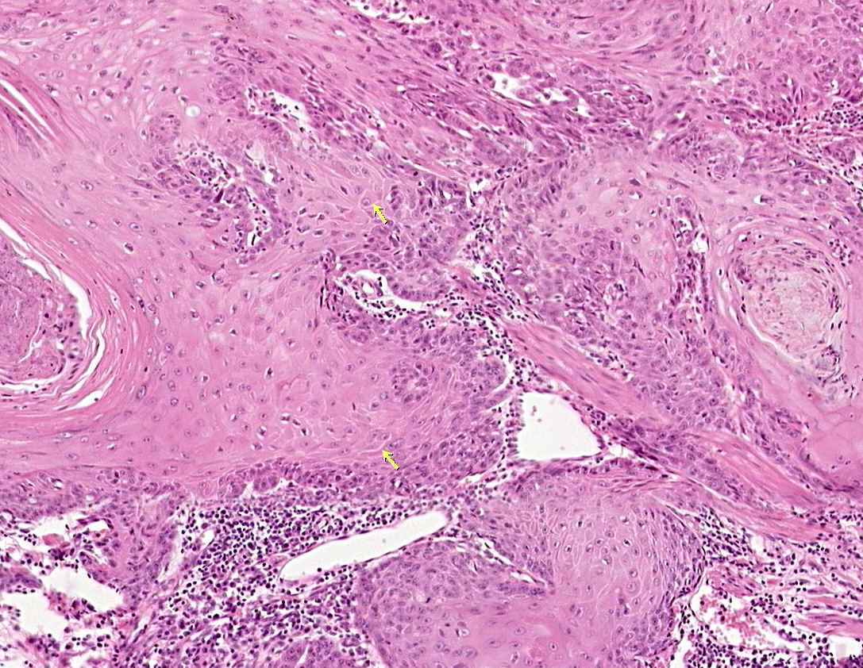
Notes:
Another characteristic of a well differentiated squamous cell carcinoma is that it still makes visible intercellular bridges.

Slide 42
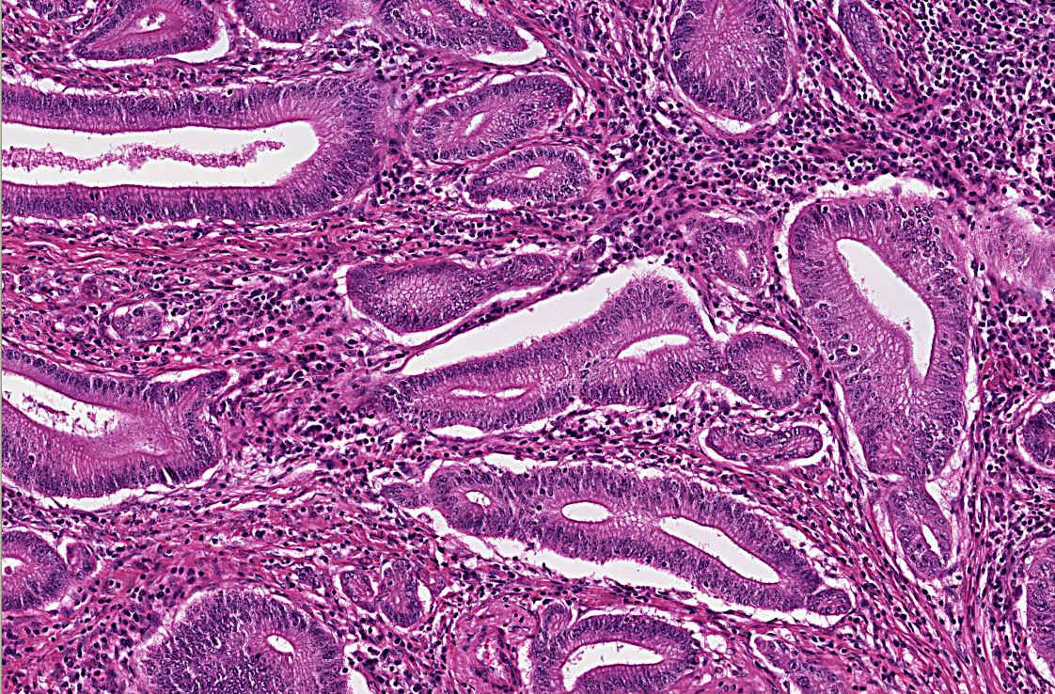
Notes:
Adenocarcinoma of color arising in a case of ulcerative colitis

Slide 43
Tumors that arise from more than one tissue components
Mixed tumors : Divergent differentiation of a single line of parenchymal cells resulting in tumors comprised more than one cell type ; usually derived from one germ cell layer.
Examples include pleomorphic adenoma
These tumors contain epithelial components scattered within a myxoid stroma that sometimes contains islands of apparent cartilage or even bone.
All these elements, it is believed, arise from epithelial and myoepithelial cells of salivary glands origin.

Slide 44
Teratomas contain representative of parenchyma cells of more than one germ layer, usually all three layers.
They arise from totipotential cells and so are principally encountered in ovary and testis. -
  Benign cystic teratoma of ovary is the most common teratoma

Slide 45

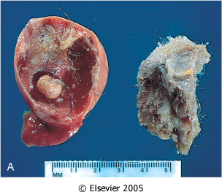
Downloaded from: Robbins & Cotran Pathologic Basis of Disease (on 28 July 2005 03:41 PM)
© 2005 Elsevier
Notes:
Figure 7-4 A, Gross appearance of an opened cystic teratoma of the ovary. Note the presence of hair, sebaceous material, and tooth. You do not need a microscope to appreciate this tumor produces both connective tissue as well as epithelial derived elements.

Slide 46
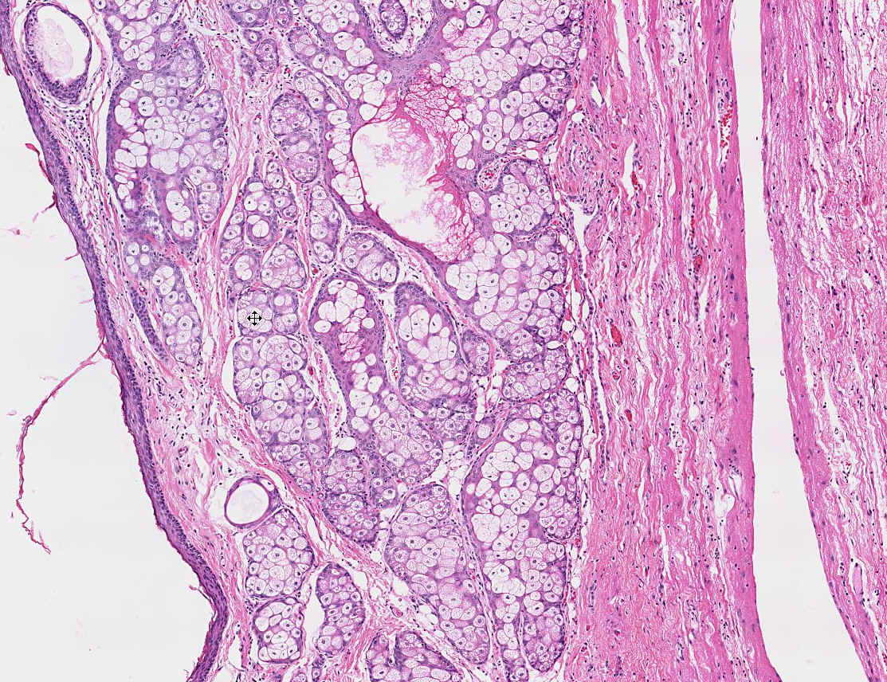
Notes:
Dermoid cyst of ovary (a component of benign cystic teratoma)
Iowa Collection

Slide 47
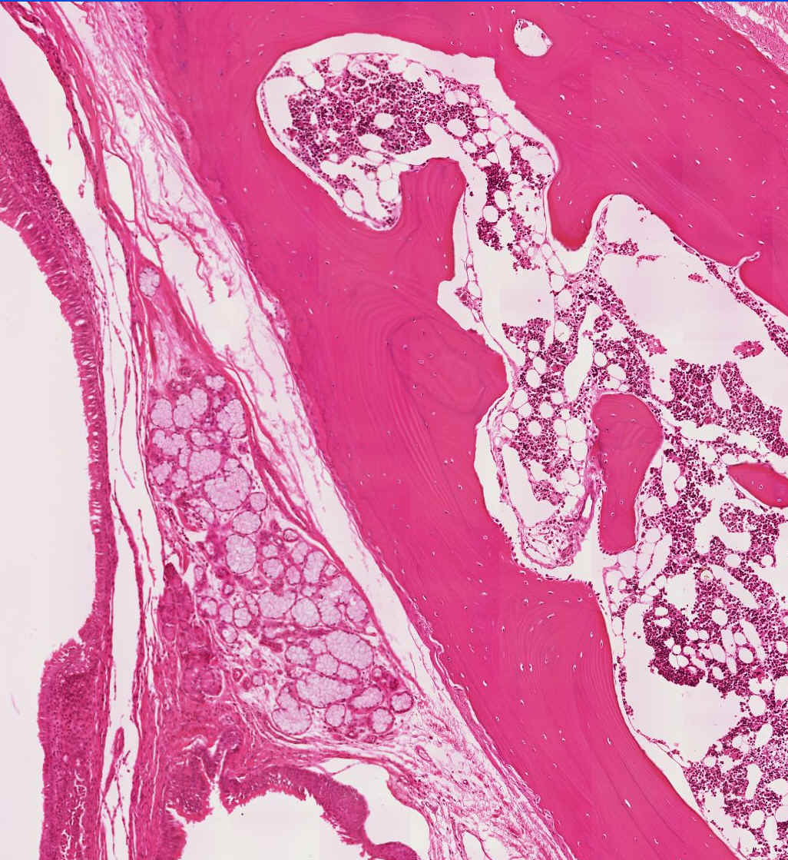
Notes:
A microscopic view of a similar tumor shows sebaceous glands, respiratory epithelium, bone, and bone marrow.

Slide 48
Aberrant differentiation
Choristoma :
These are ectopic rests of normal tissue or normal tissue at abnormal anatomical site.
They are considered as non-neoplastic, developmental malformation because their rate of growth is equal to the normal surrounding tissue.
e.g. – normal pancreatic cells under the small bowel mucosa

Slide 49
Hamartoma
These are masses of disorganised tissue indigenous to a particular site (lung hamartomas exhibit cartilage, bronchi and blood vessels).
Now considered as neoplasm because they have clonal chromosomal aberrations that are acquired through somatic mutation.
Rearrangements of chromosome 6p21 or chromosome 12q14-15 suggest that this is a neoplastic process.
It generally is seen in patients above 40 years of age

Slide 50
Differences between Hamartoma and Neoplasm
Hamartoma Neoplasm
Disorganised focal over-
growth of mature tissue indigenous to a particular site.
Always benign
Well-differentiated cells which completely resemble normal counterparts.
Polyclonal
Pulmonary hamartoma
Abnormal, excessive, unregulated, autonomous proliferation of cells.
May be benign or malignant.
Vary from well-differentiated to poorly differentiated anaplastic lesion.
Monoclonal.
Squamous cell carcinoma

Slide 51
Misnomers
  Hepatoma : malignant liver tumor
  Melanoma : malignant skin tumor
  Seminoma : malignant testicular tumor
  Lymphoma : malignant tumor of lymphocytes

Slide 52
????? Q
Tumor containing cells of all three germ layers is called-
Leiomyoma
Squamous cell carcinoma
Adenocarcinoma
Teratoma

Slide 53
???? Q
Ectopic rest of normal tissue is known as –
Choristoma
Hamartoma
Pseudotumor
Lymphoma

Slide 54
???? Q
Hamartoma is –
Malignant tumor
Benign tumor
Developmental malformation
Hemorrhage in vessel

Slide 55
????? Q
45 yr old asymptomatic male executive with a 2x2 cm subpleural nodule in left lower lobe detected on routine chest x-ray.
On m/e - shows mature hyaline cartilage along with entrapped bronchial epithelium and adipose tissue at the periphery.
Diagnosis --- ?????

Slide 56
A 32-year-old woman has experienced dull pelvic pain for the past 2 months. Physical examination shows a right adnexal mass. An abdominal ultrasound scan shows a 7.5-cm cystic ovarian mass. The mass is surgically excised. The surface of the mass is smooth, and it is nonadherent to surrounding pelvic structures. On gross examination, the mass is cystic and filled with hair. Microscopically, squamous epithelium, tall columnar glandular epithelium, cartilage, and fibrous connective tissue are present.
Which of the following is the most likely diagnosis?
(A) Adenocarcinoma (B) Hamartoma
(C) Mesothelioma (D) Teratoma

Slide 57
Why the nomenclature of tumor is important ?

Slide 58
Characteristics of Benign and Malignant Tumors
There are four fundamental features by which benign and malignant tumors can be distinguished :
Differentiation and Anaplasia (Malignant change in the target cell, referred to as transformation )
Rate of Growth (Growth of the transformed cells)
Local Invasion
Metastasis

Slide 59
Differentiation and Anaplasia
Differentiation refers to the extent to which neoplastic parenchymal cells resemble the corresponding normal parenchymal cells, both morphologically and functionally.
Lack of differentiation is called : anaplasia
In general, benign tumors are well differentiated .
The neoplastic cell in a benign adipocyte tumor—a lipoma—so closely resembles the normal cell that it may be impossible to recognize it as a tumor by microscopic examination of individual cells.

Slide 60
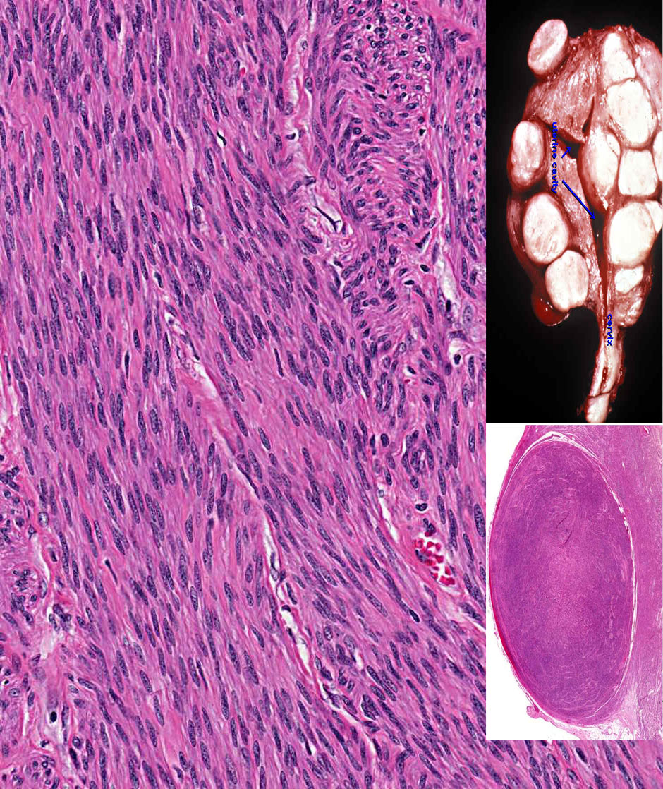
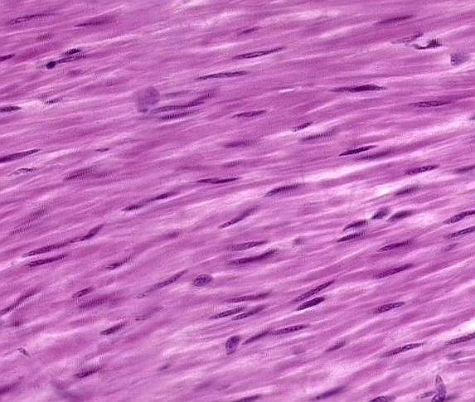
Notes:
Leiomyoma of the uterus. This benign, well-differentiated tumor contains interlacing bundles of neoplastic smooth muscle cells that are virtually identical in appearance to normal smooth muscle cells in the myometrium.

Slide 61
Malignant neoplasms are characterized by a wide range of parenchymal cell differentiation:
Well differentiated
Moderately well differentiated
Undifferentiated.

Slide 62
Malignant neoplasms that are composed of poorly differentiated cells are said to be anaplastic.
Lack of differentiation, or anaplasia, is considered a hallmark of malignancy.

Slide 63
Anaplasia literally means “backward formation”
Dedifferentiation or failure of differentiation ??
Recent studies indicate that dedifferentiation of apparently mature cells does occur during carcinogenesis
Dedifferentiation
It is now known that at least some cancers arise from stem cells in tissues
Failure of differentiation

Slide 64
Key points
Well differentiated neoplasm
Resembles mature cells of tissue of origin
• The cells in benign tumors are almost always well differentiated and resemble their normal cells of origin.
Poorly differentiated or undifferentiated cancers show proliferation without differentiation or maturation.

Slide 65
Correlation with biologic behavior
  Benign tumors are well differentiated and have good prognosis.
  Poorly differentiated malignant tumors usually have worse prognosis

Slide 66


If cells LOOK BAD, they are probably going to BEHAVE BAD
Notes:
The strong relationship between histology and biologic behavior

Slide 67

If cells LOOK GOOD, they are probably going to BEHAVE GOOD
Notes:
The Mormon Tabernacle Choir

Slide 68
Anaplasia --- Key points
Complete loss of differentiation
Hallmark of malignant transformation
Irreversible

Slide 69
ANAPLASIA
Pleomorphism
  Size
  shape
Abnormal nuclear morphology
  Hyperchromasia
  High nuclear cytoplasmic ratio
  Chromatin clumping
  Prominent nucleoli
Mitoses
  Mitotic rate
  Location of mitoses
Loss of polarity
Notes:
Dysplasia means potential PRE-cancer. Anaplasia means cancer.

Slide 70
Features of Anaplasia
Marked pleomorphism (variation in size and shape of cells)
Anisonucleosis (variation in size of nuclei)
Abnormal nuclear morphology :
Nuclei are extremely hyperchromatic (dark-staining) and large resulting in an increased nuclear-to-cytoplasmic ratio that may approach 1 : 1 instead of the normal 1 : 4 or 1 : 6.
The chromatin is often coarsely clumped and distributed along the nuclear membrane. Large nucleoli are usually present in these nuclei.

Slide 71
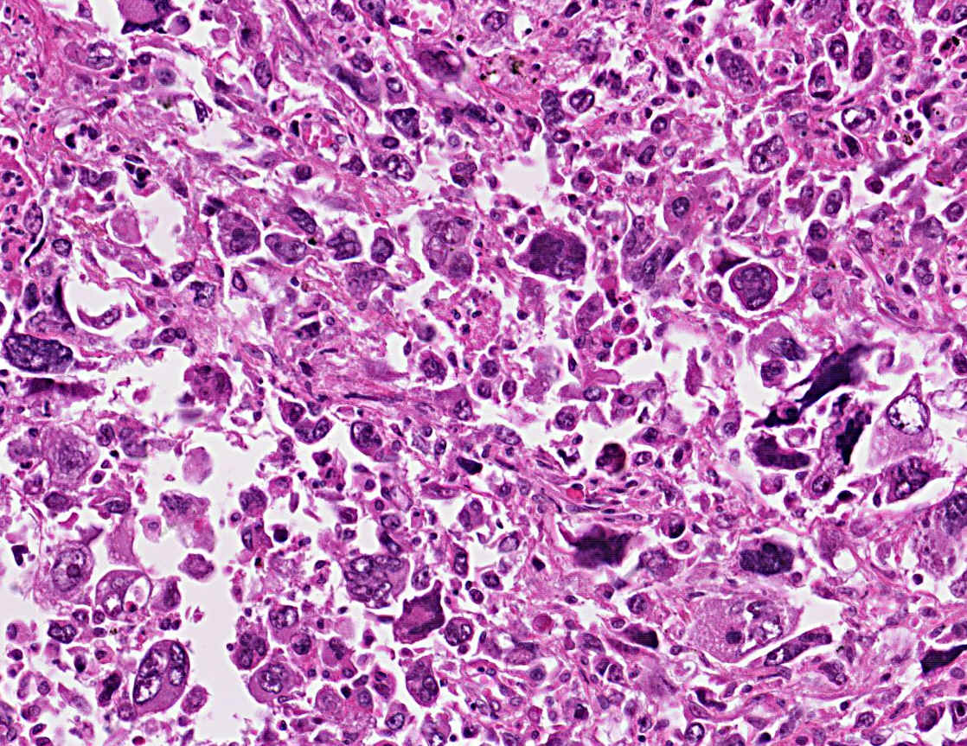
Notes:
Anaplastic large cell carcinoma of lung showing cellular and nuclear variation in size and shape. No differentiation into squamous or glandular epithelium is evident. This is what we mean when we say, it looks “bad”, i.e., pleomorphic, hyperchromatic.

Slide 72
Mitoses
Undifferentiated tumors usually possess large numbers of mitoses, reflecting the higher proliferative activity of the parenchymal cells.
The presence of mitoses, however, does not necessarily indicate that a tumor is malignant or that the tissue is neoplastic.
Many normal tissues exhibiting rapid turnover, such as bone marrow, have numerous mitoses, and non-neoplastic proliferations such as hyperplasias contain mitosis.
More important as a morphologic feature of malignant neoplasia are atypical, bizarre mitotic figures, sometimes producing tripolar, quadripolar, or multipolar spindles

Slide 73
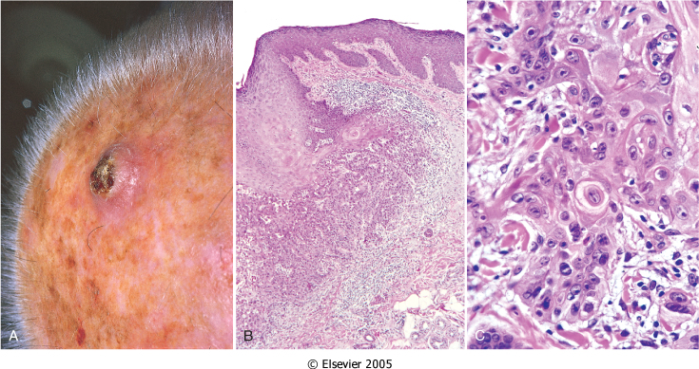
Loss of polarity
In addition to the cytologic abnormalities, the orientation of anaplastic cells is markedly disturbed (i.e., they lose normal polarity).
Sheets or large masses of tumor cells grow in an anarchic, disorganized fashion

Slide 74
Other changes
Another feature of anaplasia is the formation of tumor giant cells.
Some possessing only a single huge polymorphic nucleus and others having two or more nuclei.
These giant cells are not to be confused with inflammatory Langhan’s or foreign body giant cells, which are derived from macrophages and contain many small, normal-appearing nuclei.
In the cancer giant cell, the nuclei are hyperchromatic and large in relation to the cell

Slide 75
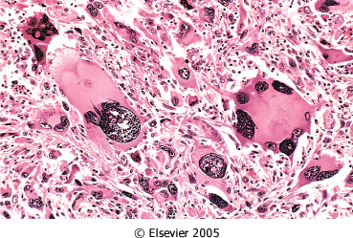
Microscopic features of tumors
Pleomorphism – variation in size and shape of cells within the neoplasm

Slide 76
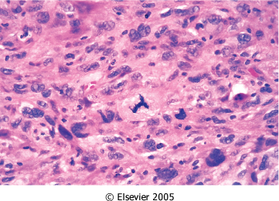
Microscopic features of tumors
Mitotic activity - Increased in more malignant tumors and often abnormal in shape (tripolar mitoses– Mercedes benz sign)

Slide 77
????? Q
Lack of differentiation is called –
Anaplasia
Dysplasia
Metaplasia
Hyperplasia

Slide 78
?????? Q
Reversible loss of polarity with abnormality in size and shape of cells is known as –
Metaplasia
Dysplasia
Hyperplasia
Anaplasia

Slide 79
What is Dysplasia?
Dysplasia is a disordered but non-neoplastic proliferation of epithelia
It is a loss in the uniformity of individual cells and in their architectural orientation
Features of dysplastic cells: .
Considerable pleomorphism (variation in size and shape)
Hyperchromatic nuclei, abnormally large for the size of the cell
Mitotic figures are more abundant than usual and appear in abnormal locations .
(In dysplastic stratified squamous epithelium, mitoses are not confined to the basal layers)

Slide 80
Mild-to-moderate changes that do not involve the entire thickness of epithelium may be reversible,
and with removal of the putative inciting causes, the epithelium may revert to normal.
When dysplastic changes are marked and involve the entire thickness of the epithelium, the lesion is referred to as carcinoma in situ, a pre-invasive stage of cancer.
(The basement membrane is intact, and there is no tumor in the subepithelial stroma)

Slide 81
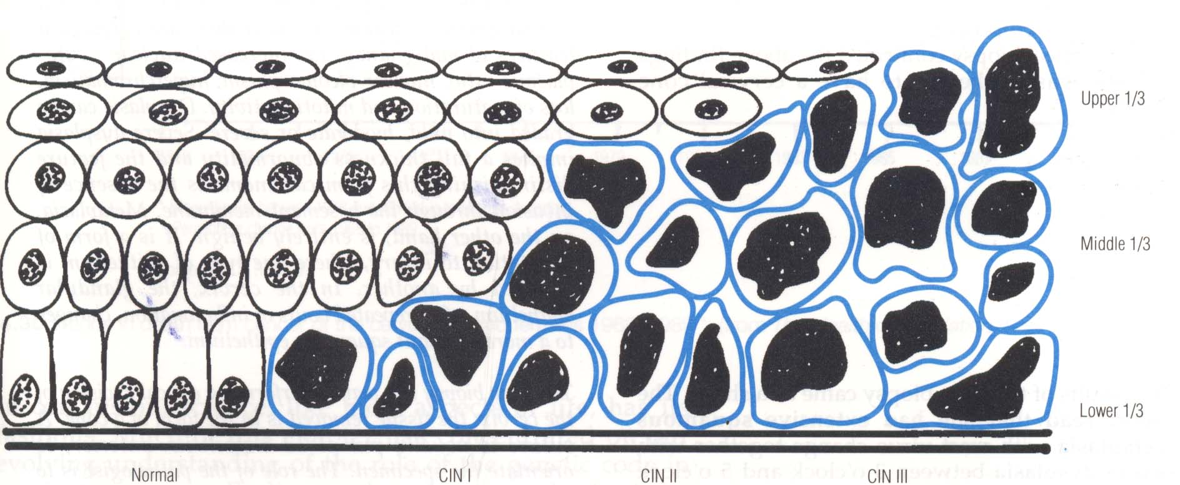

Slide 82
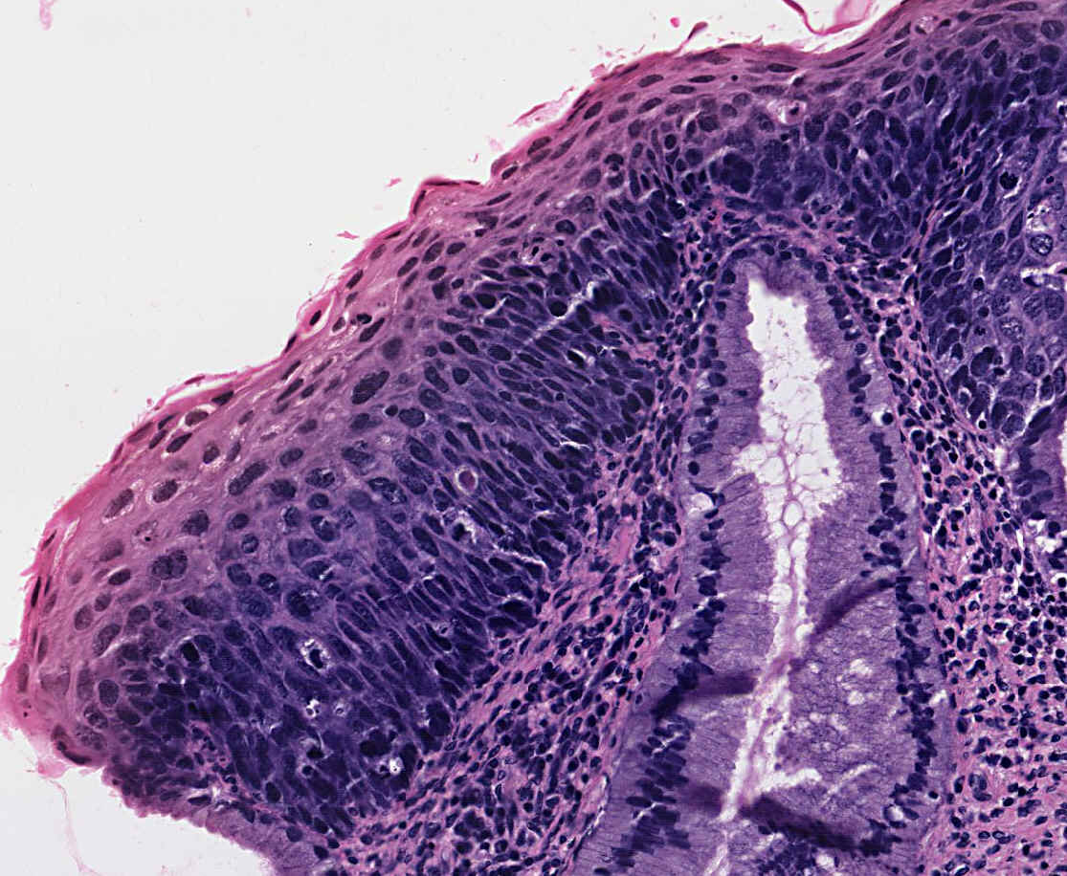
Notes:
This epithelium shows severe dysplasia: Note that dysplastic basal cells characterized by cuboidal shape, high nuclear cytoplasmic ratio, hyperchromatism, mitotic activity, and some loss of orientation to the basement membrane, occupy the lower two thirds of the surface rather than just the basal row of cells. More differentiated cells which occupy the outer third, though still retaining some dysplastic nuclear features have the appearance of maturing squamous cells rather than basal cells, and eventually become flattened on the surface.

Slide 83
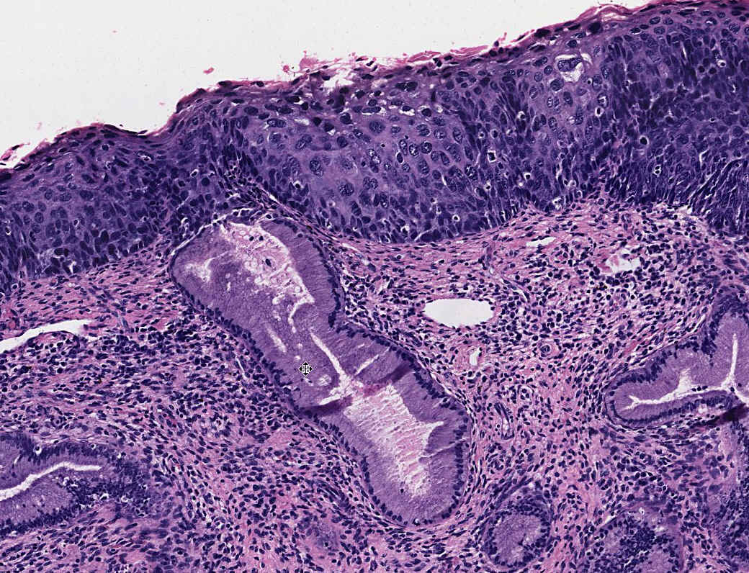
Notes:
Carcinoma in situ: This section shows that the dysplastic basiloid cells go all the way to the surface and never undergo significant differentistion towards more differentiated flattened squamous cells. Note however that the basement membrane is still intact.

Slide 84
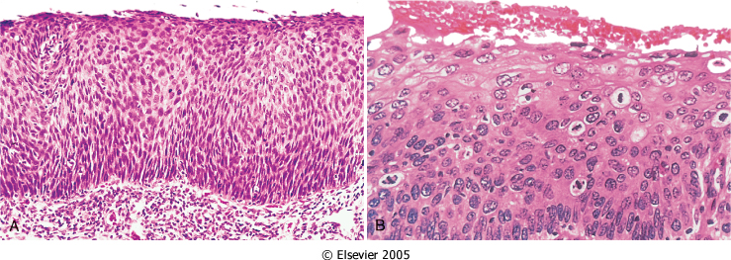

Slide 85
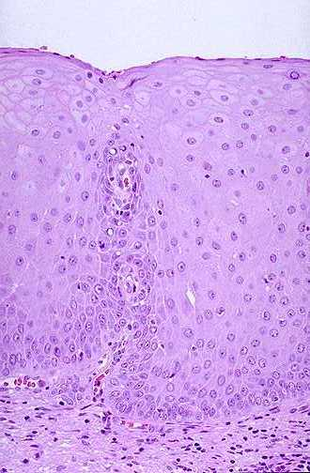
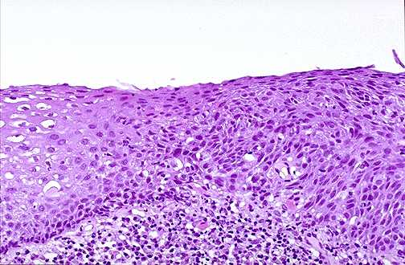

Slide 86
Carcinoma in-situ
  Definition:
  an intraepithelial malignancy in which malignant cells involve the entire thickness of the epithelium without penetration of the basement membrane.
  Applicable only to epithelial neoplasms.

Slide 87
Difference between Metaplasia and Dysplasia
Metaplasia Dysplasia
Definition : Reversible changes in which one type (epithelial or mesenchymal) is replaced by another adult cell type
Cellular pleomorphism – Usually not seen
Nuclear atypia--------------Usually not seen
Mitotic figures ------------- Few
Orientation with respect to one another (tissue architecture) -----------Maintained
Reversibilty ---Reversible, if triggering factors are removed
Example ------- Columnar to squamous epithelium in respiratory tract of chronic smokers
Loss of uniformity of the individual cells (mainly epithelial)as well as lack of architectural orientation with respect to another
Present
Hyperchromatic and abnormally large atypical nuclei may be seen
Many
Loss of ordered maturation as in dyplastic stratified squamous epithelium
May become irreversible if it involves the whole thickness of the epithelium
Cervical intraepithelial neoplasia (CIN)

Slide 88
Criteria | Metaplasia | Dysplasia | Anaplasia
Reversibility | Reversible | Partially reversible (early stage reversible) | Irreversible
Pleomorphism | Absent | Low grade | High grade
Nuclear / cytoplasmic ratio | Normal (1:4) | Increased | Increased (1:1)
Hyperchromasia | Absent | Slightly present | High grade
Cell polarity | Normal | Lost | Lost
Mitosis | Minimal or absent | Mild increased (typical type of mitotic figure) | Increased and atypical mitotic figure

Slide 89
Q????
Which one of the following numbered sequence best illustrates the postulated sequence of events that precedes the formation of an infiltrating squamous cell carcinoma of the cervix ?
1= Carcinoma in situ
2= Invasive carcinoma
3= Mild dysplasia
4= Moderate dysplasia
5= Severe dysplasia
6= Squamous metaplasia
A) 3---4---5---1---6---2
B) 3---4---5---6---1---2
C) 5---4---3---1---6---2
D) 6---3---4---5---1---2
E) 6---4---3---5---2---1

Slide 90
Q ???????
Number of cancer cells present in the smallest clinically detectable mass :
A) 10³ cell
B) 10⁹
C) 10¹¹

Slide 91
How long does it take to produce a clinically overt tumor mass?

Slide 92
Tumor Growth Rate
The original transformed cell (approximately 10 µm in diameter)
must undergo at least 30 population doublings to produce 10^{[9]} cells (weighing approximately 1 gm), which is the smallest clinically detectable mass.
In contrast, only 10 further doubling cycles are required to produce a tumor containing 10^{[12]} cells (weighing approximately 1 kg), which is usually the maximal size compatible with life

Slide 93
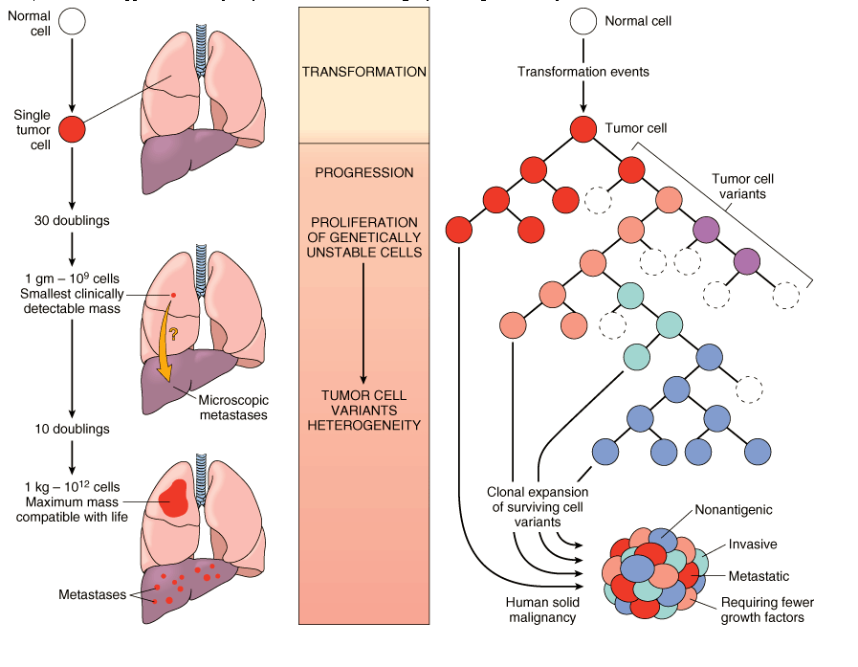
Notes:
Figure 7-12 Biology of tumor growth. The left panel depicts minimal estimates of tumor cell doublings that precede the formation of a clinically detectable tumor mass. It is evident that by the time a solid tumor is detected, it has already completed a major portion of its life cycle as measured by cell doublings. The right panel illustrates clonal evolution of tumors and generation of tumor cell heterogeneity. New subclones arise from the descendants of the original transformed cell, and with progressive growth the tumor mass becomes enriched for those variants that are more adept at evading host defenses and are likely to be more aggressive. (Adapted from Tannock IF: Biology of tumor growth. Hosp Pract 18:81, 1983.)

Slide 94
Tumor Growth Rate
The rate of growth of a tumor is determined by three main factors:
The doubling time of tumor cells,
The fraction of tumor cells that are in the replicative pool, and
The rate at which cells are shed and lost in the growing lesion.

Slide 95
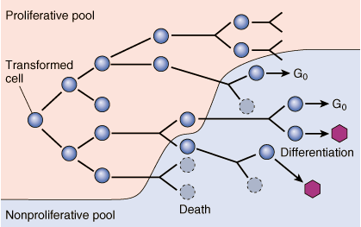
Schematic Representation Of Tumor Growth
Notes:
Figure 7-13 Schematic representation of tumor growth. As the cell population expands, a progressively higher percentage of tumor cells leaves the replicative pool by reversion to G0, differentiation, and death. Radiation and chemotherapy work on dividing cells, so the size of the non-proliferative pool is important.

Slide 96
The proportion of cells within the tumor population that are in the proliferative pool is referred to as the growth fraction.
Clinical and experimental studies suggest that during the early, submicroscopic phase of tumor growth, the vast majority of transformed cells are in the proliferative pool .
As tumors continue to grow, cells leave the proliferative pool in ever-increasing numbers owing to shedding, lack of nutrients, or apoptosis; by differentiating; and by reversion to G₀.

Slide 97
Most cells within cancers remain in the G₀ or G₁ phases.
Thus, by the time a tumor is clinically detectable, most cells are not in the replicative pool.
Even in some rapidly growing tumors, the growth fraction is only about 20% or less.

Slide 98
Ultimately the progressive growth of tumors and the rate at which they grow are determined by an excess of cell production over cell loss.
In some tumors, especially those with a relatively high growth fraction, the imbalance is large, resulting in more rapid growth than in those in which cell production exceeds cell loss by only a small margin.

Slide 99
Some leukemias and lymphomas and certain lung cancers (i.e., small cell carcinoma) have a relatively high growth fraction, and their clinical course is rapid.
By comparison, many common tumors such as cancers of the colon and breast have low growth fractions, and cell production exceeds cell loss by only about 10%; they tend to grow at a much slower pace.

Slide 100
Several important conceptual and practical lessons can be learned from studies of tumor cell kinetics :
Fast-growing tumors may have a high cell turnover, implying that rates of both proliferation and apoptosis are high.
Obviously, for the tumor to grow, the rate of proliferation should exceed that of apoptosis.
The growth fraction of tumor cells has a profound effect on their susceptibility to cancer chemotherapy.

Slide 101
Because most anticancer agents act on cells that are in cycle,
it is not difficult to imagine that a tumor that contains 5% of all cells in the replicative pool will be slow growing but relatively refractory to treatment with drugs that kill dividing cells.
One strategy employed in the treatment of tumors with low growth fraction (e.g., cancer of colon and breast) is first to shift tumor cells from G₀ into the cell cycle

Slide 102
This can be accomplished by debulking the tumor with surgery or radiation.
The surviving tumor cells tend to enter the cell cycle and thus become susceptible to drug therapy.
Such considerations form the basis of combined modality treatment.
Some aggressive tumors (such as certain lymphomas) that contain a large pool of dividing cells literally melt away with chemotherapy and cures may even be effected.

Slide 103
In general, the growth rate of tumors correlates with their level of differentiation, and thus most malignant tumors grow more rapidly than do benign lesions.
Most benign tumors grow slowly, with some exceptions: -
Leiomyomas of the uterus are influenced by circulating estrogen level: increase in size during pregnancy and cease growing after menopause.

Slide 104
On occasions, cancers have been observed to decrease in size and even spontaneously disappear.
Examples include : renal cell carcinoma, malignant melanoma, choriocarcinoma.

Slide 105
LOCAL INVASION
  Benign tumors :
    Remain localized
    Cannot invade
    Usually capsulated
  Malignant tumors :
    Progressive invasion
    Destruction
    Usually not capsulated

Slide 106
A benign neoplasm remains localized at its site of origin.
It does not have the capacity to infiltrate, invade, or metastasize to distant sites.
Most benign neoplasms are encapsulated (separated from the host tissue by a fibrous capsule).
The capsule probably derives from the stroma of the host tissue and the stroma of the tumor itself.

Slide 107
Not all benign neoplasms are encapsulated:
Leiomyoma of the uterus is discretely demarcated from the surrounding smooth muscle by a zone of compressed normal myometrium.

Slide 108
Cancers grow by progressive infiltration, invasion, destruction, and penetration of the surrounding tissue .
They do not develop well-defined capsules .
Occasionally, a slowly growing malignant tumor appears to be encased by the stroma of the surrounding host tissue.
But microscopic examination usually reveals tiny crablike feet penetrating the margin and infiltrating adjacent structures.

Slide 109
It is necessary to remove a wide margin of surrounding normal tissue when surgical excision of a malignant tumor is attempted (clean margins).

Slide 110
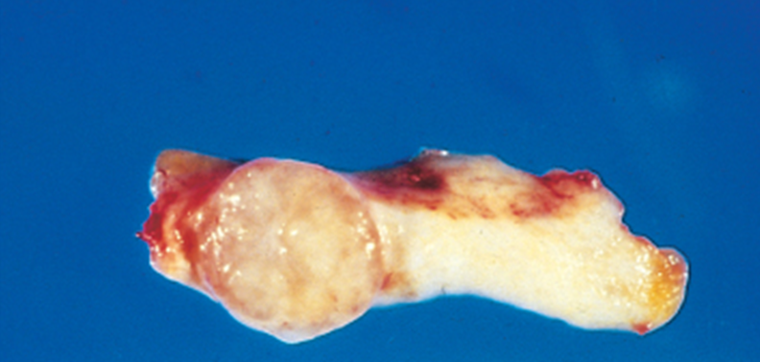

Slide 111
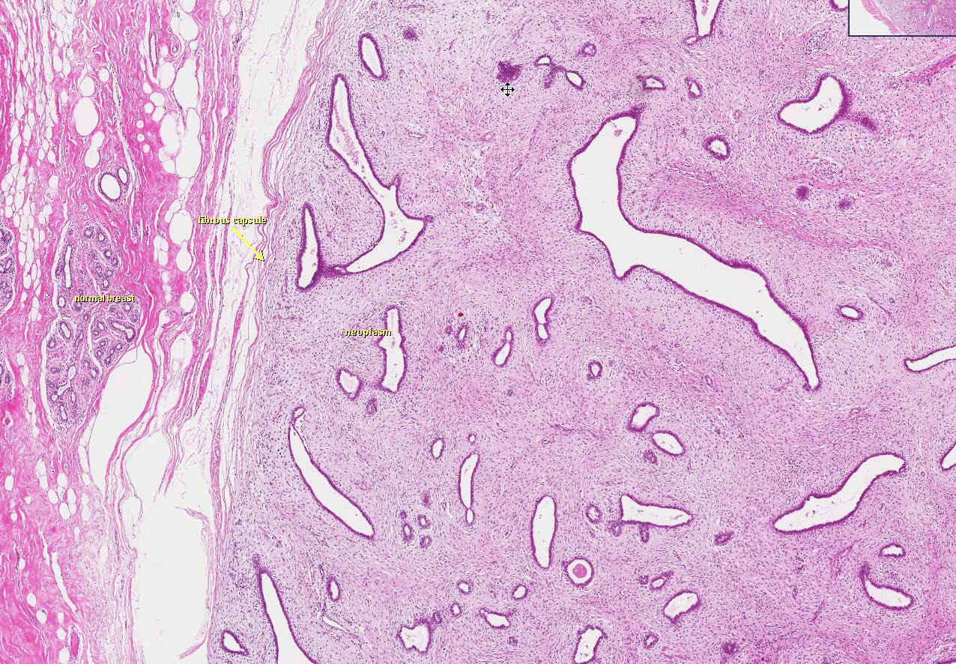
Notes:
Note the sharply demarcated border and a thin capsule in this neoplasm which is composed of both proliferating fibrous stroma (fibro) and glands (adenoma). The tumor is at the right and normal breast is at the left. As shown in this view the fibroadenoma, a benign tumor, is well circumscribed and has a fibrous capsule. This view shows the proliferation of benign appearing fibroblasts (arrows) (i.e. the "fibro" component), and several glands (the "adeno" component).

Slide 112
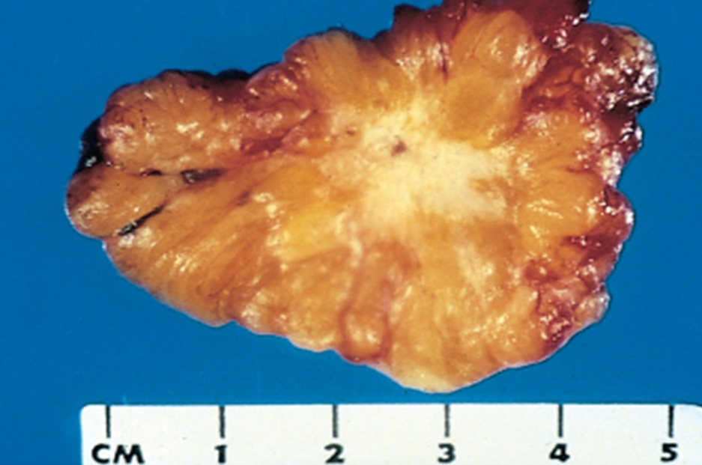
Notes:
The invasiveness aspect of solid tumors is how “cancer” got its name, i.e., “crab”-like

Slide 113
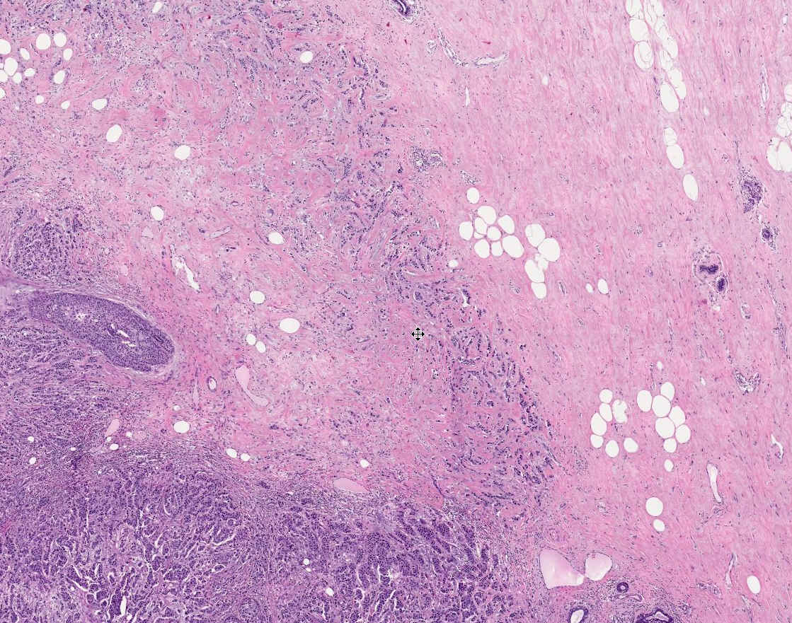
Notes:
Invasiveness (aka, “infiltration”) has BOTH gross as well as microscopic connotations

Slide 114
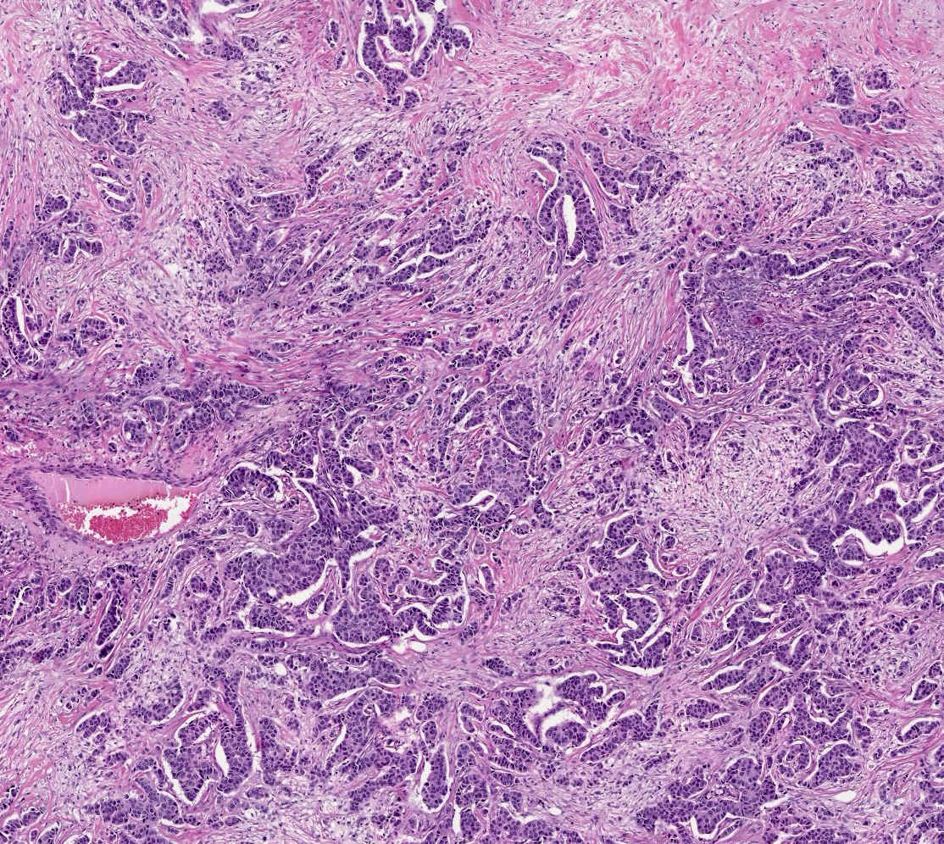
Notes:
Adenocarcinoma of the breast. Note that the fibrous stroma of the beast is infiltrated by tumor cells arranged in nests with some gland formation. The dense fibrous stroma results in the tumor having a very firm consistency (schirrous carcinoma). Every pathologist could look at this image, and instantly know it was carcinoma.

Slide 115
Next to the development of metastases, local invasiveness is the most reliable feature that distinguishes malignant from benign tumors.

Slide 116
?????? Q
A 35 yr old man presents with the new onset of a “bulge” in his left inguinal area. After performing a physical examination, you diagnose the bulge to be an inguinal hernia. You refer the patient to a surgeon, who repairs the hernia and sends the resected hernia sac to the pathology laboratory along with some adipose tissue, which he calls a “lipoma of the cord”. The pathology resident examines the tissue grossly and microscopically and decides that it is not a neoplastic lipoma, but instead is nonneoplastic normal adipose tissue. Which one of the following features should be present to make the diagnosis of lipoma rather than normal adipose tissue ?
A) Anaplasia
B) Fibrous capsule
C) Numerous mitoses
D) Prominent nucleoli
E) Uniform population of cells

Slide 117
Metastasis
Definition
Pathway : Direct spread
Lymphatic spread (via lymphatic vessels)
Haematogenous spread (via veins)
Why not arteries??
Very rare in Skeletal Muscle! Why?
(Organs least favoured for metastatic spread include striated muscles and spleen)
Seed and soil phenomenon
Lung & liver are common sites of metastasis

Slide 118
Metastasis
Definition :
Metastasis is defined as the development of secondary implants discontinuous with the primary Malignant neoplasm in remote tissues.
Metastasis is the most reliable sign of malignancy.
The invasiveness of cancers permits them to penetrate in to the blood vessel, lymphatic and body cavities providing the opportunity for spread.

Slide 119
Most malignant neoplasm metastasies except few such as :
Gliomas in the central nervous system
Basal cell carcinoma (Rodent ulcer) in the skin and
Dermatofibrosarcoma in soft tissues
  Generally, the more anaplastic and the larger the primary tumor, the more likely is metastasis

Slide 120
Metastasis : three pathways
  Direct spread : Seeding of body cavities and surfaces (transcoelomic spread) : pleural, peritoneal cavities and cerebral ventricles.
  Lymphatic spread (via lymphatic vessels)
  Haematogenous spread (via veins) . Why not arteries??

Slide 121
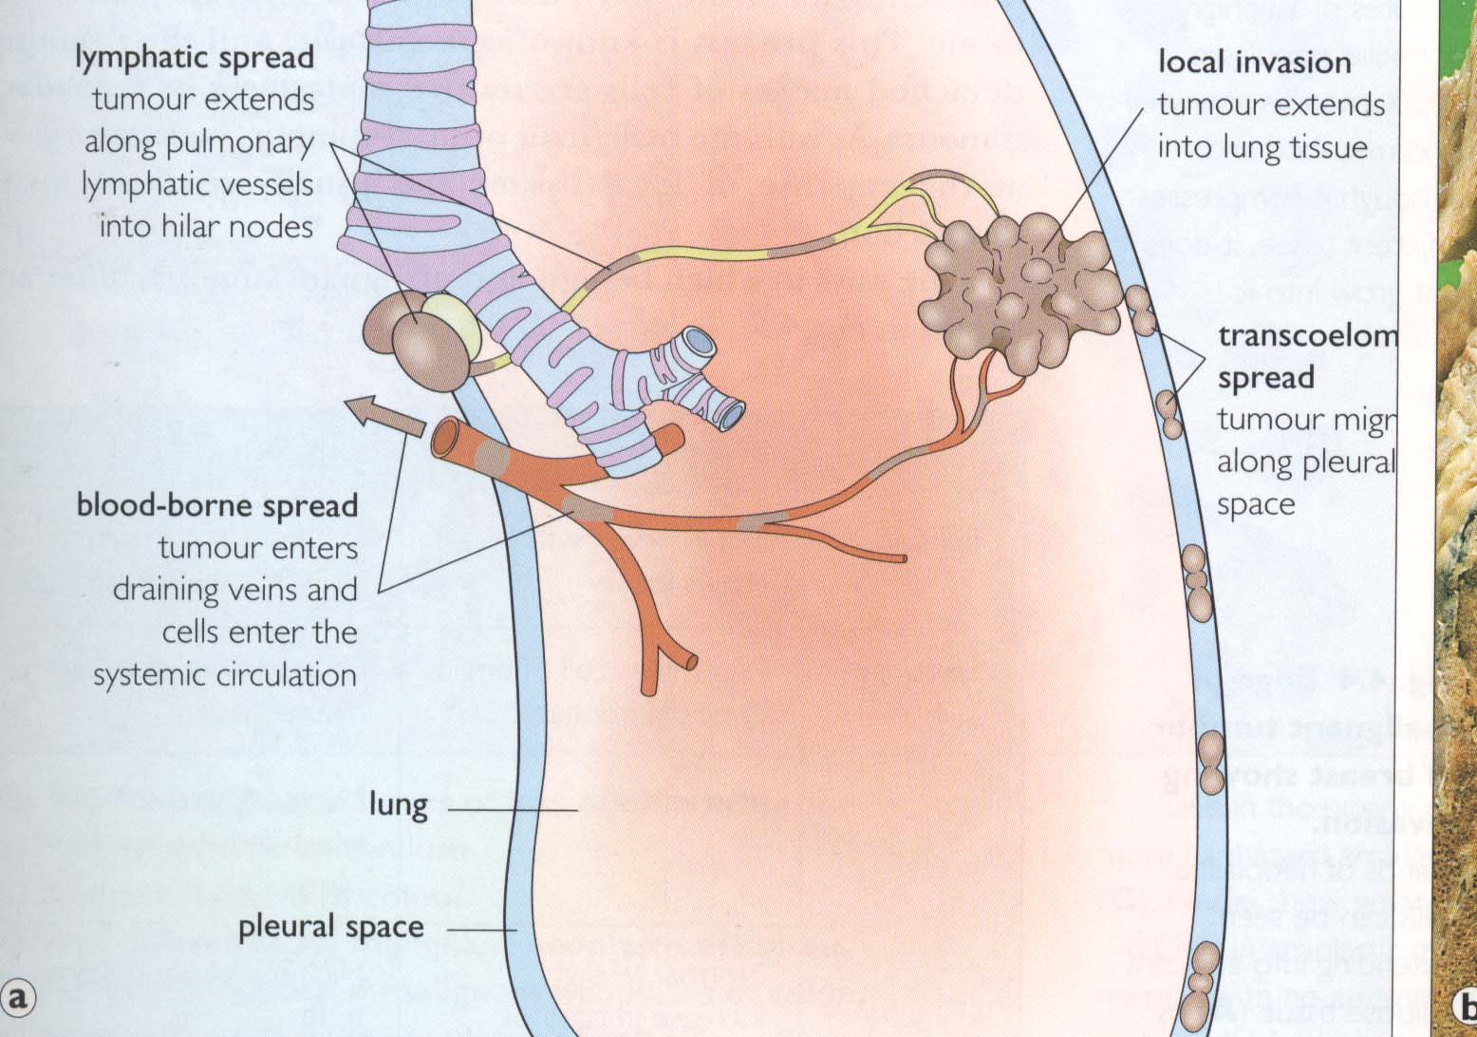

Slide 122
Pathways of spread:
Seeding of body cavities and surfaces (transcoelomic spread) :
This seeding may occur wherever a malignant neoplasm penetrates into a natural “open field”.
Most often involved is the peritoneal cavity,
but any other cavities such as : Pleural,
pericardial,
sub-arachnoid and
joint spaces-may be affected.

Slide 123
Particular examples are
Krukenberg tumour :
It is a classical example of mucin producing signet ring adenocarcinomas arising from :
Gastrointestinal tract,
Pancreas,
Breast, and
Gall bladder
may spread to one or both ovaries and the peritoneal cavities.

Slide 124
The other example is :
Pseudomyxoma peritoni
which are mucus secreting adrocarcinoma arising either from ovary or appendix.
These carcinomas fill the peritoneal cavity with a gelatinous soft, translucent neoplastic mass.

Slide 125
Lymphatic spread
Lymphatic route is the most common pathway for the initial dissemination of carcinomas
The pattern of lymph node involvement follows the natural routes of drainage
Metastasis to lymph nodes first lodge in the marginal sinus and then extends throughout the node.
A sentinel lymph node is defined as the first node in the regional lymphatic chain to receive lymph flow from the primary tumor.
The best examples of lymphatic spread of malignant neoplasm can be exemplified by breast carcinoma.

Slide 126
Skip metastasis :
may occur when local lymph nodes may be by- passed and occasionally found in lymph node distant from the site of the primary malignant neoplasm.
Skip metastasis happen to occur because of venous lymphatic anastomoses or because inflammation or radiation has obliterated the lymphatic channels
for example abdominal cancer (gastric cancer) may be initially signaled by supra clavicular node (Virchow’s node).

Slide 127
Hematogenous spread
Typical for all sarcomas and certain carcinomas
(Renal cell carcinoma and Hepatocellular carcinoma)
the spread appears to be selective with seed and soil phenomenon.
Lung & liver are common sites of metastasis because they receive the systemic and venous out flow respectively.
Other major sites of hematogenous spread include brain and bones.

Slide 128
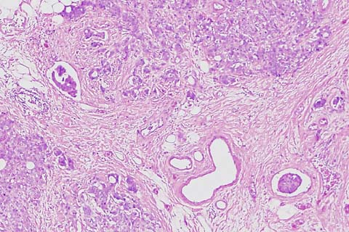
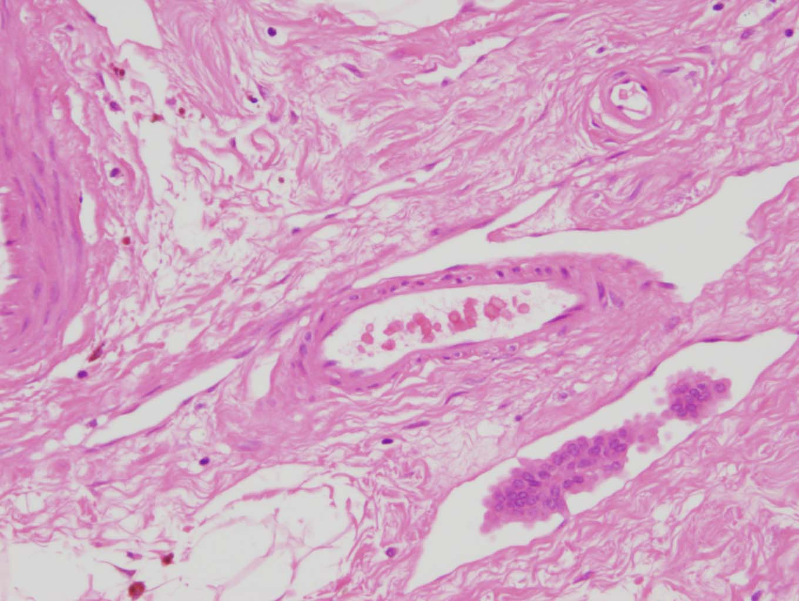
Lymphatic Invasion Vascular (Vein) invasion

Slide 129
QQQQ ?????
Which of the following has propensity to metastasize through lymph nodes ?
Alveolar rhabdomyosarcoma
Osteosarcoma
Both
None

Slide 130
Sarcomas which follows lymphatic route are :
Alveolar rhabdomyosarcoma
Synovial sarcoma

Slide 131
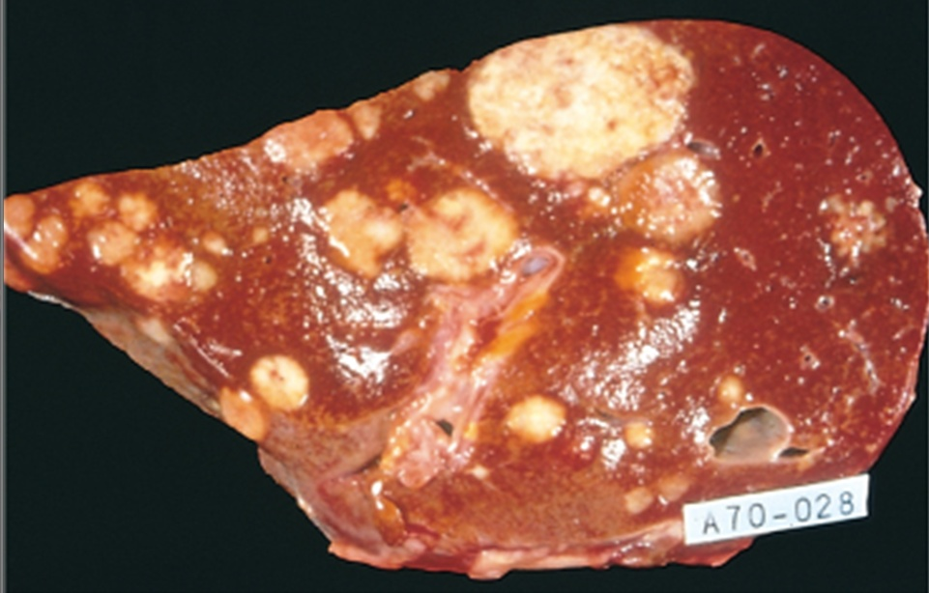

Slide 132
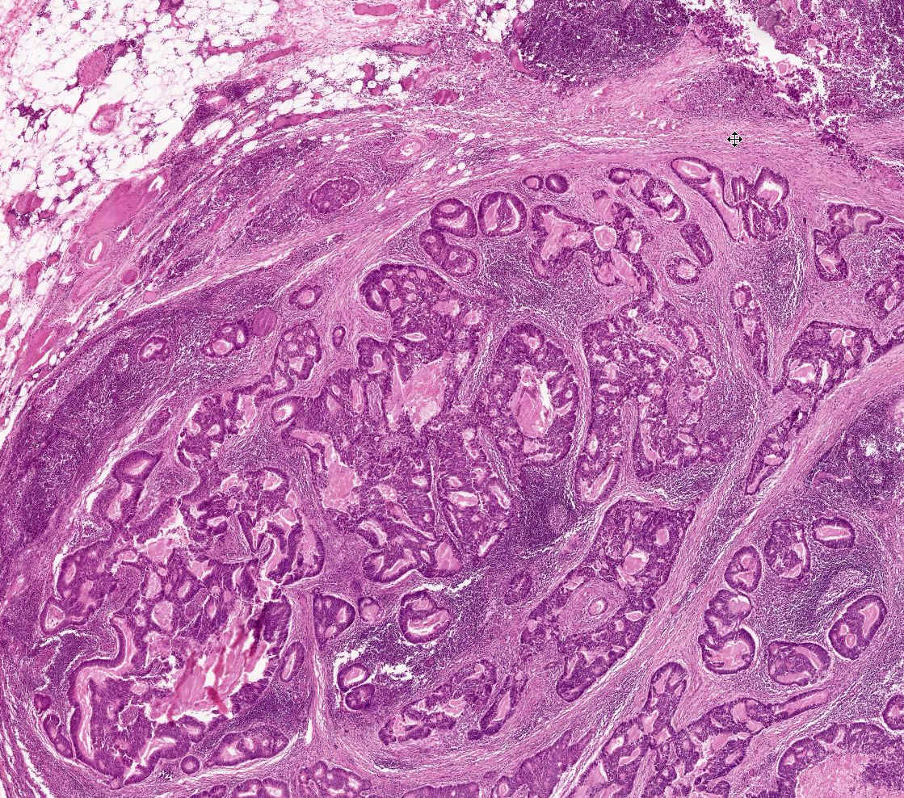
Notes:
Lymph node with metastatic adenocarcinoma. In this case only a few remnants of normal lymph node tissue are seen. Find them.
In fact, this could even be a PRIMARY with some lymphoid tissue reacting to it.

Slide 133
Benign vs Malignant Features
Feature | Benign | Malignant
Rate of growth | Progressive but slow. Mitoses few and normal | Variable. Mitoses more frequent and may be abnormal
Differentiation | Well differentiated | Some degree of anaplasia
Local invasion | Cohesive growth. Capsule & BM not breached | Poorly cohesive and infiltrative.
Metastasis | Absent | May occur

Slide 134
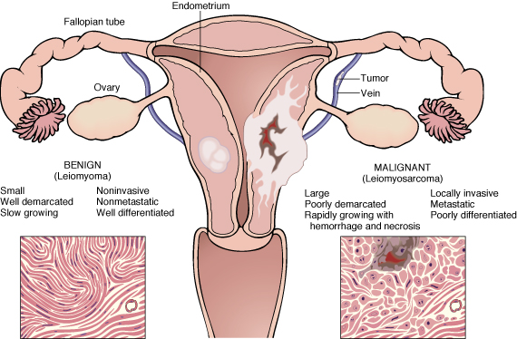

Slide 135
Features Gross features | Benign | Malignant
Boundaries | Encapsulated / well circumscribed | Ill circumscribed / unencapsulated
Size | Usually small | Usually large
Secondary changes | Less frequent | More frequent
Surrounding tissue | Compressed | Invaded

Slide 136
Features Microscopic features | Benign | Malignant
Pattern | Resemble tissue of origin | Poor resemble to tissue of origin
Polarity | Retained | Lost
Anaplasia | Absent | Present
Mitoses Tumor giant cells | Present, few, typical Rare, without atypia | Present, many, atypical as well as typical Common, with atypia

Slide 137
??? QQQQQ
The most reliable feature of malignant tumor –
Local invasion
Metastasis
Rapid growth
Poor differentiation

Slide 138
???? QQQQQ
Which is the most common site of metastasis –
Lung
Bone
Liver
Brain

Slide 139
Epidemiology
  Will help to discover aetiology
  Planning of preventive measures
  To know what is common and what is rare.
  Development of screening methods for early diagnosis

Slide 140
Commonest malignant tumors encountered worldwide
Men :
Prostate (oral cavity in India)
Lungs
Colon or rectum
Leukemia and lymphoma
Ovary
Women :
Breast (cervix in India)
Lungs
Colon or rectum
Leukemia and lymphoma
Ovary
Children :
Acute leukemia
CNS tumors
Lymphoma
Neuroblastoma
Bone sarcoma

Slide 141
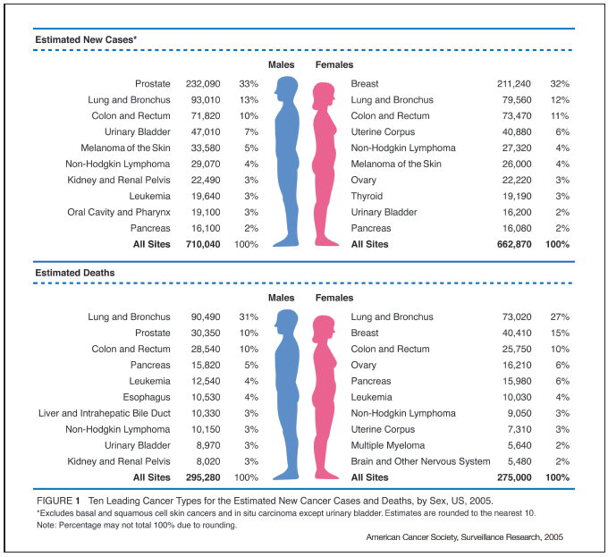
Notes:
Figure 1 indicates the most common cancers expected to occur in men and women in 2005. Among men, cancers of the prostate, lung and bronchus, and colon and rectum account for more than 56% of all newly diagnosed cancers. Prostate cancer alone accounts for approximately 33% (232,090) of incident cases in men. Based on cases diagnosed between 1995 and 2000, about 90% of these estimated new cases of prostate cancer are expected to be diagnosed at local or regional stages, for which 5-year relative survival approaches 100%.

Slide 142
Neoplasia
Factors affecting incidence of cancer :
  Geographic and Environmental
  Age
  Hereditory
  Aquired preneoplastic disorders

Slide 143
Epidemiological Factors Influencing Neoplasia
Inherited predisposition to cancer is categorized in to three groups :
(A) Inherited cancer syndromes (Autosomal dominant) with strong familial history include :
Retinoblastoma (RB)
Familial adenomatous polyps (FAP) of the colon
Multiple endocrine neoplasia (MEN) syndrome
Neurofibromatosis (NF) or von Recklinghausen disease
Li-Fraumeni syndrome
This is the most common type of genetic predisposition
The mechanism involves uncontrolled cell division due to germline mutation of cancer suppresor gene

Slide 144
(B)Defective DNA repair syndromes
Normally , if the DNA damage is present, it is repaired at cell-cycle checkpoints
If DNA repair mechanism is defective, cells replicate with defective DNA and mutation or chromosomal breaks are transferred in the progeny of the cells that can lead to uncontrolled replication.
Most of these conditions are inherited as autosomal recessive , e.g. -
Xeroderma pigmentosa
Ataxia telangiectasia
Bloom syndrome and
Fanconi anemia
One condition in this group is autosomal dominant – Hereditory nonpolypoid colon cancer (HNPCC)

Slide 145
(C) Familial cancers :
Cancer with a high frequency of occurrence within a family are called family cancers .
Carcinoma of breast, colon, uterus, ovary, stomach and some sarcoma.
Familial cancers have the following features :
Early age of onset
Multiple primary cancers in a single individuals (such as bilateral breast cancer)
No clearly identifiable pattern of transmission

Slide 146
Inherited Predisposition to Cancer
Gene | Inherited Predisposition
RB | Retinoblastoma
p53 | Li-Fraumeni syndrome
APC | Familial adenomatous polyposis/colon cancer
NF1, NF2 | Neurofibromatosis 1 and 2
BRCA1, BRCA2 | Breast and ovarian tumors
MEN1, RET | Multiple endocrine neoplasia1and 2
MSH2, MLH1, MSH6 | Hereditary nonpolyposis colon cancer

Slide 147
?????QQQQQ
Genetically determined tumors include the following except : -
Polyposis coli
Retinoblastoma
Multiple neurofibroma
Neuroblastoma

Slide 148
???? QQQQ
All of the following constitute familial cancer syndrome except : -
Xeroderma pigmentosa
Retinoblastoma
Neurofibromatosis
MEN - I

Slide 149
Neoplasia
Geographic and Environmental factors:
  Rate of stomach carcinoma in Japan is seven times the rate in North America and Europe.
  Breast carcinoma is five times higher in North America comparing to Japan
  Liver cell carcinoma is more common in African populations

Slide 150
Neoplasia
Geographic and Environmental factors:
  Asbestos : mesothelioma
  Smoking : lung cancer
  Fatty diets : colonic cancer
  Alcohol abuse : causes cancers of liver

Slide 151
Neoplasia
Age:
  Generally, the frequency of cancer increases with age.
  Most cancer mortality occurs between 55 and 75.
  Cancer mortality is also increased during childhood

Slide 152
Nonhereditory predisposing conditions
Chronic inflammation and cancer :
An increased risk of cancer has been noted in chronic inflammatory conditions, eg.
Ulcerative colitis
Helicobacter pylori gastritis
Viral hepatitis

Slide 153
Precancerous conditions
Certain non-neoplastic and benign disorders have a well-defined association with cancer.
Increased incidence of cancer in precancerous lesions is mostly attributed to continuous regenerative cell replication.
Precancerous / Premalignant

Slide 154
Actinic keratosis
Barrett oesophagus
Leukoplakia of oral cavity
Chronic atrophic gastritis
Pagets disease of bone
Multiple villous adenomas of colon
Neurofibromatosis
Long standing ulcerative colitis
Cirrhosis of liver
Chronic bronchitis (heavy smokers)
Chronic irritation of the oral cavity
Old burn scar (Marjolin ulcer)

Slide 155
Molecular Basis of Cancer (Carcinogenesis)
Basic principles of carcinogenesis:
The fundamental principles in carcinogenesis include :
1) Non-lethal genetic damage lies at the heart of carcinogenesis.
Such genetic damage (mutation) may be acquired by the action of environmental agents such as : Chemicals
Radiation
Viruses , or
it may be inherited in the germ line.

Slide 156
(2)
Tumors develop as clonal progeny of a single genetically damaged progenitor cell, i.e. Monoclonality
It is a feature of neoplasia.

Slide 157
3) The four classes of normal regulatory genes are:
(Genetic damage of four important regulatory genes : )
A) Growth – promoting proto-oncogenes
B) Growth- inhibiting tumor- suppressor genes
C) Genes that regulate programmed cell death (apoptosis)
D) Genes that regulate DNA repair

Slide 158
1) Proto-oncogenes :
Dominant
Cause ‘gain of function’ (excessively increase one or more of the normal functions of the encoded gene product)
Can transform cells despite the presence of normal counterpart

Slide 159
2) Tumour suppressor genes :
Recessive
Mutations in these genes cause a ‘loss of function’
Both normal alleles of tumour suppressor genes must be damaged to transform cell
( ? Haploinsufficiency )

Slide 160
3) Genes that regulating apoptosis and cancer :
Apoptosis in a normal cell is guided by cell death receptor CD95
BAD, BID, BAX and TP58 are proapoptotic
Bcl-2 and Bcl-X are antiapoptotic
Mutant form of Bcl-2 gene is seen in B cell lymphoma, carcinoma breast, thyroid and prostate
CD95 is depleted in hepatocellular carcinoma

Slide 161
4) DNA repair genes :
Defects in DNA repair genes predispose to mutations (called mutator phenotype)
Both alleles of DNA repair genes must be inactivated to induce genomic instability (recessive inheritance)

Slide 162
Carcinogenesis is a multistep process
Carcinogenesis is a multistep process at both the phenotypic and the genetic levels.
A malignant neoplasm has several phenotypic attributes,
such as : excessive growth,
local invasiveness,
and the ability to form distant metastases.
These characteristics are acquired in a stepwise fashion, a phenomenon called tumor progression.
At the molecular level, progression results from accumulation of genetic lesions that in some instances are favored by defects in DNA repair.

Slide 163
Difference between anti-oncogenes and proto-oncogenes
Features | Anti-oncogenes | Proto-oncogenes
Other name | Tumour suppressor genes | Precursor genes for oncogene
Function | They suppress cell proliferation, and promote differentiation and maturation of cells | They promote normal cell growth and differentiation
Inheritance | Recessive. Homozygous inactivation, ie, loss of both normal copies of gene is required for carcinogenesis | Dominant. Mutation in a single copy may lead to oncogenic conversion
Action | Act passively | Act actively
Example | P53, RB gene, BRCA-1 and 2, TGF-ß, APC, WT-1 and NF | myc, N-myc, erB1/2/3

Slide 164
TRANSFORMATION & PROGRESSION
ESSENTIAL ALTERATIONS FOR MALIGNANT TRANSFORMATION
Self-sufficiency in growth signals
Insensitivity to growth-inhibitory signals
Evasion of apoptosis
Defects in DNA repair: “Spell checker”
Limitless replicative potential
Sustained angiogenesis
Ability to invade and metastasize
Notes:
The various aspects of “malignant tansformation”.

Slide 165
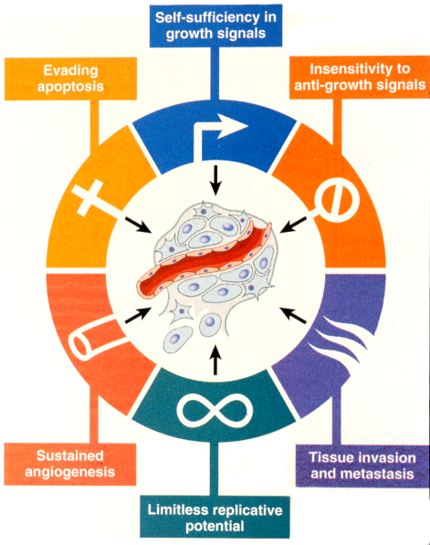

Slide 166
Self-sufficiency in growth signals:
Tumors have the capacity to proliferate without external stimuli, usually as a consequence of oncogene activation

Slide 167
Insensitivity to growth-inhibitory signals:
Tumors may not respond to molecules that are inhibitory to the proliferation of normal cells
such as transforming growth factor-β (TGF-β), and direct inhibitors of cyclin-dependent kinases.
(Resistant to tumour suppressor gene)

Slide 168
Evasion of apoptosis:
Tumors may be resistant to programmed cell death, as a consequence of inactivation of p53 or other changes

Slide 169
Defects in DNA repair:
Tumors may fail to repair DNA damage caused by carcinogens or unregulated cellular proliferation

Slide 170
Limitless replicative potential:
Tumor cells have unrestricted proliferative capacity, associated with maintenance of telomere length and function.
(Immortality)

Slide 171
Sustained angiogenesis:
Tumors are not able to grow without formation of a vascular supply, which is induced by various factors
the most important being vascular endothelial growth factor (VEGF).

Slide 172
Ability to invade and metastasize:
Tumor metastases are the cause of the vast majority of cancer deaths and depend on processes that are intrinsic to the cell or are initiated by signals from the tissue environment.
Ability to escape immune recognition and regulation

Slide 173
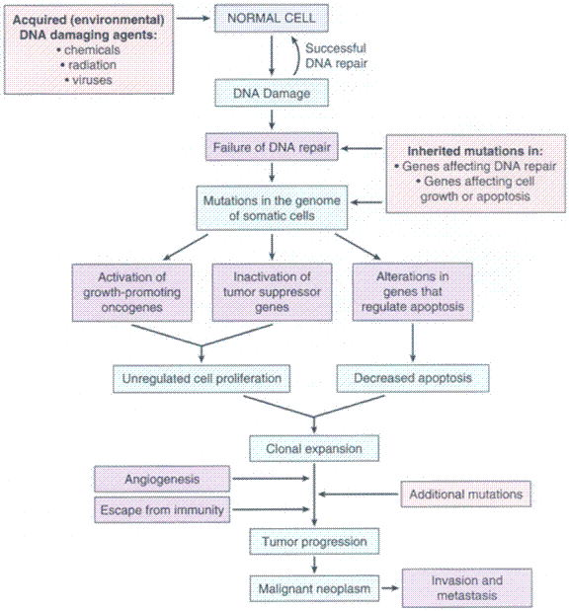
Flow chart depicting a simplified scheme of the molecular basis of cancer

Slide 174
????? QQQQ
The term “tumour progression” means
A) Spread of cancer to distant site
B) Rate of growth of tumour
C) Ability of cancer cells to resemble their normal counterpart
D) Sequential appearance of features of increasing malignancy

Slide 175
????? QQQQ
The correct sequence of cell cycle is –
1) G0-G1-S-G2-M
2) G0-G1-G2-S-M
3) G0-M-G2-S-G1
4) G0-G1-S-M-G2

Slide 176
Tumor Development and Growth
Transformation
Growth of transformed cells
Invasion of tumor cells into the surrounding tissues
Metastasis of tumor cells to distant sites

Slide 177
Self-Sufficiency in Growth Signals
Normal cell proliferation
The binding of a growth factor to its specific receptor on the cell membrane causes transient and limited activation of the growth factor receptor.
 activates several signal-transducing proteins on the inner leaflet of the plasma membrane
transmission of the transduced signal across the cytosol to the nucleus via second messengers or a cascade of signal transduction molecules
induction and activation of nuclear regulatory factors that initiate DNA transcription
progression of the cell into the cell cycle, resulting ultimately in cell division

Slide 178
Self-Sufficiency in Growth Signals
Genes that promote autonomous cell growth in cancer cells are called oncogenes and their normal cellular counterparts are called proto-oncogenes
Proto-oncogenes are the physiological regulators of cell proliferation and differentiation
Often involved in signal transduction and execution of mitogenic signals, usually through their protein products

Slide 179
Excessive and autonomous Growth
Oncogenes are mutated (altered) forms of normal proto-oncogenes, different from the latter in the following ways :
A) Presence of mutation/s in the structure of the gene
B) Ability to promote autonomous and excessive cellular proliferation in the event of overexpression, even in the absence of normal mitogenic signals

Slide 180
Activation of oncogenes can be induced by :
A) Point mutation and deletion :
as in RAS oncogene implicated in carcinoma of colon and
pancreas
B) Chromosomal translocation :
: as in Philadelphia chromosome (translocation of C-ABL proto- oncogene from chromosome 9 to chromosome 22
- and translocation of c- MYC proto-oncogenes from
chromosome 8 to chromosome 14
(seen in 75% cases of Burkitt lymphoma)

Slide 181
C) Gene amplification (chromosomal alterations that result in increased number of copies of a gene) :
: as in the case of n-MYC implicated in neuroblastoma, and ERB-B2 in breast and ovarian cancer
Oncoproteins are products of oncogenes, which resemble products of proto-oncogenes, but are devoid of important regulatory mechanisms

Slide 182
Growth Factors
All normal cells require stimulation by growth factors to undergo proliferation.
Types :
1)- paracrine action :
Growth factors are made by one cell type and act on a neighboring cell to stimulate proliferation
2)-autocrine action :
Many cancer cells acquire growth self-sufficiency by acquiring the ability to synthesize the same growth factors to which they are responsive.

Slide 183
Glioblastomas secrete platelet-derived growth factor (PDGF) and express the PDGF receptor
Many sarcomas make both transforming growth factor-α (TGF-α) and its receptor.
Genes that encode homologues of fibroblast growth factors(FGFs) e.g., HSTF-I (heparin-binding secretory transforming factor-1)
and INT-2 (also known as - FGF3) have been detected in several gastrointestinal and breast tumors
FGF-2 is expressed in human melanomas but not normal melanocytes.

Slide 184
Hepatocyte growth factor (HGF) and its receptor c-Met are both overexpressed in follicular carcinomas of the thyroid.
In many instances the growth factor gene itself is not altered or mutated
but the products of other oncogenes (e.g., RAS) stimulate overexpression of growth factor genes and the subsequent development of an autocrine loop.

Slide 185
Growth Factor Receptors
Mutant receptor proteins deliver continuous mitogenic signals to cells, even in the absence of the growth factor in the environment.
Overexpression of growth factor receptors can render cancer cells hyper-responsive to levels of the growth factor that would not normally trigger proliferation.

Slide 186
Examples
Overexpression involve the epidermal growth factor (EGF) receptor family -- ERB-B1
The EGF receptor, is overexpressed in 80% of squamous cell carcinomas of the lung.
In 50% or more of glioblastomas.
In 80-100% of epithelial tumors of the head and neck.

Slide 187
HER2/NEU (ERB-B2), is amplified in 25-30% of breast cancers and adenocarcinomas of the lung, ovary, and salivary glands.
These tumors are exquisitely sensitive to the mitogenic effects of small amounts of growth factors
High level of HER2/NEU protein in breast cancer cells is a poor prognosis.

Slide 188
The significance of HER2/NEU in the pathogenesis of breast cancers is illustrated by the clinical benefit derived from blocking the extracellular domain of this receptor with anti-HER2/NEU antibodies.
Treatment of breast cancer with anti-HER2/NEU antibody (herciptin ) proved to be clinically effective .

Slide 189
???? QQQ
The normal cellular counterparts of oncogenes are important for the following functions, except
A) Promotion of cell cycle progression
B) Inhibition of apoptosis
C) Promotion of DNA repair
D) Promotion of nuclear transcription

Slide 190
Signal-Transducing Proteins
These signaling molecules couple growth factor receptors to their nuclear targets.
Many such signaling proteins are associated with the inner leaflet of the plasma membrane,
where they receive signals from activated growth factor receptors and transmit them to the nucleus,
either through second messengers or through a cascade of phosphorylation and activation of signal transduction molecules.

Slide 191
Two important members in this category are
1-RAS gene
2-ABL gene

Slide 192
RAS is the most commonly mutated proto-oncogene in human tumors.
Approximately 30% of all human tumors contain mutated versions of the RAS gene
The incidence is even higher in some specific cancers (e.g., colon and pancreatic adenocarcinomas).
RAS is a member of a family of small G proteins that bind guanosine nucleotides (guanosine triphosphate [GTP] and guanosine diphosphate [GDP]).

Slide 193
Normal RAS proteins flip back and forth between an excited signal-transmitting state and a quiescent state.
RAS proteins are inactive when bound to GDP
stimulation of cells by growth factors leads to exchange of GDP for GTP and subsequent activation of RAS.

Slide 194
The activated RAS in turn stimulates down-stream regulators of proliferation, such as the RAF-mitogen-activated protein (MAP) kinase mitogenic cascade, which floods the nucleus with signals for cell proliferation.
The excited signal-emitting stage of the normal RAS protein is short-lived
Intrinsic guanosine triphosphatase (GTPase) activity hydrolyzes GTP to GDP, releasing a phosphate group and returning the protein to its quiescent inactive state.

Slide 195
The RAS gene is most commonly activated by point mutations.
Point mutations can affect :
1-GTP-binding pocket
2-the enzymatic region essential for GTP hydrolysis.
Mutations at these locations interfere with GTP hydrolysis that is essential to convert RAS into an inactive form.
RAS is thus trapped in its activated GTP-bound form, and the cell is forced into a continuously proliferating state.

Slide 197
Nuclear Transcription Factors
Growth autonomy may occur as a consequence of mutations affecting genes that regulate transcription of DNA.
MYC, MYB, JUN, FOS, and REL oncogenes, function as transcription factors that regulate the expression of growth-promoting genes, such as cyclins.

Slide 198
the MYC gene is involved most commonly in human tumors.
The MYC proto-oncogene is expressed in virtually all cells
the MYC protein is induced rapidly when quiescent cells receive a signal to divide.

Slide 199
In normal cells, MYC levels decline to near basal level when the cell cycle begins.
In contrast, oncogenic versions of the MYC gene are associated with persistent expression or overexpression, contributing to sustained proliferation.

Slide 200
Dysregulation of the MYC gene resulting from a t(8;14) translocation occurs in Burkitt lymphoma, a B-cell tumor.
MYC is also amplified in breast, colon, lung, and many other cancers;
N-MYC and L-MYC genes are amplified in neuroblastomas and small-cell cancers of lung.

Slide 201
Cyclins and Cyclin-Dependent Kinases (CDKs)
Cancers may become autonomous if the genes that drive the cell cycle become dysregulated by mutations or amplification.
Progression of cells through the various phases of the cell cycle is controlled by CDKs.
CDKs are activated by binding to cyclins,
so called because of the cyclic nature of their production and degradation.

Slide 203
The CDK-cyclin complexes phosphorylate crucial target proteins that drive the cell through the cell cycle.
On completion of this task, cyclin levels decline rapidly.
More than 15 cyclins have been identified; cyclins D, E, A, and B appear sequentially during the cell cycle and bind to one or more CDK.

Slide 204
Mishaps affecting the expression of cyclin D or CDK4 seem to be a common event in neoplastic transformation.
The cyclin D genes are overexpressed in many cancers, including those affecting the breast, esophagus, liver, and a subset of lymphomas.

Slide 205
Amplification of the CDK4 gene occurs in melanomas, sarcomas, and glioblastomas.
Mutations affecting cyclin B and cyclin E and other CDKs also occur, but they are much less frequent than those affecting cyclin D/CDK4.

Slide 206
Cyclins arouse the CDKs .
CDK inhibitors (CDKIs) silence the CDKs and exert negative control over the cell cycle.
One family of CDKIs, composed of three proteins :
1- p21 [CDKN1A],
2-p27 [CDKN1B],
3-p57 [CDKN1C],
inhibits the CDKs broadly

Slide 207
The other family of CDKIs has selective effects on cyclin D/CDK4 and cyclin D/CDK6.
The four members of this family :
1-p15 [CDKN2B]
2-p16 [CDKN2A]
3-p18 [CDKN2C]
4-p19 [CDKN2D]
are sometimes called INK4 (A-D) proteins.

Slide 208
Refractoriness to Growth Inhibition
(Loss of Growth-Suppressing Anti-Oncogenes)
Anti-oncogenes or tumour suppressor genes prevent entry of cells in mitotic pool and push cells into the G0 phase.
Mutated anti-oncogenes behave like growth-promoting genes.
Following are the important tumor suppressor genes involved in the growth inhibition :
Retinoblastoma (RB) gene
Tp53 gene (p53)
Transforming growth factor (TGF-ß )
Adenomatous polyposis gene (APC)
Wilm’s tumor (WT)-1 gene
Neurofibroma (NF) gene
Breast cancer susceptibility genes (BRCA) 1 and 2

Slide 209
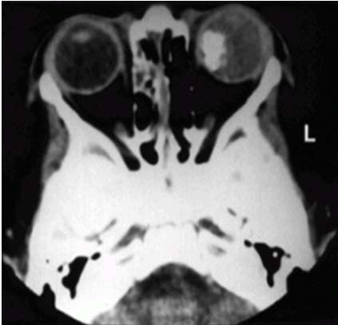
Retinoblastoma (RB) gene
Retinoblastoma (RB) gene, the first and prototypic cancer suppressor gene to be discovered.
Retinoblastoma is an uncommon childhood tumor.
Approximately 60% of retinoblastomas are sporadic, and 40% are familial.
To account for the sporadic and familial occurrence of an identical tumor, Knudson, in 1974, proposed his now famous two-hit hypothesis.

Slide 210
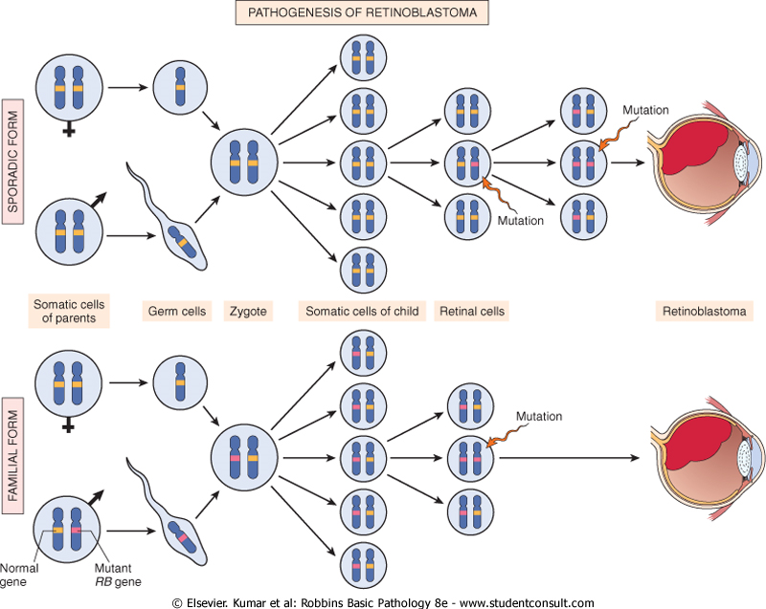

Slide 211
Two mutations (hits) are required to produce retinoblastoma.
These involve the RB gene, located on chromosome 13q14.
Both of the normal alleles of the RB locus must be inactivated (two hits) for the development of retinoblastoma.
in familial cases, children inherit one defective copy of the RB gene in the germ line; the other copy is normal.
Retinoblastoma develops when the normal RB gene is lost in retinoblasts as a result of somatic mutation.

Slide 212
Because in retinoblastoma families only a single somatic mutation is required for expression of the disease
The familial transmission follows an autosomal dominant inheritance pattern.
In sporadic cases, both normal RB alleles are lost by somatic mutation in one of the retinoblasts.
A retinal cell that has lost both of the normal copies of the RB gene becomes cancerous

Slide 213
Although the loss of normal RB genes was discovered initially in retinoblastomas, it is now evident that homozygous loss of this gene is a fairly common event in several tumors including :
Breast cancer.
Small-cell cancer of the lung.
Bladder cancer.
Patients with familial retinoblastoma also are at greatly increased risk of developing osteosarcomas and some soft tissue sarcomas.

Slide 214
RB Gene and Cell Cycle
The retinoblastoma gene encodes a 110- kDa phosphoprotein (pRB) that is expressed in almost every cell of the human body and contributes to growth regulation in these cells.
The most important target of the retinoblastoma protein is cellular transcription factor E2F.
E2F is a potent stimulator of cell cycle entry into S phase
E2F activity consists of an E2F polypeptide and DP protein (E2F/DP heterodimeric complex)

Slide 215
In the hypophosphorylated form (which occurs early in G 1), RB binds to E2F, inactivates E2F as a transcription factor and shuts the expression of E2F target genes off.
Phosphorylation of pRB by cyclin / CDK complexes in mid-to-late G1 causes pRB to lose its affinity for E2F.
The free E2F/DP transcription factor can now activate transcription of E2F target genes.

Slide 216
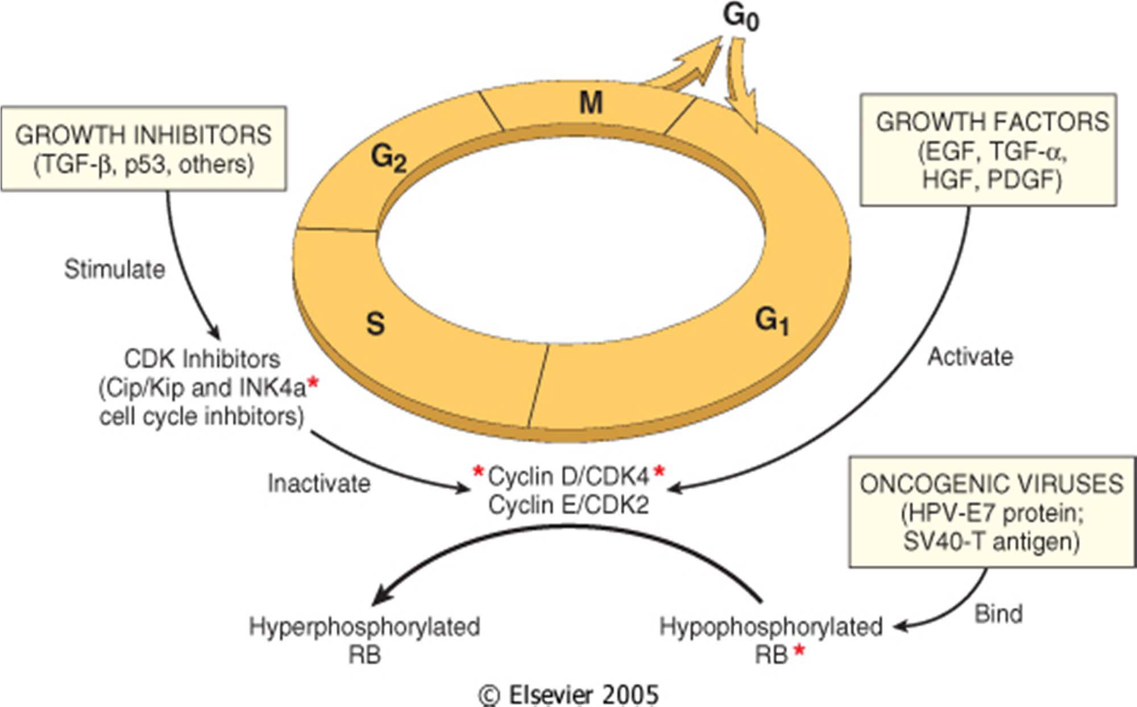

Slide 217
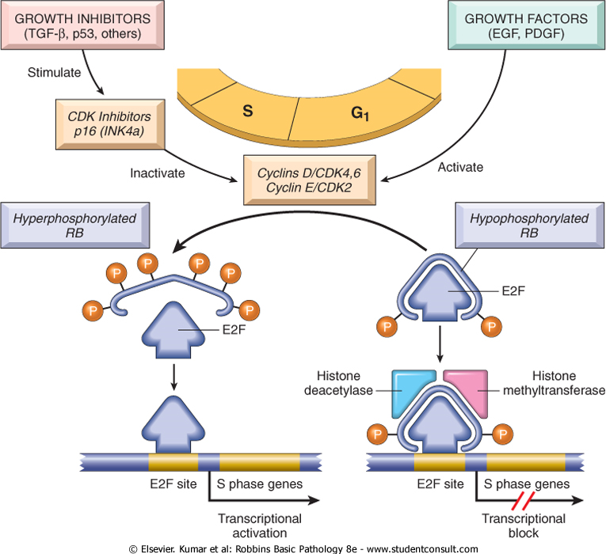

Slide 218
Cell cycle checkpoint Component RB gene Tumor suppressive “pocket’’ protein that binds E2F transcription factors in its hypophosphorylated state. It prevents G1/S transition

Slide 219
Tp53 gene (p53 gene) : Guardian of the Genome
Situated on short arm of chromosome 17
It is also called ‘protector of the genome’
The p53 tumor suppressor gene is one of the most commonly mutated genes in human cancers.
p53 can be viewed as a central monitor of stress, directing the stressed cells toward an appropriate response.

Slide 220
In nonstressed, healthy cells, p53 has a short half-life (20 minutes) because of its association with MDM2, a protein that targets it for destruction.
When the cell is stressed, for example by an assault on its DNA, p53 undergoes post-transcriptional modifications that release it from MDM2 and increase its half-life.
During the process of being unshackled from MDM2, p53 also becomes activated as a transcription factor.

Slide 221
Dozens of genes whose transcription is triggered by p53 have been found.
They can be grouped into two broad categories:
1-those that cause cell cycle arrest
2-those that cause apoptosis.

Slide 222
If DNA damage can be repaired during cell cycle arrest, the cell reverts to a normal state;
if the repair fails, p53 induces apoptosis or senescence.

Slide 223
p53-mediated cell cycle arrest may be considered the primordial response to DNA damage .
It occurs late in the G₁ phase and is caused mainly by p53-dependent transcription of the CDKI CDKN1A (p21).
The CDKN1A gene inhibits cyclin-CDK complexes and prevents phosphorylation of RB essential for cells to enter G₁ phase.
Such a pause in cell cycling gives the cells time to repair DNA damage.

Slide 224
p53 also helps the process by inducing certain proteins, such as GADD45 (growth arrest and DNA damage), that help in DNA repair.
If DNA damage is repaired successfully, p53 up-regulates transcription of MDM2, leading to destruction of p53 and relief of the cell cycle block.
If the damage cannot be repaired, the cell may enter p53-induced senescence or undergo p53-directed apoptosis.

Slide 225
More than 70% of human cancers have a defect in this gene, and the remaining malignant neoplasms have defects in genes up-stream or down-stream of p53.
Homozygous loss of the p53 gene is found in virtually every type of cancer, including :
1-carcinomas of the lung.
2-carcinoma of colon.
3-carcinoma of breast .

Slide 226
Less commonly, some individuals inherit a mutant p53 allele; this disease is called the Li-Fraumeni syndrome.

Slide 227
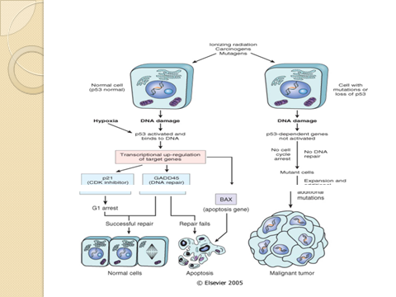

Slide 228
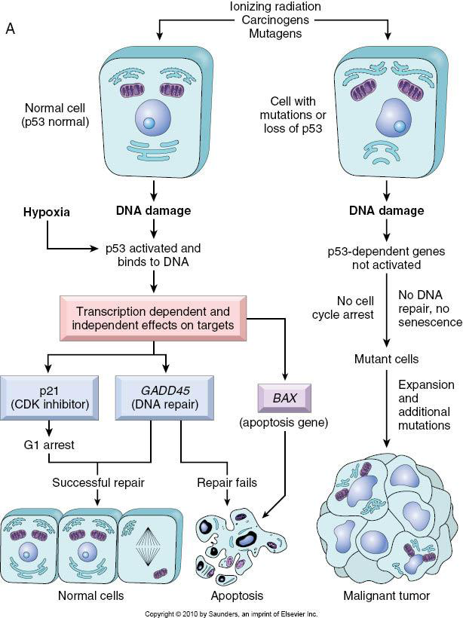

Slide 229
Transforming Growth Factor-β (TGF-ß)
TGF-β is a potent inhibitor of proliferation in most normal epithelial, endothelial, and hematopoietic cells.
TGF-ß acts on G1 phase
Its mutant form has impaired-growth-inhibiting effect, leading to uncontrolled cell proliferation and cancers as in carcinoma of prostate, colon and stomach

Slide 230
Neurofibroma (NF) gene
Prevents proliferation of Schwann cells and is involved in neurofibromatosis-1 and 2

Slide 231
Wilms tumor (WT)- 1 gene
The WT-1 gene located on chromosome 11 p 13
Associated with the development of Wilms tumor.
It is a transcriptional activator of genes involved in renal and gonadal differentiation.
Both inherited and sporadic forms of Wilms tumor occur
And mutational inactivation of the WT-1 locus have been seen in both forms.

Slide 232
Breast cancer susceptibility genes (BRCA) 1 and 2
BRCA 1 gene is located on the long arm of chromosome 17
Its protein product is involved in DNA damage repair and transcriptional regulation.
Variations in the gene have been implicated in a number of hereditory cancers
Namely breast, ovary and prostate

Slide 233
BRCA 2 gene
BRCA 2 gene is located on the long arm of chromosome 13.
It is essential for repairing damaged DNA
BRCA2 protein binds to and regulates the protein produced by the RAD51 gene to fix the breaks in DNA.
Abnormalities of the BRCA2 gene may cause an increased risk of breast cancer along with cancer of the ovaries, prostate and pancreas, as well as malignant melanoma.

Slide 234

Adenomatous Polyposis Coli- β-Catenin protein Gate Keeper Genes
Familial Adenomatous Polyposis
Normal
Affects ~1 in 7,000 individuals
Inherited in an autosomal dominant manner
Multiple benign tumors (adenomas) of the colon and rectum
APC germline mutation

Slide 235
The APC gene is normally inhibitory to mitosis , which takes place by a cytoplasmic protein ß- catenin .
ß- catenin normally has dual functions :
Firstly, it binds to cytoplasmic E-cadherin that is involved in intercellular interactions,
and secondly it can activate cell proliferation signalling pathway

Slide 236
In colon cancer cells, APC gene is lost
And thus ß- catenin fails to get degraded, alllowing the cancer cells to undergo mitosis without the inhibitory influence of ß- catenin
Patients born with one mutant APC gene allele develop large number of polyps in the colon early in life
While after the age of 20 yrs these cases start developing loss of second APC gene allele.
It is then that almost all these patients invariably develop malignant transformation of one or more polyps.

Slide 237


Slide 238
Carcinogenic Agents and Their Cellular Interactions
A large number of agents cause genetic damages and induce neoplastic transformation of cells.
They fall into the following three categories:
a) Chemical carcinogenesis
b) Radiation carcinogenesis
c) Viral carcinogenesis

Slide 239
Chemical carcinogenesis
An enormous variety of chemicals may induce tumours
This was exemplified by Sir Percival Pott’s observation in the last century that :
Increased incidence of scrotal skin cancer in chimney sweeps to chronic exposure to soot.

Slide 240
Steps involved in chemical carcinogenesis
Appropriate dose of a chemical carcinogenic agents to a cell results in the formation of initiation –promotion sequence
Initiation causes permanent DNA damage (mutation) which, is rapid and irreversible.
However, initiation alone is not sufficient for tumour formation and thus, promoters can induce tumours in initiated cells, but they are non-tumourogenic by themselves.
Furthermore, tumours do not result when a promoting agent applied before, the initiating agent

Slide 241
In contrast to the effects of initiators, the cellular changes resulting from the application of promoters do not affect DNA directly and are reversible.
Promoters render cells susceptible to additional mutations by causing cellular proliferation.
Examples of promoters include phorbol ester, hormones, phenols and drugs.

Slide 242
Chemical carcinogenic agents fall into two categories
1. Directly acting compound :
These are ultimate carcinogens and have one property in common:
They are highly reactive electrophiles (have electron deficient atoms) that can react with nucleophilic (electron-rich) sites in the cell.
This reaction is non-enzymatic and result in the formation of covalent adducts (addition products) between the chemical
carcinogen and a nucleotide in DNA.

Slide 243
Electrophilic reactions may attack several electron-rich sites in the target cells including DNA, RNA, and proteins.
Only a few alkylating and acylating agents are directly acting carcinogens

Slide 244
2. Indirect acting compounds (or pro-carcinogens)
Requires metabolic conversion in vivo to produce ultimate carcinogens capable of transforming cells.
Most known carcinogens are metabolized by cytochrome p-450 dependent monooxygenase.
Examples of this group include polycyclic and heterocyclic aromatic hydocarbones, and aromatic amines etc….
These chemical carcinogens lead to mutations in cells by affecting the functions of oncogenes, onco-suppressor genes and genes that regulate apoptosis.

Slide 245
Radiation carcinogenesis
Radiant energy whether in form of ultraviolet (UV) sun light
or ionizing electromagnetic (X rays and gamma (δ ) rays)
and particulates (α,β, protons and neutrons) radiation can transform and induce neoplasm in both humans and experimental animals.

Slide 246
Two types of radiation injuries are recognized:
i) Ultraviolet rays (UV light) :
UV rays are examples of non-ionizing radiation that cause vibration and rotation of atoms in biologic molecules
UV rays induce an increased incidence of squamous cell carcinoma, basal cell carcinoma and possibly malignant melanoma of skin.
Risk factors for developing UV rays related disorders depend on
- Type of UV rays – UV type B
- Intensity of exposure
- Quality of light absorbing “protective mantle” of melanin in the skin

Slide 247
UV rays’ effects on cell nucleus are:
The carcinogenesis of UV type B rays is attributable to its formation of pyrimidine dimmers in DNA
However, UV rays can also cause inhibition of cell division, inactivation of enzymes,
Induction of mutation and sufficient dose kill cells.

Slide 248
ii) Ionizing radiation
Ionizing radiations are of short wave length and high frequency which can ionize biologic target molecules and eject electrons
Electromagnetic and particulate radiations in forms of theureptic, occupational or atomic bomb incidents can be carcinogenic

Slide 249
Occupational hazards include:
Many of the poineers in the development of roentegen rays develop skin cancers.
Miners for radioactive elements---lung cancer

Slide 250
Therapeutic irradiations have been documented to be carcinogenic :
Thyroid cancer may result from childhood & infancy irradiation (9%),
and by the same taken radiation therapy for spondylitis may lead to a possible acute leukemia year later.

Slide 251
In atomic bonds dropped in Hiroshima and Nagasaki
initially principal cancers were acute and chronic mylogenous leukemias after a latent of about 7 years
Solid tumours such as breast, colon, thyroid and lung cancers increased in incidence.

Slide 252
C) Viral and bacterial carcinogenesis
Large groups of DNA and RNA viruses have proved to be oncogenic
and there is an association between infections by the bacterium Helicobacter Pylori and gastric lymphoma.
i) DNA oncogenic viruses :
This group includes:
Human Papilloma Virus (HPV)
Epstein Barr Virus (EBV)
Hepatitis B Virus (HBV)

Slide 253
Human papilloma Virus (HPV)
HPV definitely causes benign squamous papilloma (warts) (type 1,2,3,4, 7).
It also implicated in the genesis of squamous cell carcinomas of cervix and anogenital region
(types 16,18 and also 31,33,35,and 51 found in 85% SCC).
It is also linked to the causation of oral and laryngeal cancers.

Slide 254
Epstein – Barr virus (EBV)
EBV, a member of the herpes family, has been implicated in the pathogenesis of four types of human tumors:
the African form of Burkitt lymphoma;
B-cell lymphomas in immunosuppressed individuals (particularly in those with human immunodeficiency virus infection and those undergoing immunosuppressive therapy after organ transplantation);
some cases of Hodgkin lymphoma;
and nasopharyngeal carcinomas

Slide 255
The Association between African Burkett Lymphoma and EBV is quite strong.
More than 90% of African tumours carry the EBV genome
One hundred percent of the patients have elevated antibody titres against viral capsid antigens

Slide 256
Hepatitis B- virus (HBV)
Strong epidemiologic association prevails between HBV and hepato cellular Carcinoma.
The effects of HBV is indirect and possibly multi factorial.
i) By causing chronic liver cell injury and accompanying regenerative hyperplasia
ii) HBV encodes a regulatory element called HBx protein, which disrupts normal growth control of infected liver cells by transcriptional activation of several growth promoting genes such as insulin like growth factor II
iii) HBV binds to P53 and appears to interfere with its growth suppressing activities.

Slide 257
ii. RNA oncogenic viruses
only one retrovirus is firmly implicated in the causation
of cancer and it is Human T cells leukemia/ lymphoma virus type 1 (HTLV-1) .

Slide 258
iii. Helicobacter pylori
There is an association between gastric infections with helicobacter pylori as a cause of gastric lymphoma.
The stronger link is with B cell lymphoma of stomach.
Treatment of H. Pylori results in regression of the lymphoma in most cases.
The lymphoma arise from the mucosa associated lymphoid tissues (MALT) hence, they sometimes are called MALTOMAS

Slide 259
GRADING / STAGING
GRADING: HOW “DIFFERENTIATED” ARE THE CELLS ?
STAGING: HOW MUCH ANATOMIC EXTENSION ?
Which one of the above do you think is more important?
Notes:
Which one of these two is more important?

Slide 260
Grading of Cancer
The grading of a cancer attempts to establish some estimate of its aggressiveness or level of malignancy.
It is based on :
1-the cytologic differentiation of tumor cells.
2-the number of mitoses within the tumor.
The cancer may be classified as grade I, II, III or IV in order of increasing anaplasia.

Slide 261
Criteria for the individual grades vary with each form of neoplasia .
Difficulties in establishing clear-cut criteria have led in some instances to descriptive characterizations as :
Well-differentiated
Moderately-differentiated
Poorly-differentiated

Slide 262
Staging of cancer
Staging of cancers is based on :
1-the size of the primary lesion.
2-its extent of spread to regional lymph nodes.
3-the presence or absence of metastases.

Slide 263
This assessment is usually based on :
clinical and radiographic examination (CT scan & MRI)
and in some cases surgical exploration.

Slide 264
Two methods of staging are currently in use:
1-the TNM system
(T, primary tumor; N, regional lymph node involvement; M, metastases)
2-the AJC (American Joint Committee) system..

Slide 265
In the TNM system, T1, T2, T3, and T4 describe the increasing size of the primary lesion;
N0, N1, N2, and N3 indicate progressively advancing node involvement;
M0 and M1 reflect the absence or presence of distant metastases.

Slide 266
In the AJC method, the cancers are divided into stages 0 to IV,
incorporating the size of primary lesions and the presence of nodal spread and of distant metastases.

Slide 267
Staging has proved to be of greater clinical value than grading.

Slide 268
Laboratory Diagnosis of Cancer
The modalities for laboratory diagnosis of cancer include :
Cytology
Histopathology
Histochemistry/cytochemistry (special stains)
Immunohistochemistry / immunocytochemistry
Intermediate filaments
Electron microscopy (EM)
Tumour markers

Slide 269
Cytology
The main techniques used for cytological diagnosis are :
A) Fine needle aspiration cytology (FNAC) :
Direct
Image guided
Air -dried MGG) (May-Grunwald-Giemsa)stained smears or wet (95% ethanol) –fixed Pap stained smears are prepared from the FNAC material obtained and examined.

Slide 270
B) Exfoliative cytology :
Due to loss of cohesiveness, neoplastic cells are continuously shed from tumours into the surrounding space.
These are called exfoliated cells and can be examined in the following preparations :
i) Papanicolaou smears (for carcinoma cervix)
Ii) Sputum and bronchial washings (for bronchogenic carcinoma)
Iii) Pleural, pericardial and peritoneal fluid (for local cancers)
iv) Urine (for urothelial malignancy)
V) Cerebrospinal fluid (for CNS tumour)
Vi) Gastric secretions (for gastric carcinoma)

Slide 271
Diagnostic reliability of exfoliative cytology varies between : 80%-90%

Slide 272


Slide 273


Slide 274


Slide 275


Slide 276
Histopathology
Histopathological diagnosis entails microscopy supported by clinical and investigative data.
Formalin fixation is required for routine histopathology
Glutaraldehyde fixation is required for electron microscopy.
Frozen section aids in rapid/itraoperative diagnosis

Slide 277
Histochemistry / cytochemistry (special stains)
These are diagnostic tools for identifying chemical composition of cells for the purpose of tumour diagnosis and classification

Slide 278
Special stains in tumour diagnosis
Substances | Stains
Basement membrane/collagen | PAS Reticulin Van Gieson Masson’s trichrome
Glycogen | PAS with diastase loss
Glycoprotein | PAS
Mucins of epithelial origin | Mucicarmine
Acid mucins (of mesenchymal origin) | Alcian blue
Argyrophilic / argentaffin granules / fungi | Silver stains
Fat | Oil red- O, Sudan black B

Slide 279
Immunohistochemistry / immunocytochemistry
Immunohistochemistry (IHC) is a tool for surgical pathology and research.
IHC is an immunological method of recognizing a cell based on recognition of specific components called “ antigens”.
Specific antibodies against antigens are raised.
Antigen –antibody complexes on the slides (histological sections or cytological smears) are made visible for microscopic identification by labels (fluorochromes or enzyme systems)

Slide 280
Uses
Categorization of undifferentiated neoplasm
Specific typing of leukemias / lymphomas
Determination of site of origin of a metastatic tumour
Detection of molecules that have prognosis or therapeutic significance, eg, ER-PR receptors in carcinoma breast
Differentiating benign from malignant lesions

Slide 281
Intermediate filaments (IFs)
IFs are a family of related proteins that share common structural features
They have an average diameter of 10 nanometers
Most types of intermediate filaments are cytoplasmic except lamins, which are nuclear.

Slide 282
“Intermediate filaments” and their significance in the tumour diagnosis
Keratins | Carcinomas, mesotheliomas and Germ -cell tumours
Vimentin | Sarcomas, melanoma
Desmin | Myogenic tumours
Neurofilaments | Neural tumours
Glial fibrillary acidic proteins | Glial tumours

Slide 283
Electron microscopy (EM)
EM is used for confirming or substantiating tumour diagnosis based on :
Presence and type of cell junctions
Presence of microvilli
Shape of nucleus, features of nuclear membrane and nucleoli
Cytoplasmic organelles

Slide 284
Tumour markers
These are substances found in blood, urine, body fluids or tissue
The level of which might be elevated in association with a cancer.
Tumour markers may be used to help diagnose cancer, predict a patients response to cancer therapy
Check a patients response to treatment or determine cancer recurrence.

Slide 285
Role of tumour markers in neoplasia
Tumour marker | Associated neoplasm
AFP (α- fetoprotein) | Hepatocellular carcinoma, nonseminomatous –germ-cell tumours
PSA (prostate-specific antigen) | Prostatic carcinoma
HCG (human chorionic gonadotropin) | Trophoblastic tumors
Calcitonin | Medullary carcinoma of thyroid
CA-125 | Carcinoma of ovary
CEA (carcinoembryonic antigen) | Cancer of bowel, pancreas and breast
CA-15.3 | Carcinoma of breast

Slide 286
QQQQ ??????
An autopsy is performed on a 64-year-old man who died of congestive heart failure. Sections of the liver reveal yellow-brown granules in the cytoplasm of most of the hepatocytes. Which of the following stains would be most useful to demonstrate with positive staining that these yellow-brown cytoplasmic granules are in fact composed of hemosiderin (iron) ?
A) Oil red stain
B) Periodic acid-Schiff stain
C) Prussian blue stain
D) Sudan black B stain
E) Trichrome stain

Slide 287
Modern Aids in the Tumour Diagnosis
Flow cytometry :
Flow cytometry simultaneously measures and analyzes multiple physical and / or chemical characteristics of single particles, usually cells, as they flow in a fluid stream through a beam of light.
With this technique any suspended microparticles, ranging in size from 0.2 to 150 µm can be analyzed.
is used routinely in the classification of leukemias and lymphomas.
Fluorescent antibodies against cell surface molecules and differentiation antigens are used to obtain the phenotype of malignant cells.

Slide 288
A variety of DNA- / RNA- based techniques in which DNA / RNA are extracted and analysed, eg, DNA analysis by Southern blot and RNA analysis by Northern blot are also avialable.
In situ hybridization
Spectral karyotyping
Comparative genome hybridization
DNA microarray analysis and proteomics
The above molecular methods can be used for :
Analysis of molecular cytogenetic abnormalities and mutational analysis
Study of oncogenic viruses at molecular level
Detection of minimal residual disease
Diagnosis of hereditory predisposition to cancer

