Slide 1
Pulmonary vascular diseases
DR. NISHI
Assistant Professor
Department of Pathology
SKMCH, Muzaffarpur

Slide 2
Pulmonary Diseases of Vascular Origin
Pulmonary Embolism and Infarction
Pulmonary Hypertension
Diffuse Pulmonary Hemorrhage Syndromes
(1) Goodpasture syndrome,
(2) Idiopathic pulmonary hemosiderosis, and
(3) Vasculitis-associated hemorrhage,

Slide 3
Pulmonary Embolism and Infarction
Pulmonary embolism is an important cause of morbidity
and mortality, particularly in patients who are bedridden,
but also in a wide range of conditions that are associated
with hypercoagulability.
Blood clots that occlude the large pulmonary arteries are almost always embolic in origin.
The usual source—Thrombi in the deep veins of the leg
(>95% of cases)

Slide 4
Pulmonary embolism causes more than 50,000 deaths in the United States each year.
Its incidence at autopsy has varied from 1% in the general population of hospital patients to 30% in patients dying after severe burns, trauma, or fractures.
It is the sole or a major contributing cause of death in about 10% of adults who die acutely in hospitals.
By contrast, large-vessel pulmonary thromboses are rare and develop only in the presence of pulmonary hypertension, pulmonary atherosclerosis, and heart failure.

Slide 5
Pathogenesis
Pulmonary embolism usually occurs in
patients with a predisposing condition that produces an increased tendency to clot (thrombophilia).
Patients often have cardiac disease or cancer, or have been immobilized for several days or weeks prior to the appearance of a symptomatic embolism.

Slide 6
Those with hip fractures are at particularly high risk.
Hypercoagulable states, either
Primary
(e.g., factor V Leiden, prothrombin mutations, and antiphospholipid syndrome) or
Secondary
(e.g., obesity, recent surgery, cancer, oral contraceptive use, pregnancy), are important risk factors.

Slide 7
The pathophysiologic response and clinical significance of pulmonary embolism depend on
the extent to which pulmonary artery blood flow is obstructed,
the size of the occluded vessels,
the number of emboli, and
the cardiovascular health of the patient.
Emboli have two deleterious pathophysiologic consequences:
Respiratory compromise due to the nonperfused, although ventilated, segment; and
Hemodynamic compromise due to increased resistance to pulmonary blood flow caused by the embolic obstruction.
Sudden death often ensues, largely as a result of the blockage of blood flow through the lungs.
Death may also be caused by acute right-sided heart failure (acute cor
pulmonale).

Slide 8
MORPHOLOGY
Large emboli lodge in the main pulmonary artery or its major branches or at the bifurcation as a saddle embolus.
Smaller emboli travel out into the more peripheral vessels, where they may cause hemorrhage or infarction.
In patients with adequate cardiovascular function, the bronchial arterial supply sustains the lung parenchyma; in this instance, hemorrhage may occur, but there is no infarction.

Slide 9
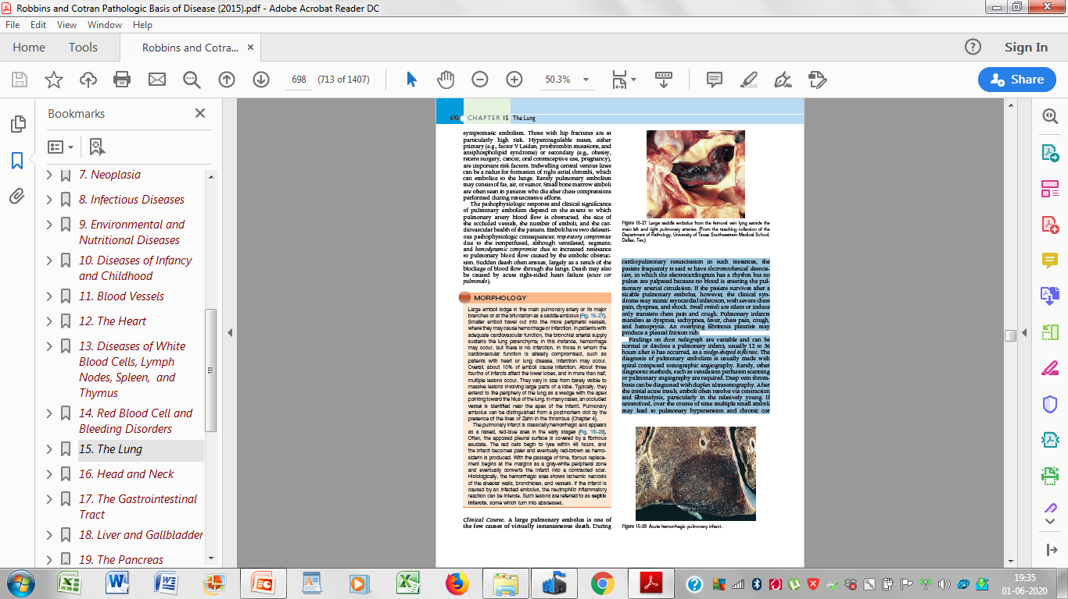

Slide 10
In those in whom the cardiovascular function is already compromised, such as
patients with heart or lung disease, infarction may occur.
Overall, about 10% of emboli cause infarction.
About three fourths of infarcts affect the lower lobes, and in more than half,
multiple lesions occur.
They vary in size from barely visible to massive lesions involving large parts of a lobe.
Typically, they extend to the periphery of the lung as a wedge with the apex
pointing toward the hilus of the lung.
In many cases, an occluded vessel is identified near the apex of the infarct.
Pulmonary embolus can be distinguished from a postmortem clot by the
presence of the lines of Zahn in the thrombus.

Slide 11
The pulmonary infarct is classically hemorrhagic and appears
as a raised, red-blue area in the early stages
Often, the apposed pleural surface is covered by a fibrinous
exudate.
The red cells begin to lyse within 48 hours, and
the infarct becomes paler and eventually red-brown as hemosiderin
is produced.
With the passage of time, fibrous replacement
begins at the margins as a gray-white peripheral zone
and eventually converts the infarct into a contracted scar.
Histologically, the hemorrhagic area shows ischemic necrosis
of the alveolar walls, bronchioles, and vessels.
If the infarct is caused by an infected embolus, the neutrophilic inflammatory
reaction can be intense.
Such lesions are referred to as septic infarcts, some which turn into abscesses.

Slide 12
Clinical Course.
A large pulmonary embolus is one of
the few causes of virtually instantaneous death.
During cardiopulmonary resuscitation in such instances, the patient frequently is said to have electromechanical dissociation, in which the electrocardiogram has a rhythm but no pulses are palpated because no blood is entering the pulmonary arterial circulation.

Slide 13
If the patient survives after a sizable pulmonary embolus, however, the clinical syndrome may mimic myocardial infarction, with severe chest pain, dyspnea, and shock.
Small emboli are silent or induce only transient chest pain and cough.
Pulmonary infarcts manifest as dyspnea, tachypnea, fever, chest pain, cough, and hemoptysis.
An overlying fibrinous pleuritis may
produce a pleural friction rub.

Slide 14
Findings on chest radiograph are variable and can be
normal or disclose a pulmonary infarct,
Usually 12 to 36 hours after it has occurred, as a wedge-shaped infiltrate.
The diagnosis of pulmonary embolism is usually made with
spiral computed tomographic angiography.
Rarely, other diagnostic methods, such as ventilation perfusion scanning
or pulmonary angiography are required.
Deep vein thrombosis can be diagnosed with duplex ultrasonography.
After the initial acute insult, emboli often resolve via contraction
and fibrinolysis, particularly in the relatively young.
If unresolved, over the course of time multiple small emboli
may lead to pulmonary hypertension and chronic cor pulmonale.

Slide 16
Perhaps most important is that a small embolus
may presage a larger one.
In the presence of an underlying predisposing condition, patients with a pulmonary embolus have a 30% chance of suffering a second embolus.
Prevention of pulmonary embolism is a major clinical challenge for which there is no easy solution.
Prophylactic therapy includes early ambulation in postoperative and postpartum patients, elastic stockings and graduated compression stockings for bedridden patients, and anticoagulation
in high-risk individuals.

Slide 17
Treatment of pulmonary embolism includes anticoagulation and supportive measures;
thrombolysis may have some benefit in those with severe complications (e.g., shock), but carries a high risk of bleeding.
Those at risk of recurrent pulmonary embolism
in whom anticoagulation is contraindicated may be fitted with an inferior vena cava filter (an “umbrella”) that catches clots before they reach the lungs.

Slide 18
KEY CONCEPTS/ Summary
Pulmonary Embolism
■ Almost all large pulmonary artery thrombi are embolic in
origin, usually arising from the deep veins of the lower leg.
■ Risk factors include prolonged bed rest, leg surgery,
severe trauma, CHF, use of oral contraceptives (especially
those with high estrogen content), disseminated cancer,
and genetic diseases of hypercoagulability.
■ The vast majority (60% to 80%) of emboli are clinically
silent, a minority (5%) cause acute cor pulmonale, shock,
or death (typically from large “saddle emboli”), and the
remaining cause pulmonary infarction.
■ Risk of recurrence is high.

Slide 19
Pulmonary Hypertension
Pulmonary hypertension is defined as a mean pulmonary
artery pressure greater than or equal to 25 mm Hg at rest.
Based on underlying mechanisms, the World Health
Organization has classified pulmonary hypertension into
five groups.
(1) Pulmonary arterial hypertension, a diverse collection of disorders that all primarily impact small pulmonary muscular arteries;
(2) Pulmonary hypertension secondary to left-heart failure;
(3) Pulmonary hypertension stemming from lung parenchymal
disease or hypoxemia;
(4) Chronic thromboembolic pulmonary hypertension; and
(5) Pulmonary hypertension of multifactorial basis.

Slide 20
Pathogenesis
Pulmonary hypertension has diverse causes---As in Classification
It is most frequently associated with structural cardiopulmonary conditions that increase pulmonary blood flow, pulmonary vascular resistance, or left heart resistance to blood flow.

Slide 21
Some of the more common causes are the
following:
Chronic obstructive or interstitial lung diseases (group 3).
These diseases obliterate alveolar capillaries, increasing pulmonary resistance to blood flow and, secondarily, pulmonary blood pressure.

Slide 22
Antecedent congenital or acquired heart disease (group 2).
Mitral stenosis, for example, causes an increase in left
atrial pressure and pulmonary venous pressure that is
eventually transmitted to the arterial side of the pulmonary
vasculature, leading to hypertension.
• Recurrent thromboemboli (group 4).
Recurrent pulmonary emboli may cause pulmonary hypertension by reducing the functional cross-sectional area of the pulmonary vascular bed, which in turn leads to an increase in pulmonary vascular resistance.

Slide 23
• Autoimmune diseases (group 1).
Several of these diseases (most notably systemic sclerosis) involve the pulmonary vasculature and/or the interstitium, leading to increased vascular resistance and pulmonary hypertension.
• Obstructive sleep apnea (also group 3) is a common disorder that is associated with obesity and hypoxemia.
Now recognized to be a significant contributor to
the development of pulmonary hypertension and cor
pulmonale.

Slide 24
When all known causes pulmonary hypertension are excluded; this is referred to as idiopathic pulmonary arterial hypertension.
This is a bit of a misnomer,
As 80% of idiopathic” pulmonary hypertension (sometimes referred to as primary pulmonary hypertension) has a genetic basis, sometimes being inherited in familes as an autosomal dominant trait.
Within these families, there is incomplete Penetrance.
Only 10% to 20% of the family members actually develop overt disease.

Slide 25
Pathogenesis of pulmonary hypertension has been learned about
by investigating the molecular basis of the uncommon familial form of the
disease.
The first mutation to be discovered in familial pulmonary arterial hypertension was in the bone morphogenetic protein receptor type 2 (BMPR2).
Inactivating germline mutations in the BMPR2 gene are found in 75%
of the familial cases of pulmonary hypertension, and 25% of sporadic cases.
Subsequently other mutations have been discovered that also converge on the BMPR2 pathway and affect intracellular signaling.
It has also been demonstrated that BMPR2 is down-regulated in lungs from some idiopathic pulmonary arterial hypertension patients without
mutation in its gene.

Slide 26
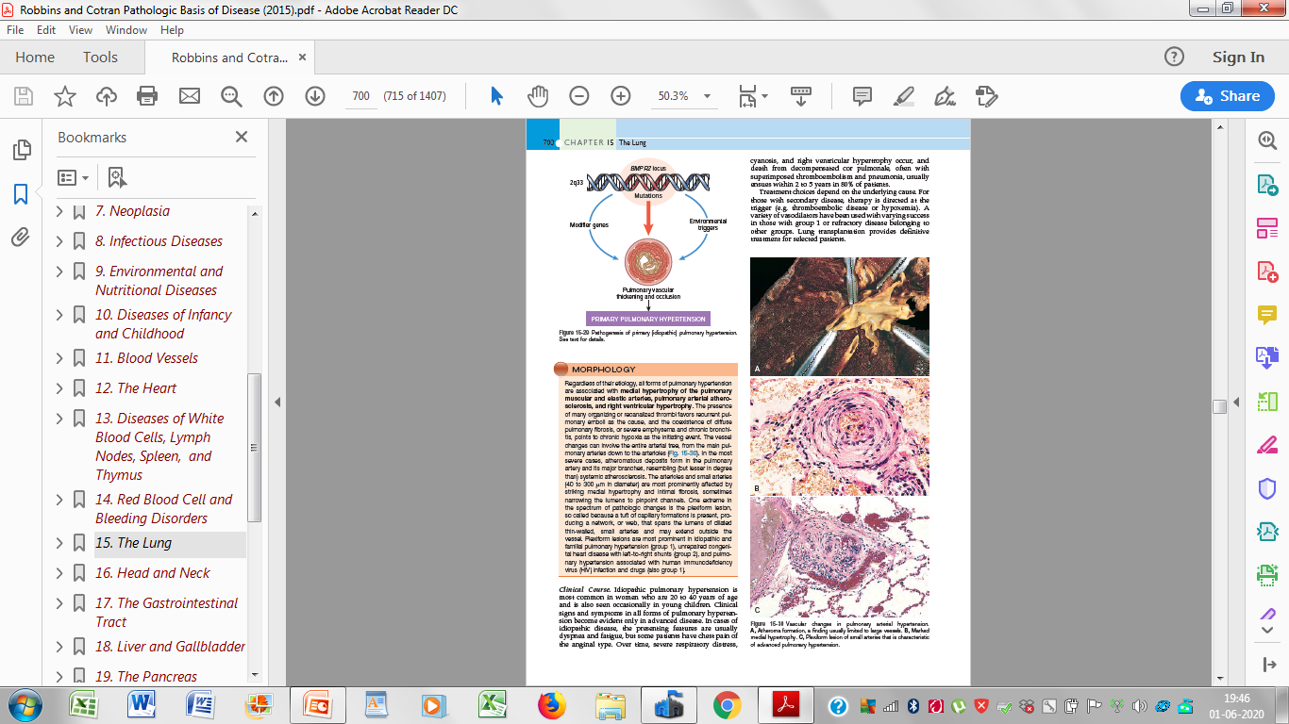

Slide 27
BMPR2 is a cell surface protein belonging to the TGF-β receptor superfamily, which binds a variety of cytokines, including TGF-β, bone morphogenetic protein (BMP),activin, and inhibin.
Although originally described in the context of bone growth, BMP-BMPR2 signaling is now known to be important for embryogenesis, apoptosis, and cell proliferation and differentiation.
Details remain to be worked out, but it appears that haploinsufficiency forBMPR2 leads to dysfunction and proliferation of endothelial cells and vascular smooth muscle cells.
Because only 10% to 20% of individuals with BMPR2 mutations develop disease, it is likely that modifier genes and/or environmental triggers also contribute to the pathogenesis of the disorder.
A two-hit model has been proposed whereby a genetically susceptible individual with a BMPR2 mutation requires additional genetic or environmental insults to develop the disease.

Slide 28
MORPHOLOGY
Regardless of their etiology, all forms of pulmonary hypertension are associated with medial hypertrophy of the pulmonary muscular and elastic arteries, pulmonary arterial atherosclerosis, and right ventricular hypertrophy.
The presence of many organizing or recanalized thrombi favors recurrent pulmonary
emboli as the cause, and the coexistence of diffuse pulmonary fibrosis, or severe emphysema and chronic bronchitis, points to chronic hypoxia as the initiating event.
The vessel changes can involve the entire arterial tree, from the main pulmonary arteries down to the arterioles.
In the most severe cases, atheromatous deposits form in the pulmonary artery and its major branches, resembling (but lesser in degree than) systemic atherosclerosis.
The arterioles and small arteries (40 to 300 μm in diameter) are most prominently affected by striking medial hypertrophy and intimal fibrosis, sometimes narrowing the lumens to pinpoint channels.

Slide 29
One extreme in the spectrum of pathologic changes is the plexiform lesion, so called because a tuft of capillary formations is present, producing a network, or web, that spans the lumens of dilated thin-walled, small arteries and may extend outside the vessel.
Plexiform lesions are most prominent in idiopathic and
familial pulmonary hypertension (group 1), unrepaired congenital heart disease with left-to-right shunts (group 2), and pulmonary hypertension associated with human immunodeficiency virus (HIV) infection and drugs (also group 1).

Slide 31
Clinical Course
Idiopathic pulmonary hypertension is
most common in women who are 20 to 40 years of age
and is also seen occasionally in young children.
Clinical signs and symptoms in all forms of pulmonary hypertension become evident only in advanced disease.
In cases of idiopathic disease, the presenting features are usually dyspnea and fatigue, but some patients have chest pain of the anginal type.
Over time, severe respiratory distress, cyanosis, and right ventricular hypertrophy occur, and death from decompensated cor pulmonale, often with superimposed thromboembolism and pneumonia, usually ensues within 2 to 5 years in 80% of patients.

Slide 32
Treatment choices depend on the underlying cause.
For those with secondary disease, therapy is directed at the trigger (e.g, thromboembolic disease or hypoxemia).
A variety of vasodilators have been used with varying success in those with group 1 or refractory disease belonging to other groups.
Lung transplantation provides definitive
treatment for selected patients.

Slide 33
Diffuse Pulmonary Hemorrhage Syndromes
Pulmonary hemorrhage is a complication of some interstitial lung disorders.
Pulmonary hemorrhage syndromes are
(1) Goodpasture syndrome,
(2) Idiopathic pulmonary hemosiderosis, and
(3) Vasculitis-associated hemorrhage, which is found in
conditions such as
Hypersensitivity angiitis,
Wegener granulomatosis, and
Systemic lupus erythematosus

Slide 34
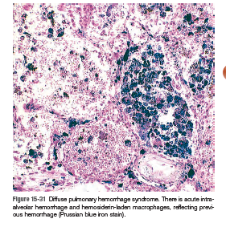

Slide 35
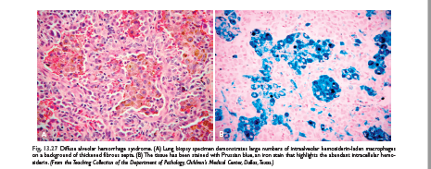

Slide 36
Goodpasture Syndrome
Goodpasture syndrome is an uncommon autoimmune disease in which kidney and lung injury are caused by circulating autoantibodies against the noncollagenous domain of the α3 chain of collagen IV.
When only renal disease is caused by this antibody, it is called antiglomerular basement membrane disease.
The term Goodpasture syndrome designates the 40% to 60% of patients who develop pulmonary hemorrhage in addition to renal disease.
The antibodies initiate inflammatory destruction of the basement membrane in renal glomeruli and pulmonary alveoli, giving rise to rapidly progressive glomerulonephritis and a necrotizing hemorrhagic interstitial pneumonitis.
Although any age can be affected, most cases occur in the teens or 20s, and in contrast to many other autoimmune diseases, there is a male preponderance.
The majority of patients are active smokers.

Slide 37
Pathogenesis
The immunopathogenesis of the syndrome
and the nature of the Goodpasture antigens.
The trigger that initiates the production
of anti-basement membrane antibodies is still unknown.
Because the epitopes that evoke anticollagen antibodies are normally hidden within the molecule.

Slide 38
It is presumed that some environmental insult such as viral infection, exposure to hydrocarbon solvents (used in the dry cleaning industry), or smoking is required to unmask the cryptic epitopes.
As in other autoimmune disorders, a genetic predisposition is indicated by association with certain HLA subtypes (e.g., HLA-DRB1*1501 and *1502).

Slide 39
MORPHOLOGY
In the classic case, the lungs are heavy, with areas of red-brown consolidation.
Histologically, there is focal necrosis of alveolar walls associated with intra-alveolar hemorrhages.
Often the alveoli contain hemosiderin-laden macrophages .
In later stages there may be fibrous thickening of the septae, hypertrophy of type II pneumocytes, and organization of blood in alveolar spaces.
In many cases immunofluorescence studies reveal linear deposits of immunoglobulins along the basement membranes of the septal walls.
The kidneys have the characteristic findings of focal proliferative glomerulonephritis in early cases or crescentic glomerulonephritis in patients with rapidly progressive glomerulonephritis.
Diagnostic linear deposits of immunoglobulins and complement are seen by immunofluorescence studies along the glomerular basement membranes even in the few patients without renal disease.

Slide 40
Clinical Features
Most cases begin clinically with respiratory symptoms, principally hemoptysis, and radiographic evidence of focal pulmonary consolidations.
Soon, manifestations of glomerulonephritis appear, leading to rapidly progressive renal failure.
The most common cause of death is uremia.
The once dismal prognosis for this disease has been markedly improved by intensive plasmapheresis.
This procedure is thought to be beneficial by removing circulating antibasement membrane antibodies as well as chemical mediators of immunologic injury.
Simultaneous immunosuppressive therapy inhibits further antibody production, ameliorating both lung hemorrhage and glomerulonephritis.

Slide 41
Idiopathic Pulmonary Hemosiderosis
Idiopathic pulmonary hemosiderosis is a rare disorder characterized by intermittent, diffuse alveolar hemorrhage.
Most cases occur in young children, although the disease has been reported in adults as well.
It usually presents with an insidious onset of productive cough, hemoptysis, and anemia associated with diffuse pulmonary infiltrations
similar to Goodpasture syndrome.

Slide 42
The cause and pathogenesis are unknown, and no antibasement membrane antibodies are detectable in serum or tissues.
However, favorable response to long-term immunosuppression with prednisone and/or azathioprine indicates that an immunologic mechanism could be involved in the pulmonary capillary damage underlying alveolar bleeding.
In addition, long-term follow-up of patients shows that some of them develop other immune
disorders.

Slide 43
Polyangiitis With Granulomatosis
Previously called Wegener granulomatosis
This autoimmune disease most often involves the upper respiratory tract and/or the lungs, with hemoptysis being the common presenting symptom.

Slide 44
Transbronchial lung biopsy might provide the only tissue available for diagnosis.
Since the amount of tissue is small, necrosis and granulomatous vasculitis might not be present.
The diagnostically important features are capillaritis and scattered, poorly formed granulomas (unlike those of sarcoidosis,
which are rounded and well-defined).

Slide 45
Thank you.

