Slide 1
CEREBRUM
Dr Rakesh Ranjan
Assistant Professor
Anatomy Dept
Sri Krishna Medical college, Muz

Slide 3
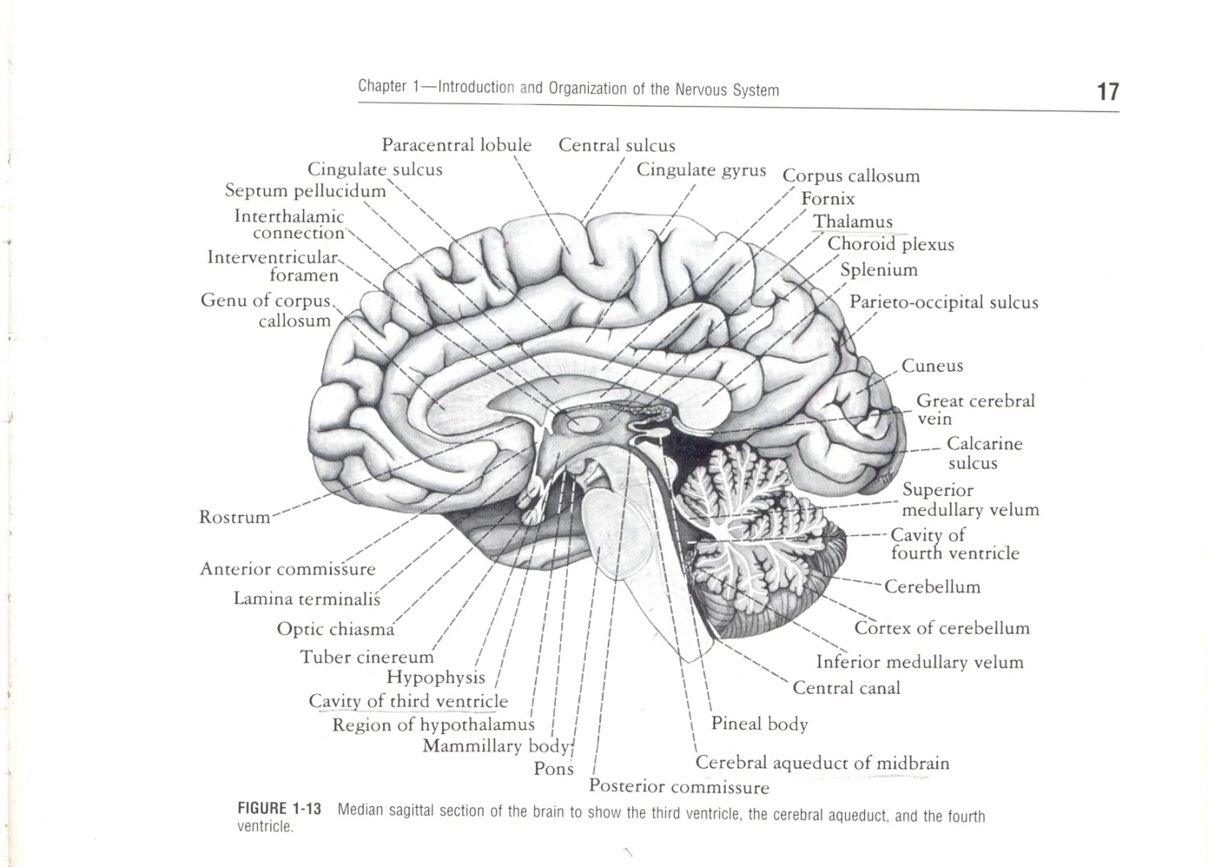
Situated in the Anterior & Middle Cranial Fossae of Skull
Division –
Diencephalon - which forms the central core
Telencephalon - which forms the Cerebral Hemispheres

Slide 4
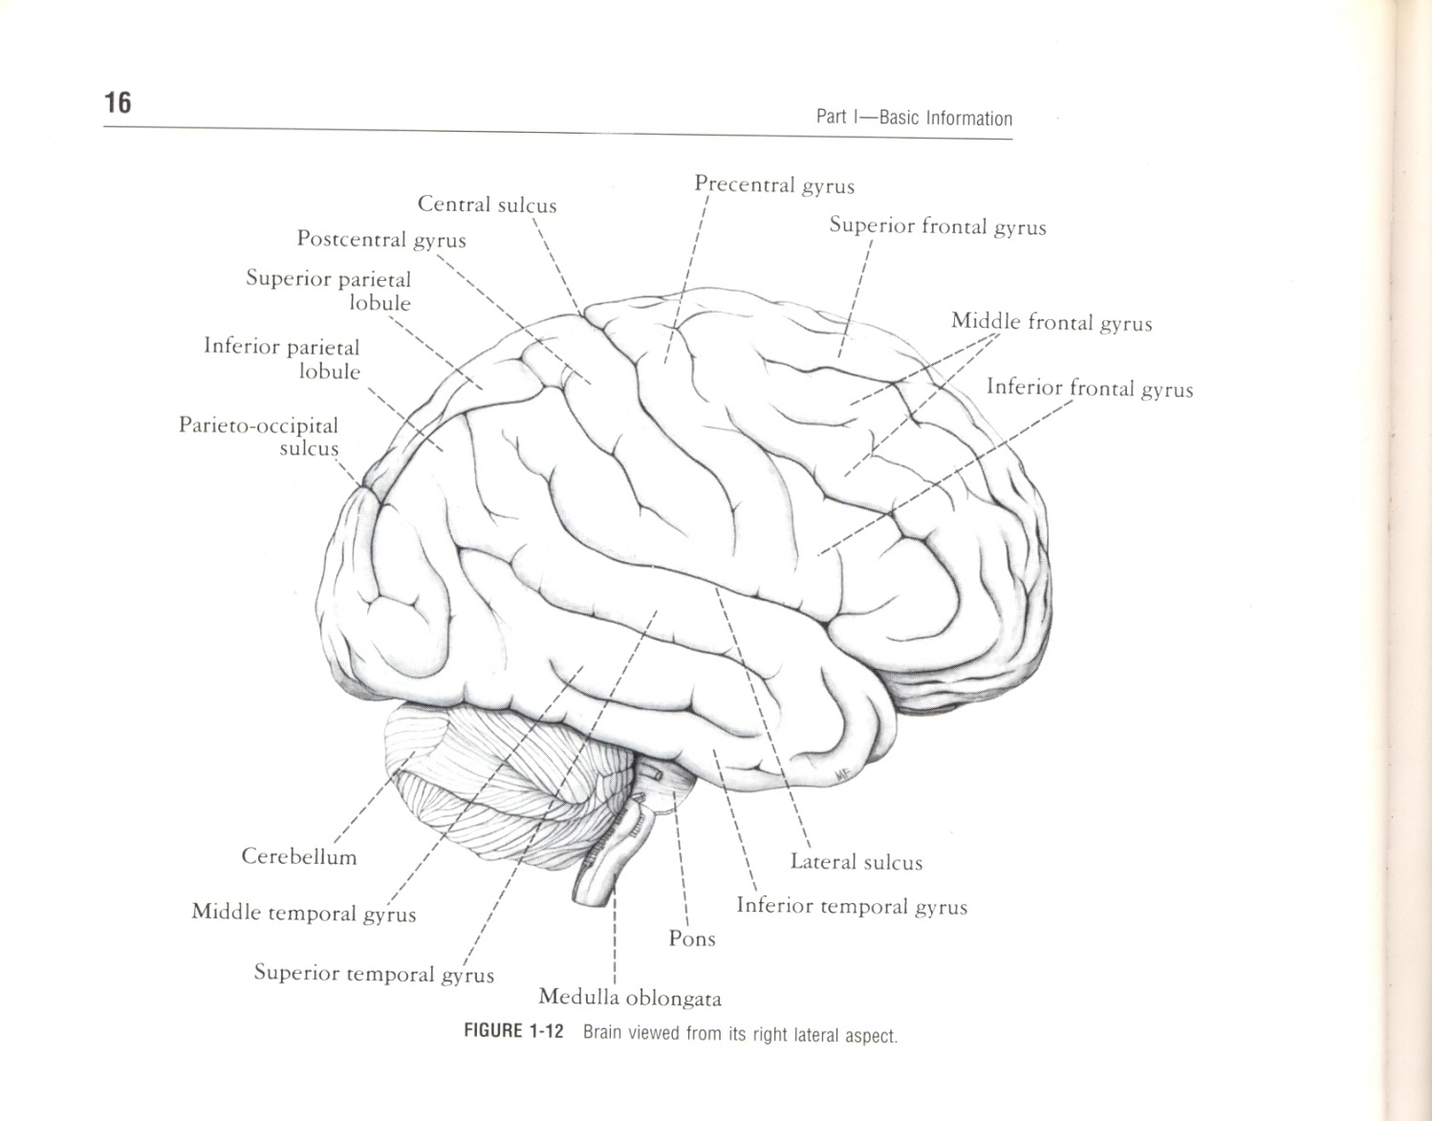
The Cerebral Hemispheres
General Appearance
Largest part of brain separated by a Longitudinal Cerebral Fissure
To increase the surface area it is thrown into
Folds Or Gyri
Sulci or Fissures

Slide 5
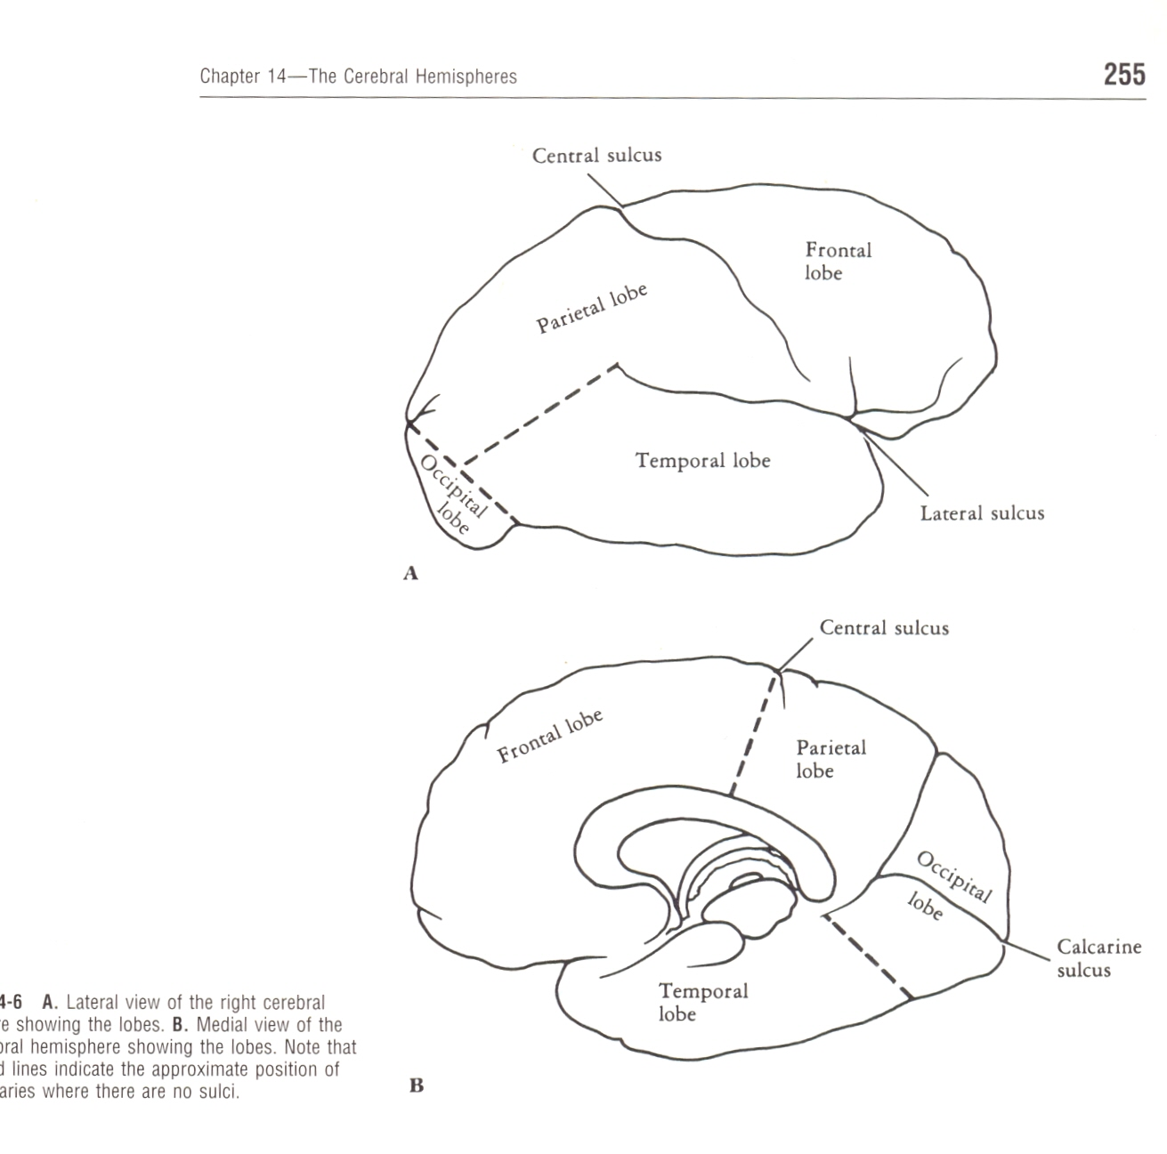
CEREBRAL HEMISPHERE
Each Cerebral Hemispheres divided into Lobes and according to the Cranial bones under which they lie.
Frontal
Parietal
Occipital
Temporal

Slide 6
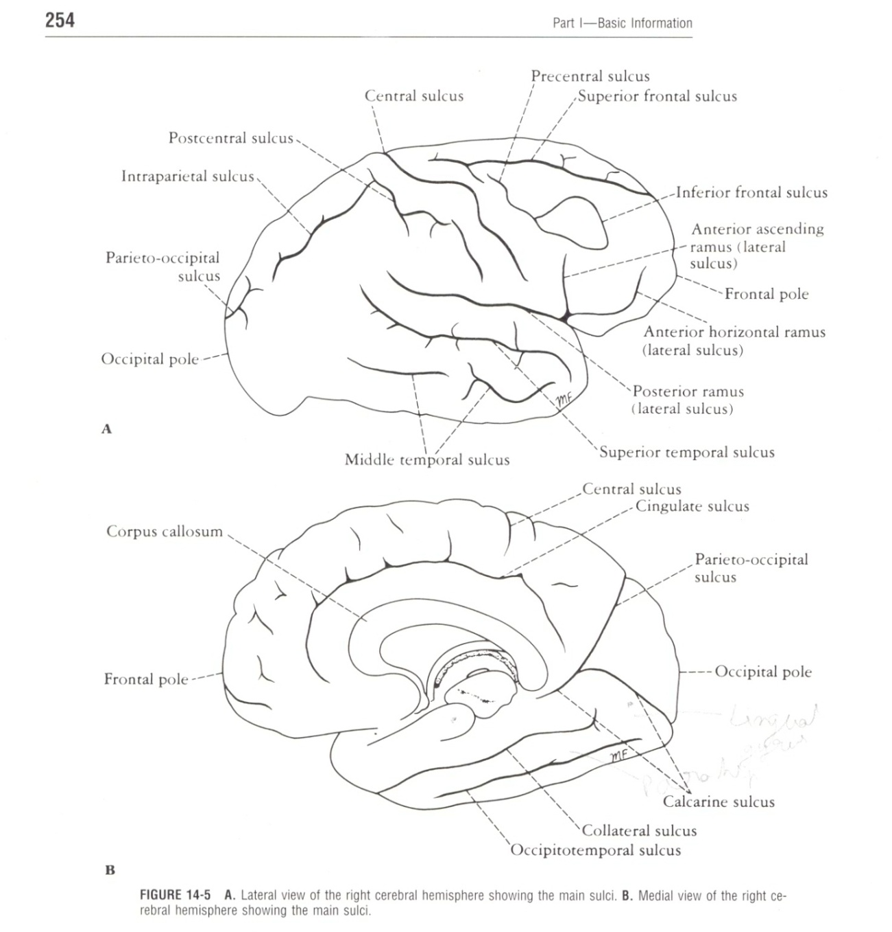
Main Sulci
Central sulcus
Lateral sulcus – three Ramus
Ant. Horizontal
Ant. Ascending
Post. Ramus
Parieto-occipital sulcus
Calcarine sulcus

Slide 7
Surfaces of Cerebral Hemispheres
Supero-Lateral Surface
Medial surface
Inferior Surface

Slide 8
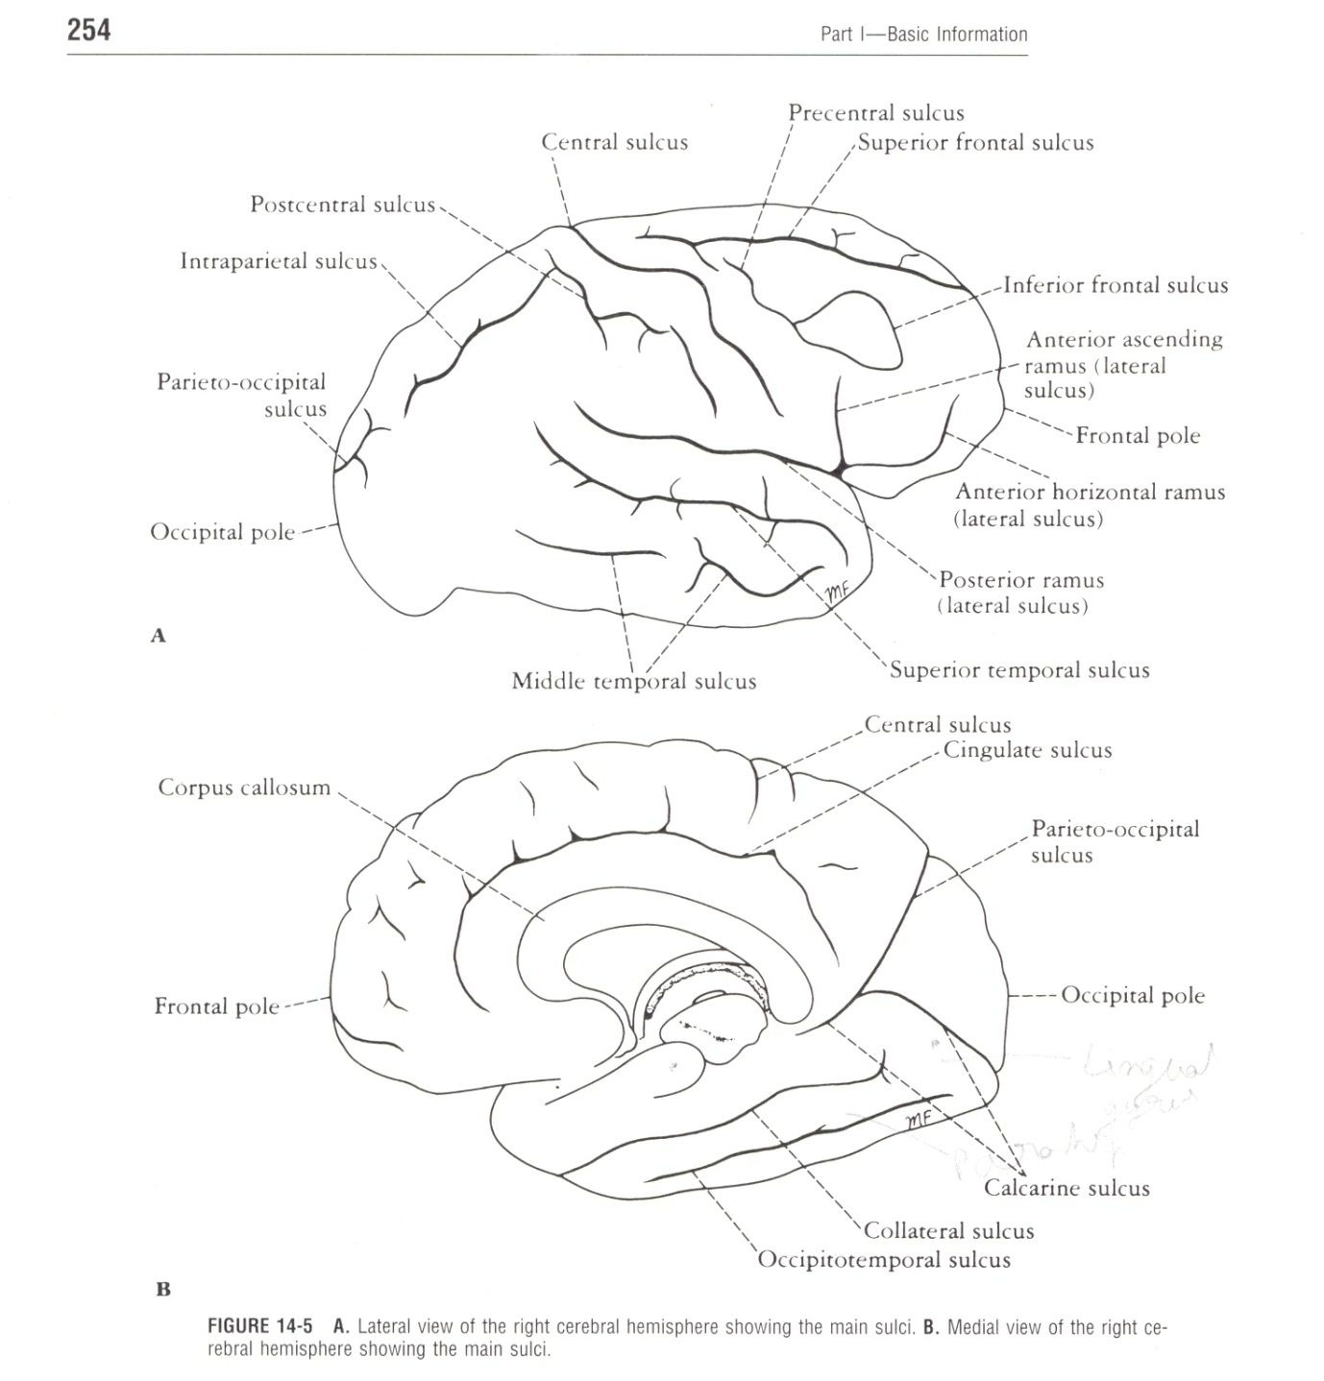
Frontal Lobe
Three sulci –
Precentral
Superior
Inferior
Four Gyri –
Precentral
Superior Frontal
Middle Frontal
Inferior Frontal

Slide 9
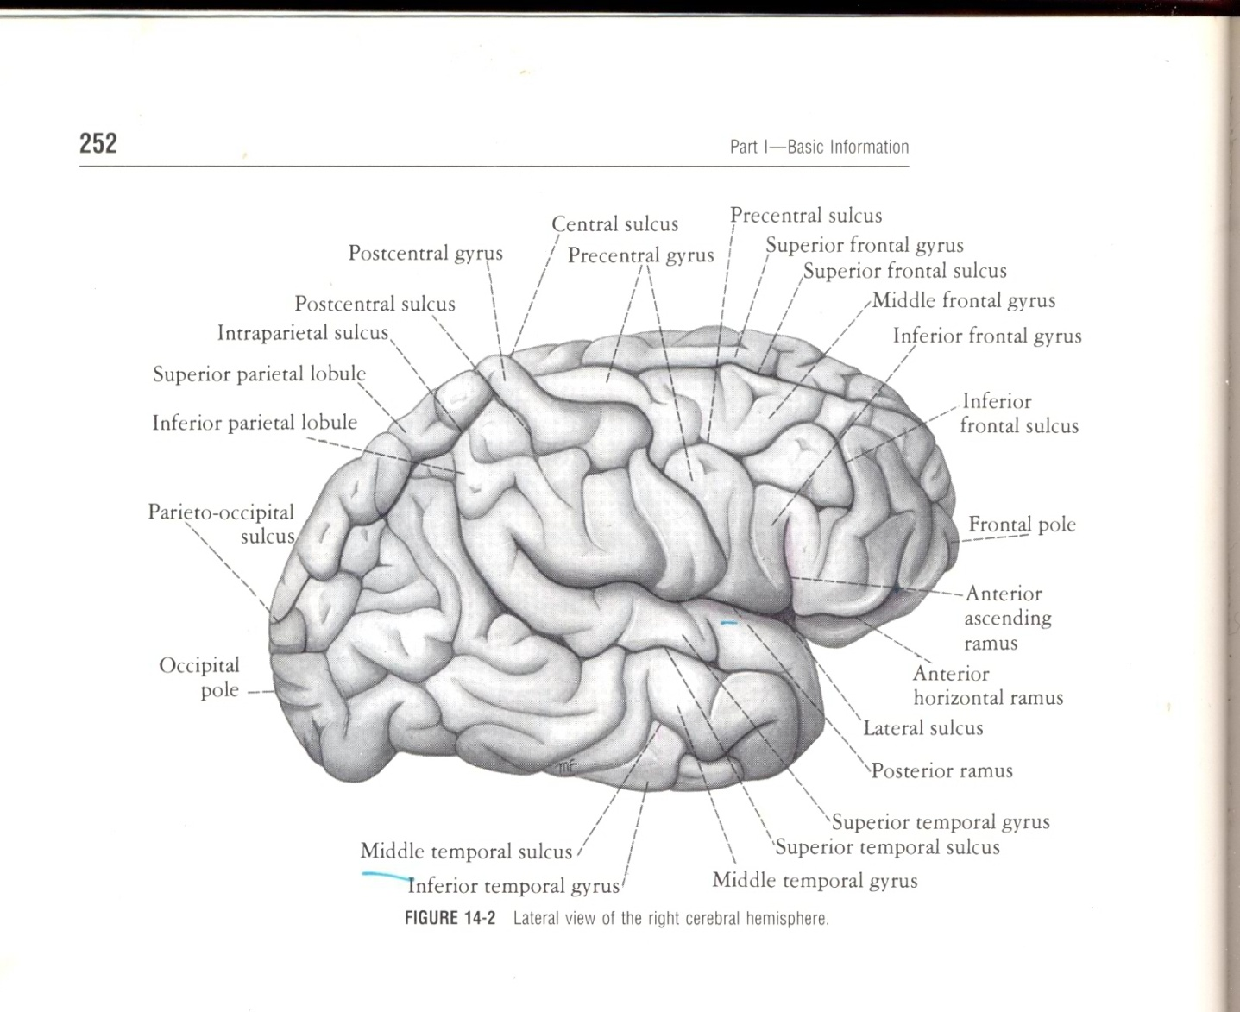
Parietal Lobe
Two sulci –
Postcentral
Intraparietal
Three Gyri –
Postcentral
Superior parietal
Inferior parietal

Slide 10
Temporal Lobe
Area inferior to the Lateral sulcus
Lateral surface –
Two sulci-
Superior temporal
Middle temporal
Three Temporal gyri
Superior
Middle
Inferior

Slide 11
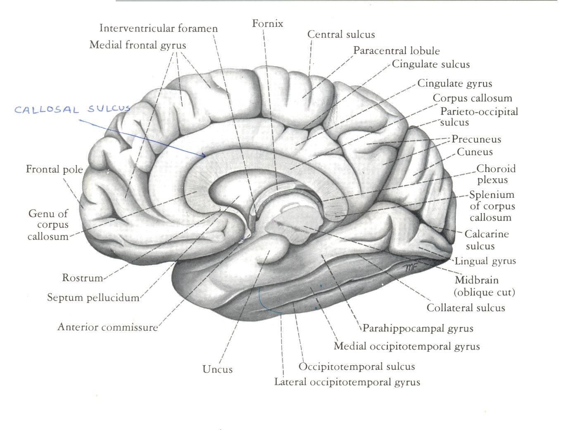
Medial and Inferior Surface
This surface is not clearly defined
Some important area that should be recognized
Corpus Callosum
Cingulate Gyrus
Callosal Sulcus
Cingulate Sulcus

Slide 12
Medial and Inferior Surface
Paracentral Lobule
Precuneus
Cuneus
Collateral Sulcus
Lingual Gyrus
Parahippo-Campal Gyrus
Uncus

Slide 13
Medial and Inferior Surface
Medial Occipitotemporal Gyrus
Rhinal Sulci
Occipitotemporal Sulcus

Slide 14
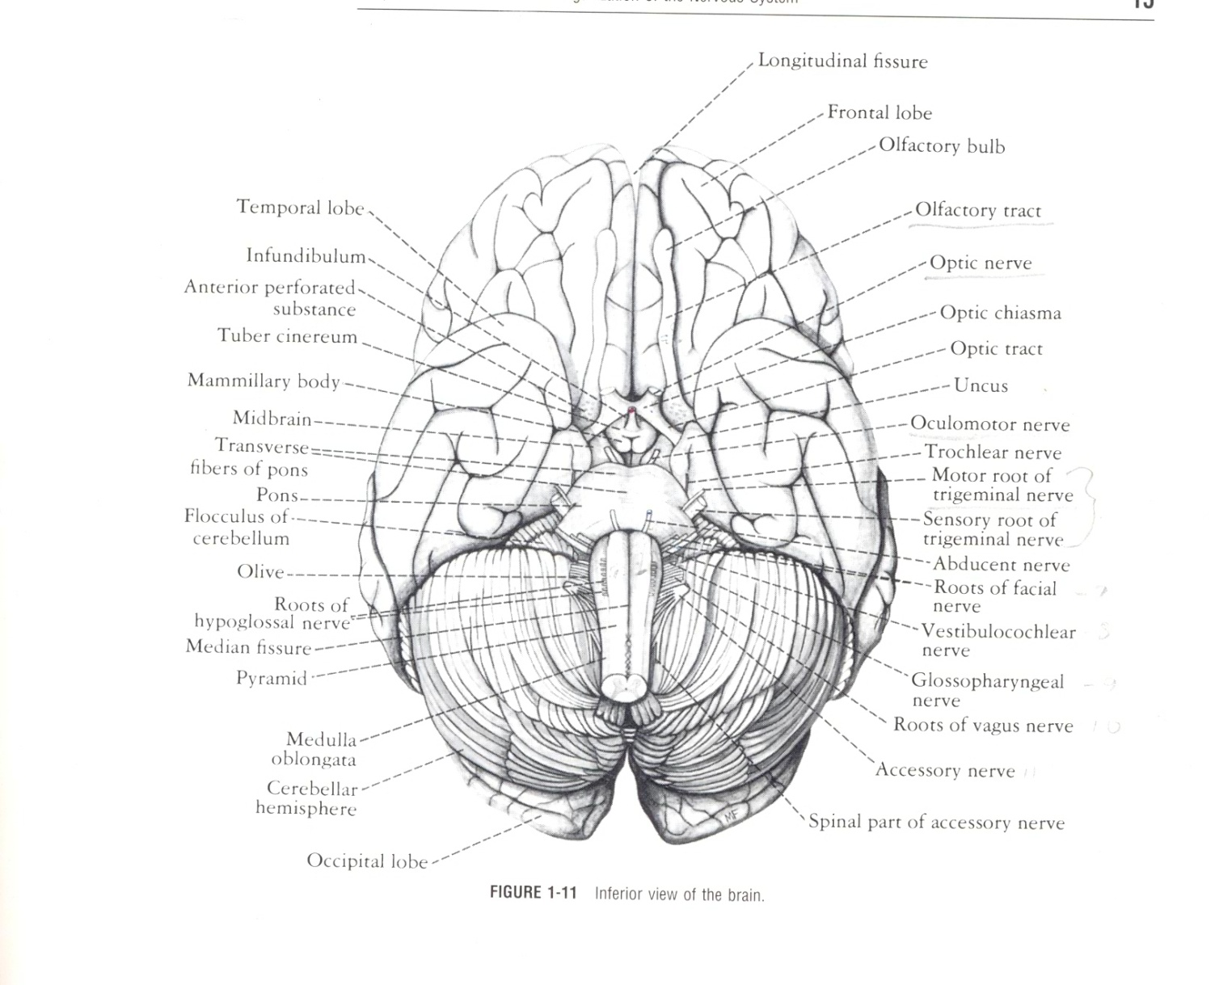
Medial and Inferior Surface
On the inferior surface of FRONTAL LOBE
OLFACTORY SULCUS
GYRUS RECTUS
ORBITAL GYRI

Slide 15
STRUCTURE AND FUNCTIONAL LOCALIZATION OF THE CEREBRAL CORTEX
Mechanisms of the CEREBRAL CORTEX
It is organized into vertical units of functional activity
Functional unit possesses Afferent fibers, Internuncial neurons & Efferent fibers

Slide 16
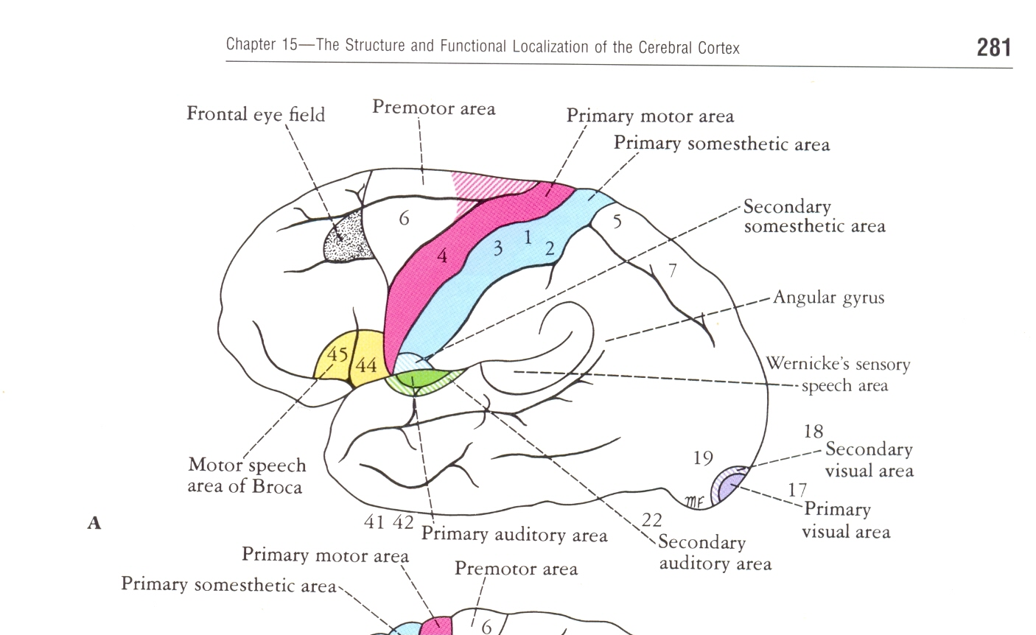
Cortical Areas
Frontal Lobe
Precentral Area -
Divided into Posterior Region – Referred as Primary Motor or Brodmann’s Area -4 occupies the precentral gyrus
Anterior Region – Known as Secondary Motor or Brodmann’s Area – 6,part of Area 8,

Slide 17
Cortical Areas
SUPPLEMENTARY MOTOR AREA
Frontal Eye Field
The Motor Speech Area of Broca(Brodmann’s Area – 44&45)
Prefrontal Cortex

Slide 18
Cortical Areas
Parietal Lobe
Primary Somesthetic Area occupies the postcentral gyrus – Brodmann’s Area – 3,1&2
Secondary Somesthetic Area
- Brodmann’s Area – 5&7

Slide 19
Cortical Areas
Occipital Lobe
Primary Visual Area ( BRODMANN’S AREA-17)
Secondary Visual Area ( BRODMANN’S AREA-18&19)
The Occipital Eye Field

Slide 21
Cortical Areas
Temporal Lobe
Primary Auditory Area( BRODMANN’S Area-41&42)
Secondary Auditory Area(Auditory Association cortex)-BRODMANN’S Area - 22
Sensory Speech Area of Wernicke

Slide 22
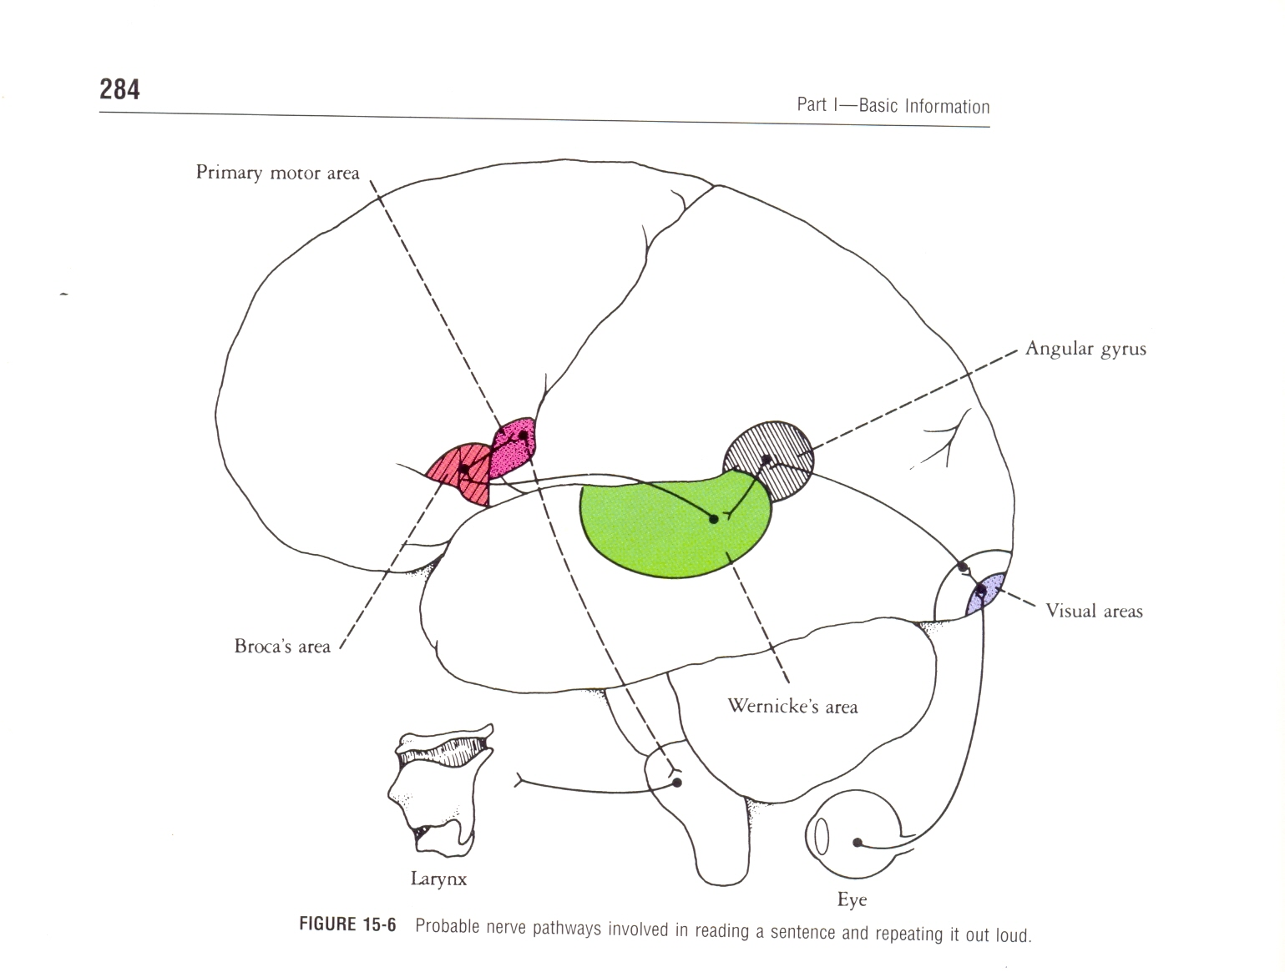
Other Cortical Areas
Taste Area- at lower end of postcentral gyrus( area-43)
Vestibular Area – lies opposite to auditory area
Insula

Slide 23
Association Cortex

Slide 24
CEREBRAL DOMINANCE

Slide 25
APPLIED

