Slide 1
The Pons
Dr Rakesh Ranjan
Assistant Professor
Anatomy Dept
Sri Krishna Medical college, Muz

Slide 2
The Pons
Pons in latin means Bridge
It connects the mid-brain with medulla

Slide 3
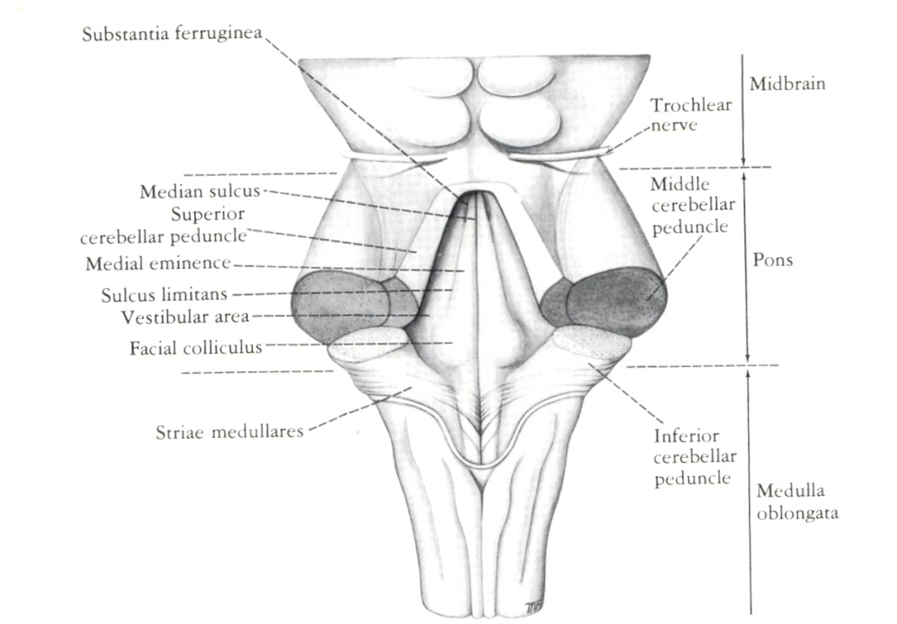
Gross Anatomy
Pons has 2 surfaces
Ventral and dorsal

Slide 4
Ventral surface
Convex in both direction
Transversely running fibres from median plane laterally
Vertical basilar sulcus which lodges the basilar artery
Laterally at junction of pons with middle cerebellar peduncle trigeminal nerve is attached by two roots

Slide 5
Dorsal Surface
Dorsal surface is hidden by cerebellum and forms upper half of the floor of fourth ventricle
Substantia Ferruginea

Slide 6
Internal Structure of The Pons
Pons divided into
Posterior Tegmentum
Anterior Basal

Slide 7
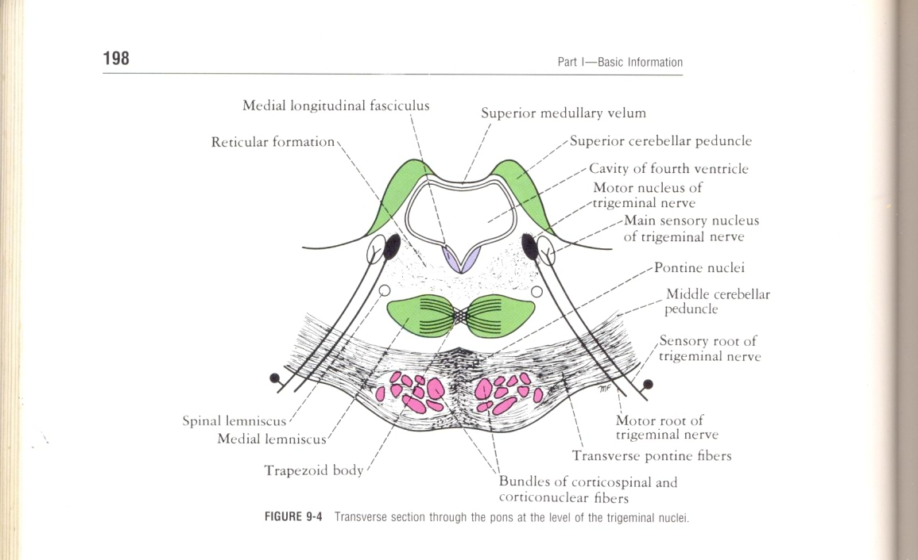
Transverse sections
Through caudal part, passing through the Facial Colliculus
Through Cranial part, passing through the Trigeminal Nuclei

Slide 8
Transverse Section Through the Caudal part(Facial Colliculus)
Medial Lemniscus with Spinal & Lateral Lemniscus
Facial Nucleus
Medial Longitudinal Fasciculus
Medial Vestibular Nucleus

Slide 9
Transverse Section Through the Caudal part(Facial Colliculus)
Spinal Nucleus of Trigeminal
Trapezoid body is made up of fibers derived from the cochlear nuclei & the nuclei of the Trapezoid body.

Slide 10
Internal structure basilar part
Pontine Nuclei
White matter of basilar part longitudinal fibres
cortico-spinal and corticonuclear
Corticopontine fibres
Transverse fibres
Ponto cerebellar

Slide 11
Transverse section Through The Cranial part(Trigeminal Nuclei)
Motor Nucleus of the Trigeminal Nerve
Principal Sensory Nucleus of the Trigeminal Nerve
Superior Cerebellar Peduncle
Trapezoid body
Medial Lemniscus
Lateral & Spinal Lemniscus

Slide 12
Functions
Transit of fibres between higher and lower centres of nervous system
Trigeminal system
Auditory system
Cortico-ponto-cerebellar pathway

Slide 13
Blood supply
Ventral part
Para-median and short circumfrential branches of basilar artery
Anterior inferior cerebellar artery
Superior cerebellar artery

Slide 14
Clinical anatomy
Pontine haemorrhage
Tumor in cerebello pontine angle leads to involvement of choroid plexuses, 7th ,8th nerve and flocculus
Astrocytoma of Pons –
Symptoms & Signs

Slide 15
Tegmentum in the lower part at facial colliculus level
Cranial nerve nuclei
Abducent nerve nucleus
Lies in the median plane on either side
In line with the hypoglossal nucleus below
Forming one of the components of general somatic efferent column

Slide 16
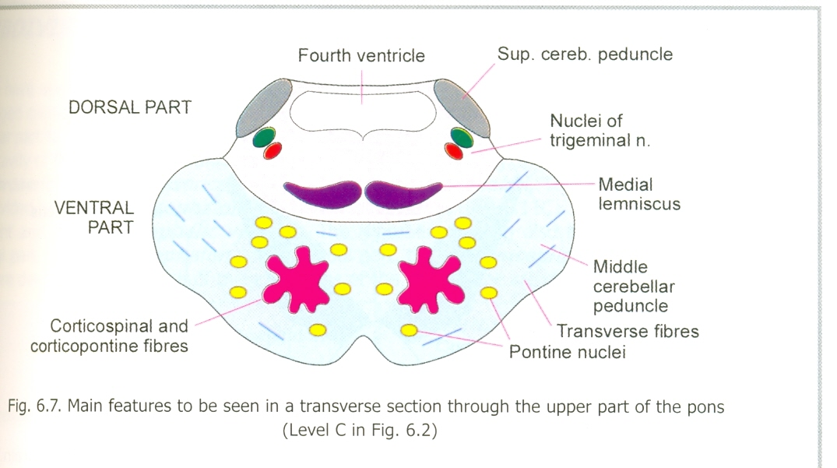
Grey matter of basilar part
Pontine nuclei which lies between longitudinal and transverse fibres
They are the relay pathway for the cortico-ponto-cerebellar fibres
Basilar part is uniform through out its length

Slide 17
Facial nucleus lies in the ventro-lateral part
Dorsal andlateral to it is spinal tract of trigeminal nerve
Fibres arising from the facial nucleus takes an unusual course
First towards lower pole of abducent nucleus then towards its upper pole

Slide 18
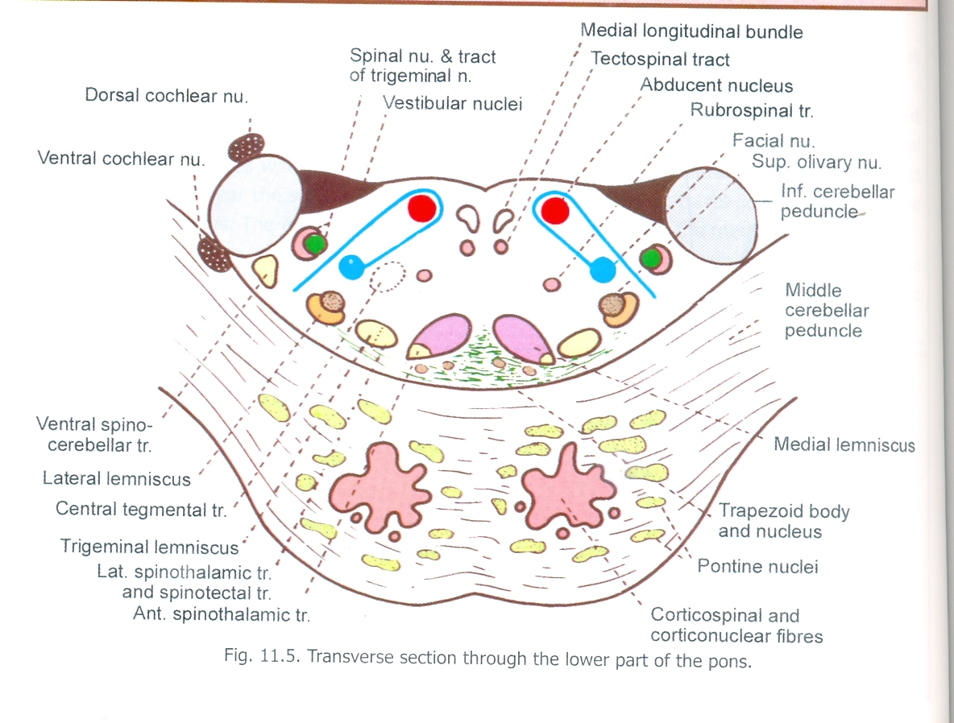
Neurobiotaxis
Facial nerve nucleus migrates towards its sensory source or stimulation [nucleus f spinal tract of trigeminal nerve ] to complete the reflex arc

Slide 19
Vestibular nuclei lie deep to the vestibular area
It has 4 components superior, inferior , medial and lateral
Afferents from the vestibular part of vestibulo-cochlear nerve
Efferents to cerebellum,medial longitudinal bundle,lateral lemniscus and spinal cord

Slide 20
Cochlear nuclei
Dorsal and ventral
Afferents from cochlear nerve
Second neurons from these nuclei decussate and form trapezoid in the lower ponssome from cochlear nucleus end in olivary nucleus

Slide 21
Third neuron from this nuclei are added to the auditory pathway and form the lateral lemniscus
Lacrimatory and saliatory nucleus in the caudal end
Nucleus of spinal tract of trigeminal

Slide 22
White matter
Trapezoid body
Transverse band of fibres from the ventral cochlear nuclei of 2 sides
Nerve cells of the trapezoid body are dorsal and ventral trapezoid nuclei

Slide 23
Emerging fibres of sixth and seventh cranial nerves
Trigeminal lemniscus
Second neuron fibres in the path way of pain and temperature
Medial longitudinal fasciculus close to mid line

Slide 24
Other tracts
Medial to lateral
Medial lemniscus
Trigeminal lemniscus
Spinal lemniscus
Lateral lemniscus

Slide 25
Tegmentum in the upper part of pons
Bounded laterally by superior cerebellar peduncles
Medial to it is main sensory nucleus of 5th nerve
Further medially motor nucleus of 5th nerve
A small part of superior olivary nucleus

Slide 26
White matter
Lateral lemniscus very prominent
Some fibres of trapezoid body
Reticular formation
Medial lemniscus
Medial longitudinal bundle

Slide 27
Functions
Transit of fibres between higher and lower centres of nervous system
Trigeminal system
Auditory system
Cortico-ponto-cerebellar pathway

Slide 28
Blood supply
Para-median and short circumfrential branches of basilar artery
Anterior inferior cerebellar artery
Superior cerebellar artery

Slide 29
Clinical anatomy
Pontine haemorrhage
Tumor in cerebello pontine angle leads to involvement of choroid plexuses, 7th ,8th nerve and flocculus

