Slide 1
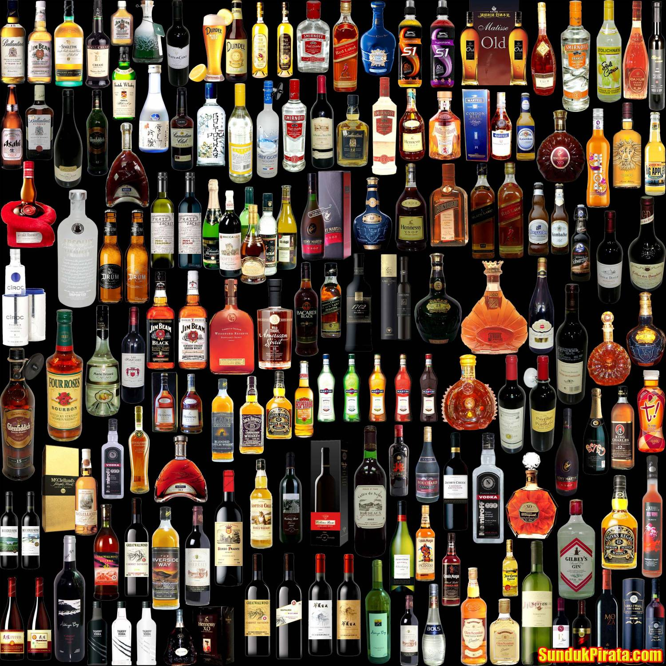

ALCOHOL
DR. KUNAL SHARMA
DEPARTMENT OF PHARMACOLOGY
SKMC MUZAFFARPUR
PART - 1

Slide 2

What is Alcohol?
Hydroxy derivatives of aliphatic hydrocarbons.
Small high polar molecule, nonionized with both lipophilic and hydrophilic characteristics.
Alcohol is manufactured by fermentation process of Sugars → till alcohol content reaches ~ 15%.
Alcohol classified as:
  Monohydroxy : Methanol (methyl alcohol),
  Ethanol (ethyl alcohol).
  Dihydroxy : Ethylene Glycol.
  Trihydroxy : Glycerol (Glycerine).
  Polyhydroxy : Mannitol.
Notes:
AMPIPATHIC NATURE

Slide 3
Alcoholic Beverages
MALTED LIQUORS
  Obtained by fermentation of germinating cereals
  Undistilled alcohol content is low (3–6%)
  Beers, Stout, strong beers (upto 10%)
WINE – 10-15% v/v
  Produced by fermentation of natural sugars as present in grapes and other fruits. These are also undistill-ed. Light wines (9-12%), Fortified wines (16-22%), Effervescent wine ( Champagne 12-16%)
DISTILLED SPIRITS
  Rum, Vodka, Gin, Baijiu, Tequila, Whisky, Brandy, Slivovitz, Soju the alcoholic about 40-55% higher.
Notes:
AMPIPATHIC NATURE

Slide 4
Other forms of Alcohols
Absolute Alcohol
  90% w/w ethanol (dehydrated alcohol)
Rectified spirit
  90% w/w ethyl alcohol produced from fermented mollases, by distillation
Proof spirit
  100% proof spirit = 49.29% w/w alcohol = 57.1% v/v alcohol
  Used as proof of strength of alcohol.
Methylated Spirit
  Called denatured spirit by adding 5 parts of wood naphtha (methyl alcohol) to 95 parts of rectified spirit so as to render it unfit for drinking. It can be applied on the skin for antiseptic, cleaning and astringent purposes.
Notes:
AMPIPATHIC NATURE

Slide 5
PHARMACOKINETICS
ABSORPTION :
Oral cavity, Stomach and small intestine.
Peak blood level occurs in 30 mins after ingestion of alcohol.
First pass metabolism occurs in the liver and stomach by Alcohol dehydrogenase.
Lower blood ethanol levels (BELs) by oral route compared to i.v route.
Notes:
Delay in Gastric emptying slows down ethanol absorption.

Slide 6
FACTORS AFFECTING THE RATE OF ABSORPTION OF ALCOHOL (ETHANOL)
The rate, volume, and concentration of alcohol consumed.
The presence or absence of food in the stomach.
Interaction with medications like drugs interfering with the gastric motility. Delay in Gastric emptying slows down ethanol absorption.

Slide 7
DISTRIBUTION
0.5 - 0.7 L/Kg
Hydrophilic, distributed along the distribution of the total body water.
Distributed in tissues with high water content and more blood supply (Brain, skeletal muscle).
Body composition and gender dependent distribution of the alcohol.
Females have a higher blood alcohol level than male :
  Smaller Lean body mass and blood volume than males.
  Lower first pass metabolism by gastric ADH than males

Slide 8
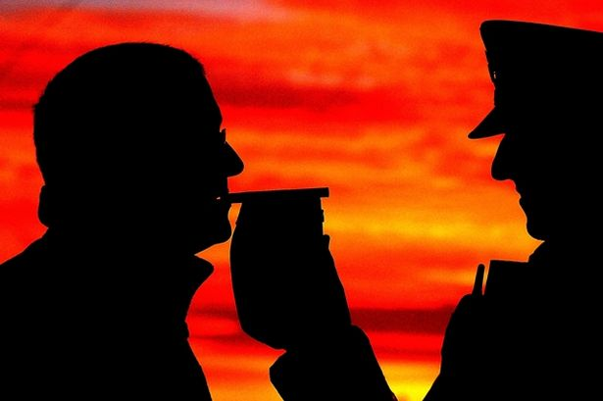
MEDICOLEGAL IMPLICATIONS
Ratio of ethanol in end expiratory alveolar air and the blood is relatively constant.
BELs can be measured in the
expired air.
The partition coefficient for
ethanol between blood and
alveolar air is 2000 : 1.
BELs is dependent on other factors like
  sex, rate of drinking, body weight, rate of metabolism, stomach emptying.
Notes:
Legally allowed BELs typically are set at or below 80 mg%.

Slide 9
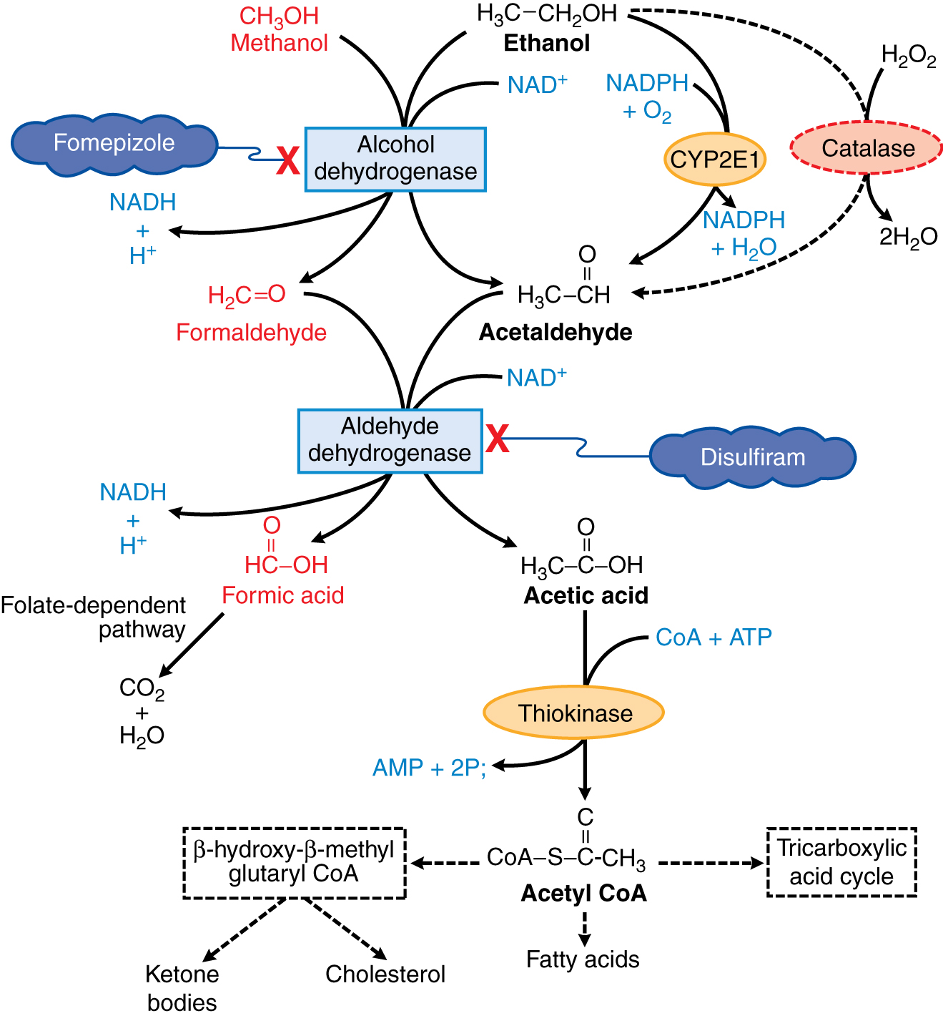
PHARMACOKINETICS
ELIMINATION
Cytosol
RATE LIMITING STEP
Mitochondria
Extra hepatic
90-98%
Notes:
Ethanol is metabolized by sequential hepatic metabolism.The oxidation of one mole of ethanol to one mole to one mole of acetic acid requires 2 moles of NAD.This greatly exceeds the supply of NAD in the liver.Hence the NAD availability limits the metabolism of ethanol by 8gm or 10 ml an hour in a 70kg adult.
Hence hepatic ethanol saturates at relatively low blood level and high BEL level. Ethanol level follows a zero order kinetics
CYP2E1 is induced by chronic consumption of ethanol, increasing the clearance of the substrate and activation of certain toxins like CCL4

Slide 10
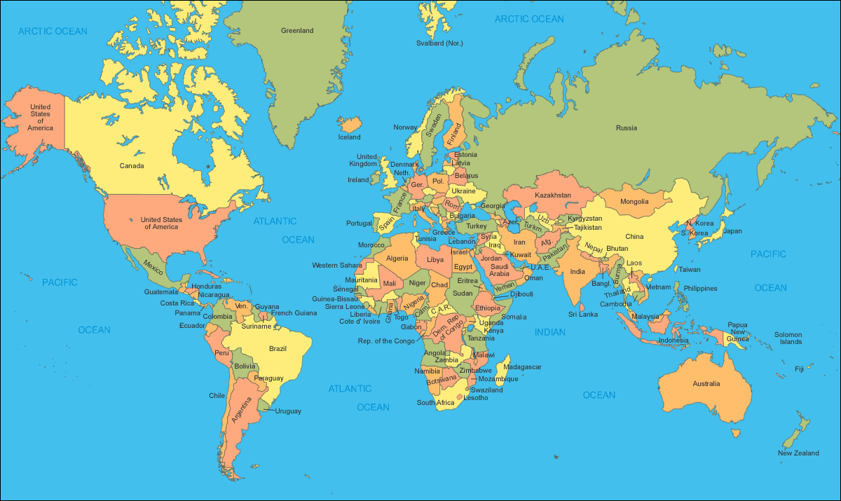
GENETIC FACTORS INFLUENCING METABOLISM OF ALCOHOLS
ADH1B
ALDH-2
ADH1B
ADH1C
ADH1B
ADH1B
ADH1B
ALDH-2

Slide 11
ELIMINATION
Metabolism follows zero order kinetics (8-12ml of absolute alcohol/hour)
98% of alcohol is oxidized in the liver.
<10% escapes metabolism.
Excretion occurs in kidney and lungs
8

Slide 12
PHARMACODYNAMICS
CENTRAL NERVOUS SYSTEM :
UNCONTROLLED MOOD SWINGS
EMOTIONAL OUTBURST/ VIOLENT BEHAVIOUR
SEVERITY
CNS FUNCTIONS GET IMPAIRED
GENERAL ANAESTHESIA
DEATH

Slide 13
CENTRAL NERVOUS SYSTEM
ACUTE ALCOHOLISM
CHRONIC ALCOHOLISM
Ethanol adaptation to acute doses act opposite to chronic doses
Shrinkage of brain; loss of both grey and white matter
Frontal lobe the most sensitive to damage by alcohol.
ROLE OF NEUROTRANSMITTER SYSTEMS :
Acute ethanol intake
-Activation of the dopaminergic pathways
-Increase in synaptic dopamine

Slide 14
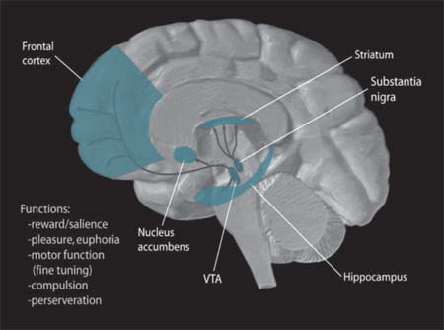
CENTRAL NERVOUS SYSTEM
ROLE OF NEUROTRANSMITTER SYSTEMS :
Acute ethanol intake
-Activation of the dopaminergic pathways
-Increase in synaptic dopamine
-Alteration in the dopamine activity in the ventral tegmental area(VTA) plays a role in euphoria and reward circuits in the brain.
-Dopaminergic activity in the VTA is further augmented by opioid receptors.

Slide 15
CENTRAL NERVOUS SYSTEM
ROLE OF NEUROTRANSMITTER SYSTEMS :
Acute ethanol intake
-Acute ethanol ingestion causes release of β endorphines which act on the μ receptor and increases dopamine release.
-Increase in 5-HT in synaptic space, also plays a role in the dopaminergic systems.
-Activation of cannabinoid receptor affects release of DA, GABA, Glutamate.

Slide 16
CENTRAL NERVOUS SYSTEM
CHRONIC ALCOHOLISM :
Activation of both D2 and D4 receptors hence the desire for alcohol intake and relapse symptoms are higher.
Up-regulation of 5 HT receptors. Higher alcohol intake and lower levels of reaction to alcohol

Slide 17
CENTRAL NERVOUS SYSTEM
ROLE OF NEUROCHEMICAL SYSTEMS :
Alcohol disturbs the balance between the excitatory and inhibitory influences in the brain.
Ethanol has predominant effects on the ligand gated, voltage gated ion channels, and GPCR systems

Slide 18
CENTRAL NERVOUS SYSTEM
ROLE OF NEUROCHEMICAL SYSTEM
Nicotinic Ach receptors :
-Increases Ach and dopamine release.
NMDA receptors :
-Inhibited.
Inhibition of adenosine transport.
Neuronal excitability is reduced by alcohol acting on the voltage gated Ca⁺² channel.

Slide 19
CENTRAL NERVOUS SYSTEM
Alcohol causes the enhancement of GABA and glycine mediated inhibition.
In acute alcoholism there is increase in GABA release, in chronic alcoholism expression of genes impacting on the GABA subunits.
This results in sleepiness, muscle relaxation.
Intoxication is viewed as a GABA rich state while withdrawal as GABA deficiency.

Slide 20
SIGNS AND SYMPTOMS OF ALCOHOLISM
CHRONIC ALCOHOLISM :
Antero-grade amnesia called as Alcoholic blackouts.
Disruption of sleep architecture, nightmares, rapid eye movements
Hangover the next morning
Alcoholic dementia
Thiamine and nutritional deficiencies
Wernicke’s encephalopathy, Korsakoff’s psychosis
Depressive symptoms, suicidal thoughts, panic attacks
Auditory hallucinations, paranoid delusions (3%)

Slide 21
SIGNS AND SYMPTOMS OF ACUTE ALCOHOLISM
Confusion, unpredictable behavior, stupor
Sudden lapse between semi-consciousness and unconsciousness.
Amnesia
Vomiting
Seizure
Respiratory depression(<8 breaths/min)
Cold clammy skin due to insufficient oxygen

Slide 22
ALCOHOL LEVELS AND EFFECT ON CNS
50-100 Mg/dl- Relief of anxiety, sedation, loss of inhibition, impaired judgement.
100-200 mg/dl - Gross drunkenness characteristics like slurred speech, ataxia, mental clouding, impaired motor functions
200-300 mg/dl - Emesis and stupor
300-400 mg/dl – Respiratory and cardiovascular depression , coma
>500mg/dl - Lethal

Slide 23
NEUROTOXICITY
WERNICKE KORSAKOFF SYNDROME
Thiamine deficiency
Symmetric peripheral nerve injury, degenerative changes
Paralysis of external ocular muscles, ataxia, confused state
Progressive in nature
Chronic disabling memory disorder called as Korsakoff’s psychosis.

Slide 24
DEMONSTRATION OF ALCOHOL ON MOTOR DRIVING
BAD JUDGEMENT
INACCURATE CORNERING
TENDENCY TO DRIVE IN THE MIDDLE OF ROAD
DELAYED RECOVERY FROM DAZZLE
LACK OF COLOUR DISCRIMINATION
EXCESSIVE CAUTION
MORE STEERING WHEEL MOVEMENTS
OVERCONFIDENCE
INCREASED DISTRACTABILITY
INABILITY TO DEAL WITH CRISIS
LOSS OF SKILL
ON ALCOHOL
INTAKE
ACCIDENTS

Slide 25
CARDIOVASCULAR SYSTEM
CARDIOVASCULAR SYSTEM :
Ethanol > 3 drinks/day increases the chance of heart disease (10-20 mmol/l)
“French paradox”
Prospective cohort studies have found that persons consuming 1-20gm/day to moderate
21-40gm/day lowered the rate of Angina pectoris ,myocardial infarction, PVD.

Slide 26
CARDIOVASCULAR SYSTEM
THE MECHANISM OF THE CARDIOPROTECTIVE EFFECTS OF ALCOHOL IN LOW DOSES :
Increase in HDL levels, binds to cholesterol and returns it to the liver.
Prevents the accumulation of cholesterol in the arterial wall
Increase in tissue plasminogen, helps in dissolution of clot.
Decrease in fibrinogen levels
Inhibition of platelet activation.

Slide 27
CARDIOVASCULAR SYSTEM
ACUTE ALCOHOL INTAKE
Alcohol raises systolic and diastolic Blood pressure
5-11% prevalence of HTN in alcoholism (MEN > WOMEN)
>30 gms alcohol/day associated with 1.5-2.3 mm rise in diastolic and systolic BP.
Small doses : cutaneous and gastric vasodilation
Moderate doses : causes tachycardia and mild rise in BP
Large doses :Marked fall in BP
Significant myocardial depression (>100mg/dl)

Slide 28
CARDIOVASCULAR SYSTEM
CHRONIC ALCOHOLISM
Cardiac arrhythmias seen with ethanol is
    -Supraventricular tachycardia
    -Atrial fibrillation
    -Atrial flutter
    -Ventricular Tachycardia.
Mechanisms for this arrhythmias are prolongation of QT interval, prolonged ventricular repolarization, sympathetic stimulation.
Patient with chronic alcoholism are resistant to cardioversion, digoxin, and Ca⁺² channel blockers

Slide 29
CARDIOVASCULAR SYSTEM
Cardiomyopathy due to toxic effect of alcohol on cardiac and skeletal muscles.
Decrease in cardiac contractility.
Women at greater risk than men
40-50% of people with alcohol induced cardiomyopathy die within 3-5 years.

Slide 30
CARDIOVASCULAR SYSTEM
STROKE is caused by consumption of more than 40 gm/day of ethanol. (Haemorrhagic and ischaemic stroke)
CAUSES :
  Cardiac arrhythmias and thrombus formation
  High BP and subsequent cerebral artery degeneration
  Acute rise in BP and alteration of cerebral artery tone
  Head trauma

Slide 31
SKELETAL MUSCLES
Decreased muscle strength
Decreased muscle protein synthesis
Muscle fibre damage, muscle atrophy, skeletal myopathy
Investigations in the patient show
  Increase in creatinine kinase
  Reduction of serum carnosinase
  Electro-myo-graphical changes

Slide 32
BODY TEMPERATURE
The person feels warm due to cutaneous and gastric Vasdilatation & increase blood flow to that areas. (Peripheral vasdilataion)
Increased sweating
On large doses the central temperature regulating mechanism becomes depressed
In low temperature this action of alcohol is more pronounced.

Slide 33
GASTROINTESTINAL SYSTEM
Esophagus – Alcohol causes esophageal reflux,
Barrette’s esophagus, traumatic rupture of esophagus.
-Smoking further increases the chances for cancer by 10%
-Cause :
Due to decrease in peristalsis & increased Lower esophageal sphincter pressure

Slide 34
GASTROINTESTINAL SYSTEM
STOMACH :
Beverage containing more than 40% alcohol causes direct toxic effect on the gastric mucosa.
Back diffusion of acid from the gastric lumen into the mucosa, disrupts the gastric mucosal barrier.
Exacerbates acid peptic disorder.
Acute alcohol → gastric erosions and petechial haemorrhage.
Chronic alcoholism → Chronic gastritis
Acts synergistically with H.Pylori - delays healing.

Slide 35
GASTROINTESTINAL SYSTEM
INTESTINE :
Chronic diarrhoea and malabsorption
Rectal fissure and pruritis ani
Cause :
  Structural and functional change in the small intestine.
  Villi gets flattened
  Digestive enzyme levels are decreased
Reversible on abstinence

Slide 36
GASTROINTESTINAL SYSTEM
PANCREAS :
Acute and chronic pancreatitis.
Causes :
Direct toxic metabolic effect of alcohol on pancreatic acinar cells.
Altered permeability of pancreatic epithelial cells
Formation of protein plugs and CaCO₃ stones
Hyperglycemia

Slide 37
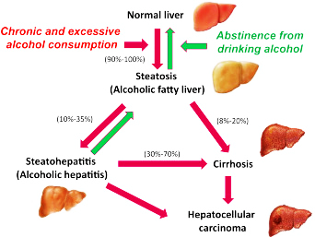
GASTROINTESTINAL SYSTEM
LIVER :
15-30% of alcoholics develop liver disease.

Slide 38
GASTROINTESTINAL SYSTEM
LIVER :
FATTY LIVER HEPATITIS CIRRHOSIS
Hepatic cirrhosis is the end stage liver disease with fibrosis, regenerating hepatocytes not in tune with the blood and biliary system.
Diversion of portal blood causing esophageal varices bleeding.
15-30% of alcoholics develop liver disease.
REVERSIBLE
IRREVERSIBLE

Slide 39
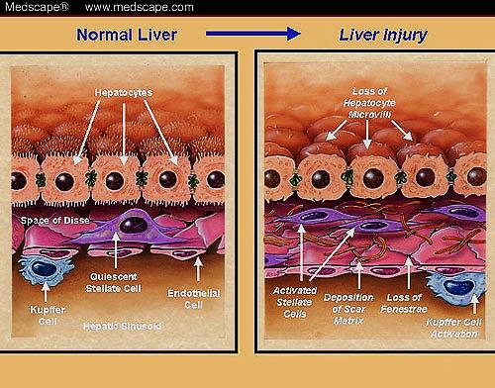
GASTROINTESTINAL SYSTEM
LIVER:
Cause : Due to fatty acid release from adipose tissue & also Impaired fatty acid oxidation → increased oxidative stress, sympathetic discharge

Slide 40
REPRODUCTIVE FUNCTIONS
REPRODUCTIVE ACTIONS : MALE
Impotence seen in 50% of chronic alcoholics.
Testicular atropy
Gynaecomastia (increased response to estrogen and increased metabolism of testosterone).
Cause :Direct toxic effect of alcohol on leydig cells.

Slide 41
REPRODUCTIVE ACTIONS
FEMALE
Loss of libido
Vaginal dryness
Menstrual cycle abnormalities
Ovaries small without follicular development
Fertility rates are lower for alcoholic females
Co-morbid conditions like anorexia nervosa aggravate the problem

Slide 42
HAEMATOLOGICAL AND IMMUNOLOGICAL EFFECTS
Microcytic, macrocytic & sideroblastic anaemias.
Alcohol affects granulocyte and lymphocytes
Leucopenia and decreased immunoglobulin production
Poor resistance to infections like Klebsiella pneumonia, listeria, TB, HIV
Altered function of lymphoid cells and disruption of cytokine regulation

Slide 43
OTHER ACTIONS :
Vitamin and mineral deficiencies
In acute alcoholism alcohol inhibits vasopressin hence diuresis but later the person develops less urine output.

Slide 44
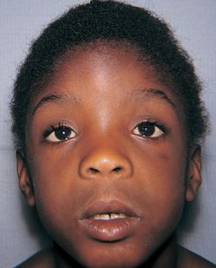
ETHANOL IN PREGNANCY
Incidence 3/1000 live birth
1970,term fetal alcohol syndrome
30% of children born to alcoholic
mother
Alcohol related neuro-developemental disorder. (ARND) [More common]

Slide 45
TOLERANCE AND DEPENDANCE
Tolerance is the reduced behaviour or physiological response to the same dose of ethanol.
Dependence is elicitation of a withdrawal syndrome when alcohol consumption is terminated. It is of two types :
-Physical and psychological
Symptoms
HYPEREXCITABILITY
TOXIC PSYCHOSIS
SEIZURES
DELIRIUM TREMENS

Slide 46
TOLERANCE AND DEPENDENCE
DUE TO :
Change in the synaptic and intracellular signaling
Increase in the NMDA receptor function after the chronic alcoholism phase leading to hyperexcitability and neurotoxicity
Impairment of dopaminergic system and hence increase in alcohol consumption to regain activation
Prefrontal cortex is sensitive to alcohol damage, hence the process of decision making and emotions are compromised in alcoholics

Slide 47
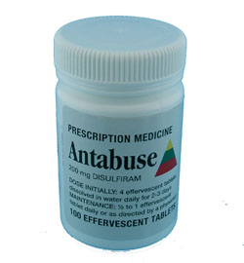
DRUG INTERACTIONS
MEDICATIONS CAUSING DISULFIRAM LIKE REACTIONS
ANALGESICS – Phenacetin
Phenylbutazone
ANTIBIOTICS -
Cefoperazone
Cefotetan
Chloramphenicol
Griseofulvin
Isoniazid
Metronidazole
Nitrofurantoin
Sulfamethoxazole
Sulfisoxazole
CARDIOVASCULAR DRUGS
Isosorbide dinitrate (nitrates) Nitroglycerin
DIABETES MEDICATIONS
Chlorpropamide (sulfonylureas) Glyburide
Tolazamide
Tolbutamide
ANTICOAGULANTS
Warfarin

Slide 48
DRUG INTERACTIONS
PHARMACOKINETIC
ANALGESICS | ASPIRIN ACETAMINOPHEN | Increases gastric emptying Inhibit gastric ADH Alcohol metabolizes acetaminophen into a toxic metabolite causing liver damage Increases ethanol bioavaillability
ANTIBIOTICS | ERYTHROMYCIN ISONIAZID | Increases gastric emptying Enhances isoniazid induced liver toxicity
ANTICONVULSANTS | PHENYTOIN | Alcohol causes phenytoin breakdown Phenytoin induces microsomal enzymes

Slide 49
DRUG INTERACTIONS
ANTICOAGULANTS | WARFARIN | Acute alcoholism decreases warfarin metabolism. Chronic alcoholism increases metabolism of warfarin. Disulfiram reaction
ANTIDIABETIC AGENT | Chlorpropamide Glyburide Glipizide Tolbutamide metformin | Hypoglycemia Chlorpropamide,glyburide ,tolbutamide causes disulfiram like reaction Metformin increases levels of lactic acid in blood after alcohol consumption
BARBITURATES | Phenobarbital | Increase in barbiturate metabolism by cytochrome P450 Enhances sedative, hypnotic effect on CNS

Slide 50
DRUG INTERACTIONS
MUSCLE RELAXANTS | Carisoprodol Cyclobenzaprine | Enhances the impairment of physical abilities and sedation Carisoprodol produces a opiate like” high” when taken with alcohol. Metabolized to meprobamate, abused as street drug
HISTAMINE H2 RECEPTOR ANTAGONIST | Cimetidine Ranitidine | INHIBIT ADH IN THE STOMACH INCREASE GASTRIC EMPTYING
IMMUNE MODULATORS | methotrexate | Liver damage in association with alcohol

Slide 51
DRUG INTERACTIONS
NSAIDS | Ibuprofen Naproxen Diclofenac | Alcohol increases the risk of gastrointestinal bleeding
SEDATIVES AND HYPNOTICS | Chloral hydrate Meprobamate | Alcohol inhibits the metabolism and enhances the sedation, drowsiness
TRICYCLIC ANTIDEPRESSANTS | Amitryptaline Imipramine Desipramine Clomipramine | Enhances the sedation Orthostatic hypotension
VITAMINS | Vitamin A Vitamin D | Vitamin A should be monitered when taken with alcohol to prevent retinol induced hepatoxicity Vitamin D hydroxylation is hampered by the liver damage of alcohol

Slide 52
DRUG INTERACTIONS
PHARMACODYNAMIC
ANTIHISTAMINICS | Diphenhydramine Chlorpheniramine Clemastine Hydroxyzine Promethazine | Enhances the drowsiness, sedation, decreased motor skills. (More in elderly people)
BARBITURATES | Phenobarbital | Enhances sedative, hypnotic effect on CNS
BENZODIAZEPINES | Alprazolam Chlordiazepoxide | Alcohol enhances the effect of these agents on the CNS.
MUSCLE RELAXANTS | Carisoprodol Cyclobenzaprine | Enhances the impairment of physical abilities and sedation
OPIOIDS | Codeine Morphine Propoxyphene , Fentanyl | Enhances the effect like sedation,drowsiness, and decreased motor skills

Slide 53
DRUG INTERACTIONS
PHARMACODYNAMIC
SEDATIVES AND HYPNOTICS | Chloral hydrate Meprobamate | Alcohol inhibits the metabolism and enhances the sedation,drowsiness
TRICYCLIC ANTIDEPRESSANTS | Amitryptaline Imipramine Desipramine Clomipramine | Enhances the sedation Orthostatic hypotension
CORTICOSTEROIDS | Prednisolone Dexamethazone | Aggravate the stomach irritation Psuedo cushing’s syndrome
BRONCHODILATORS | Theophyllin Aminophyllin | Impair mucociliary clearance Increased chance of infection
LIPID LOWERING AGENTS | Atorvastatin | Aggravate liver damage

Slide 54
DRUG INTERACTIONS
PHARMACODYNAMIC
ANTIBIOTICS | SULFONAMIDES | Disulfiram like reaction
MAO INHIBITORS | Moclobemide | Hypertensive crisis
THANK YOU

