Slide 1
Histology of liver

Slide 2
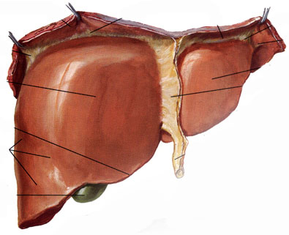
Introduction
Accessory digestive gland
Largest gland (1500gm)
Double blood supply

Slide 3
Gross histological organization
Serous coat
A thin connective tissue capsule- Glisson’s capsule
Lobes and lobules
Porta hepatis- portal vein, hepatic artery, bile duct

Slide 5
Pig liver Vs human liver

Slide 7
Connective tissue- partially surrounds liver lobules
Portal triad

Slide 8
Microscopic organization
Classical liver lobule
Portal lobule
Liver acinus

Slide 10
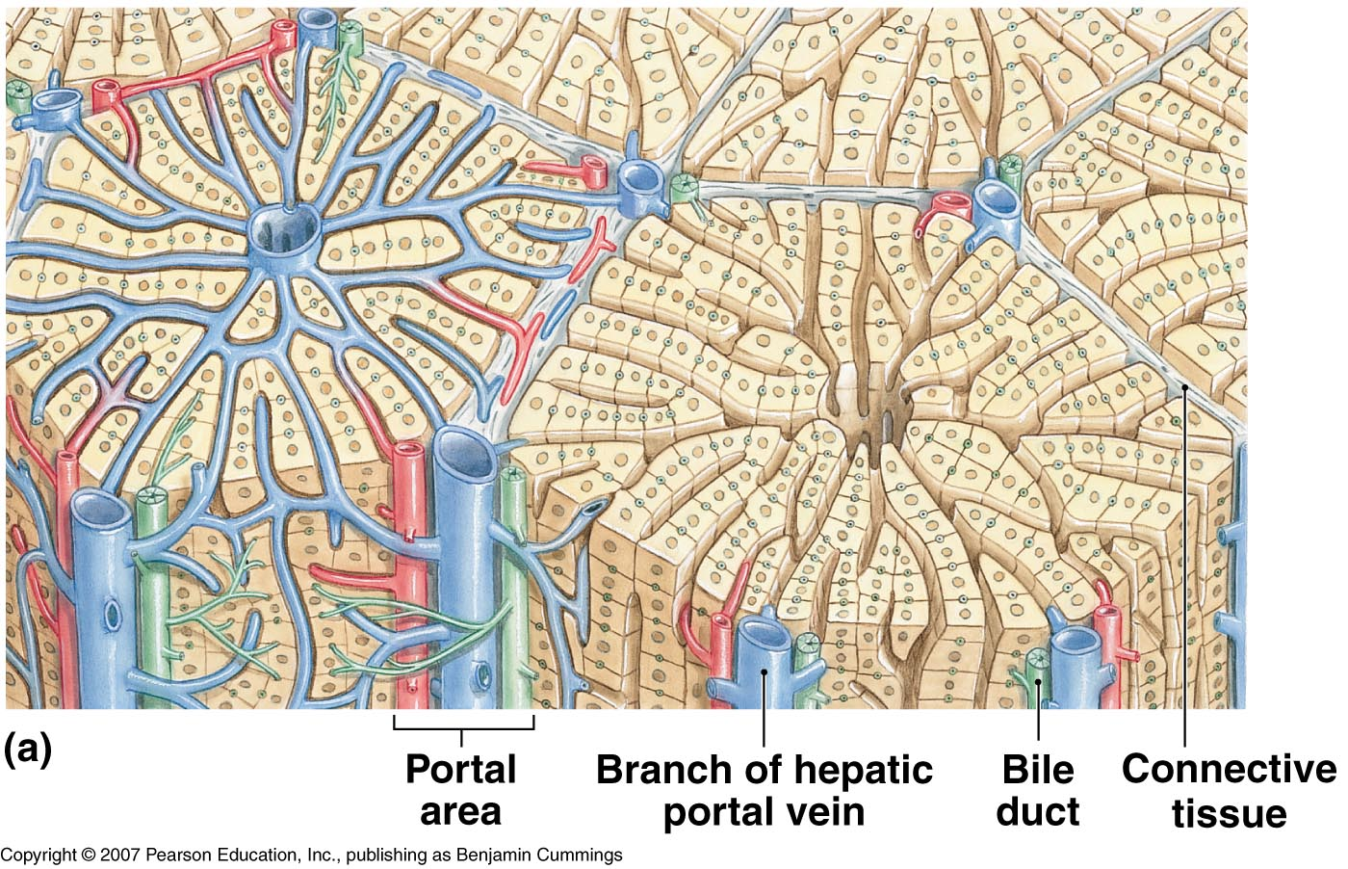
Classical liver lobule
Hexagonal mass of liver cells
Surrounded by interlobular connective tissue septa
Septas – ill defined
At corners- portal triads
In centre- central vein

Slide 11
Arrangement of Hepatocytes-
laminae- one
cell thick
Lacunae-
sinusoids

Slide 12
Liver

Slide 13
Sinusoids
Wider – 9 – 12µm
Blood flow
The lateral branches of the small hepatic artery and portal venules open in sinusoids
Vascular sponge

Slide 15
Lined by
Fenestrated endothelial cells
Kupffer cells
- Phagocytosing cells
Perisinusoidal space-
space of disse
Microvilli
filopodia
Exchange
Ito cells

Slide 16
Space of mall

Slide 17
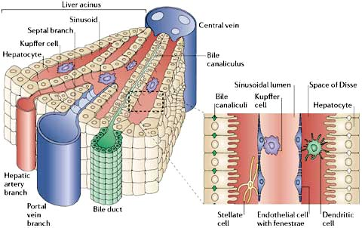
Bile canaliculi-
minute channels
Walls of canaliculus are formed by plasma membrane.
Canals of herring

Slide 18
hepatocytes
Polyhedral - 5-12 sides
20 – 30 µm in width
Constitute 80% of liver volume
Cells form hepatic cords, which may branch and anastomose.
Some sides are exposed to sinusoids, other sides show infoldings – bile canaliculi.
Life span about 5 months and are capable of regeneration.

Slide 19
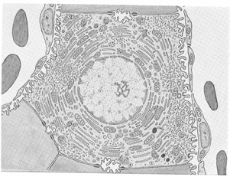
Hepatocyte
Electron microscopic structure

Slide 21
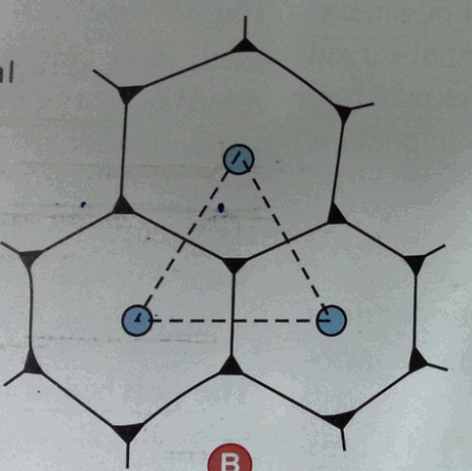
Portal lobule
Triangular area
Nutritional lobule

Slide 22
Liver Acinus of Rapaport
Structural and functional unit
Diamond shaped

Slide 23
3 zones
Zone 1-
Good nutrition
Good oxygenation
Less metabolic waste
Glycogenesis & plasma protein synthesis
Zone 2
Intermediate zone
Zone 3-
Less nutrition
Poor oxygenation
Cytotoxic wastes

Slide 25
Liver - Functions
Processing and storage of food
Bile production & excretion
Synthesis of proteins
Detoxification of lipid soluble drugs
Degradation of hormones
Removal of waste from blood
Storage of vitamins and their Modification

Slide 26
Histology of Pancreas

Slide 27
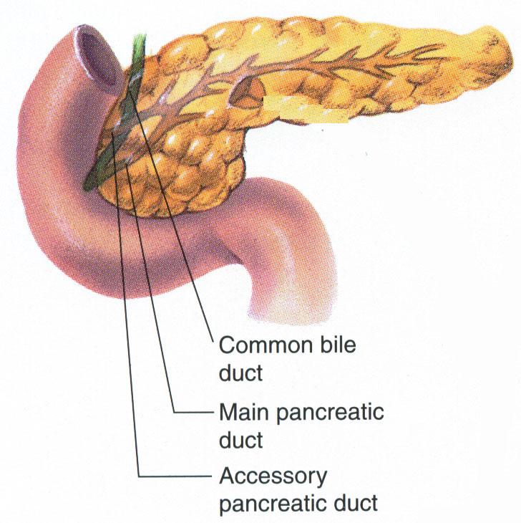
Introduction
Accessory gland of digestion
It is a mixed gland : endocrine and exocrine
The exocrine pancreas secretes pancreatic juice that helps in digestion
Endocrine pancreas secretes hormones which regulates the metabolism of carbohydrates

Slide 28
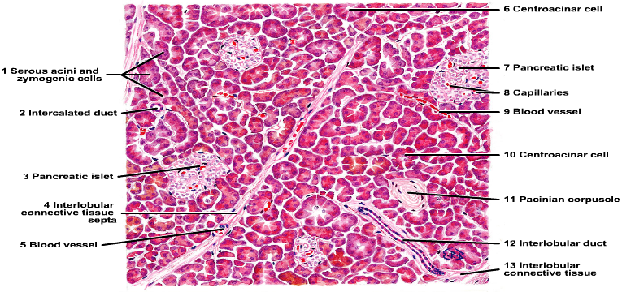
Histology of Pancreas
Exocrine parts shows similar structure as salivary gland
Secretory unit is tubuloacinar in shape
Endocrine unit are called islets of langerhans

Slide 29
Histology of exocrine pancreas
Pancreas is covered with very thin layer of capsule
Thin Septa arises from it and divides the gland into many lobules
Lobules are not very distinct

Slide 31
Pancreatic acini
Acini is serous in nature
Rounded or slightly elongated
Acini is lined by pyramidal cells and have
small lumen
Intercalated duct begins within the acini

Slide 32
Pancreatic Acini

Slide 34
These Secretory granules contains precursors of several digestive enzymes like -
amylase ,
lipase ,
ribonuclease ,
Trypsinogen ,
Chemotrypsinogen etc.

Slide 35
Ducts
Like salivary gland, it has an extensive duct system i.e.,
Intralobular (intercalated )
Interlobular
Main ducts

Slide 36
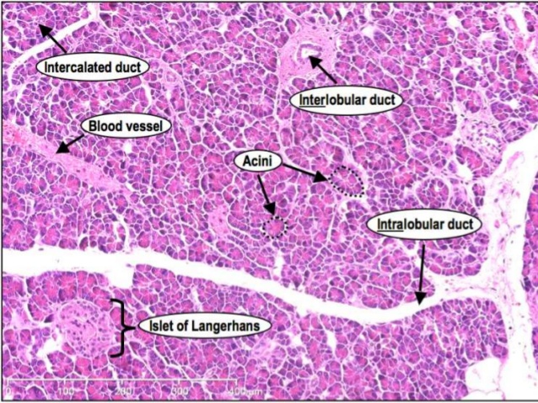
Intralobular duct
Intralobular ducts are also called intercalated
Very small in diameter
Lined by squamous or simple low cuboidal epithelium
Begins in the acinus

Slide 37
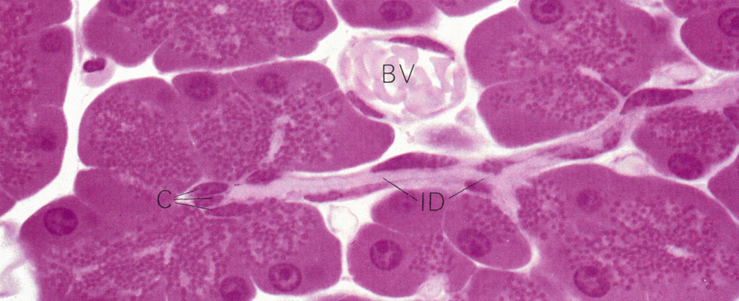
Ends of intercalated ducts are surrounded by the acinus cells
Acinar lumen shows pale staining cells of intercalated ducts these are called centroacinar cells

Slide 38
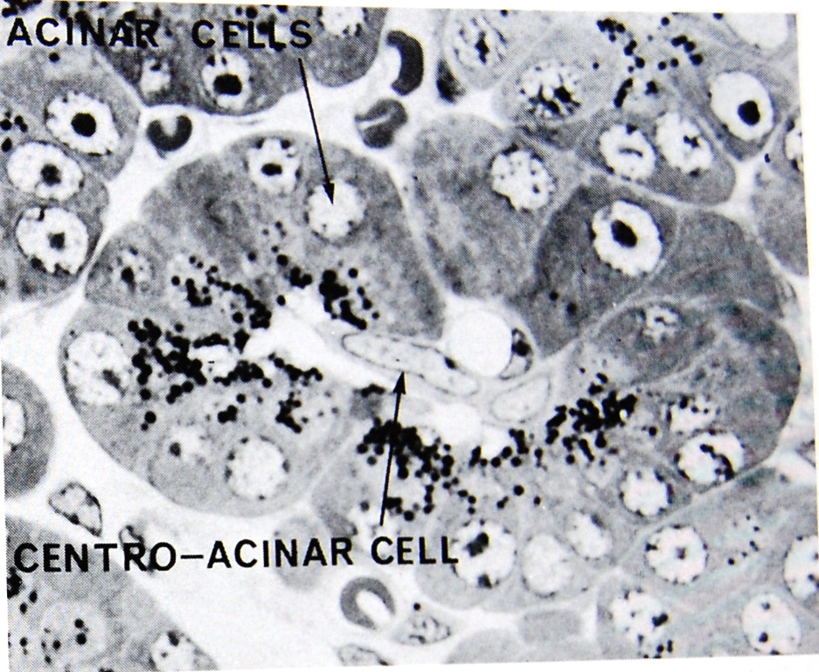

Slide 39
Intercalated duct opens into intralobular collecting ducts which is lined by the cuboidal or low columnar epithelium
Interlobular duct is lined by simple columnar epithelium
Main duct is lined by tall columnar cells

Slide 40
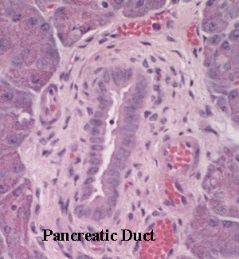

Slide 41
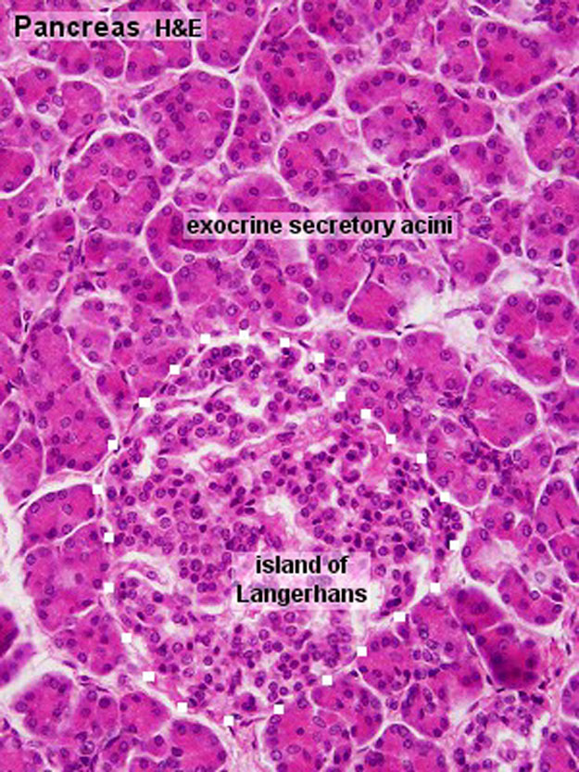
Histology of endocrine part
Endocrine part is in the form of small group of cells (island) scattered among the acini
They are called as ISLETS OF LANGERHANS

Slide 42
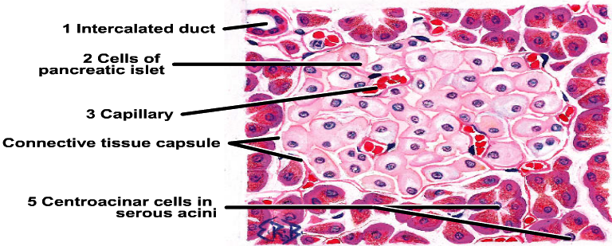

Slide 43
Islets are lightly stained with H&E and can be easily differentiated from acini
Cells of islets are arranged as anastomosing plates or cords and are permeated by rich network of fenestrated capillaries
They pour there secretion directly into blood capillaries

Slide 45
Types of cells in islets
Alpha cells
Beta cells
Delta cells
PP cells or F cells
D-1 cells
Enterochromaffin cells
G cells

Slide 46
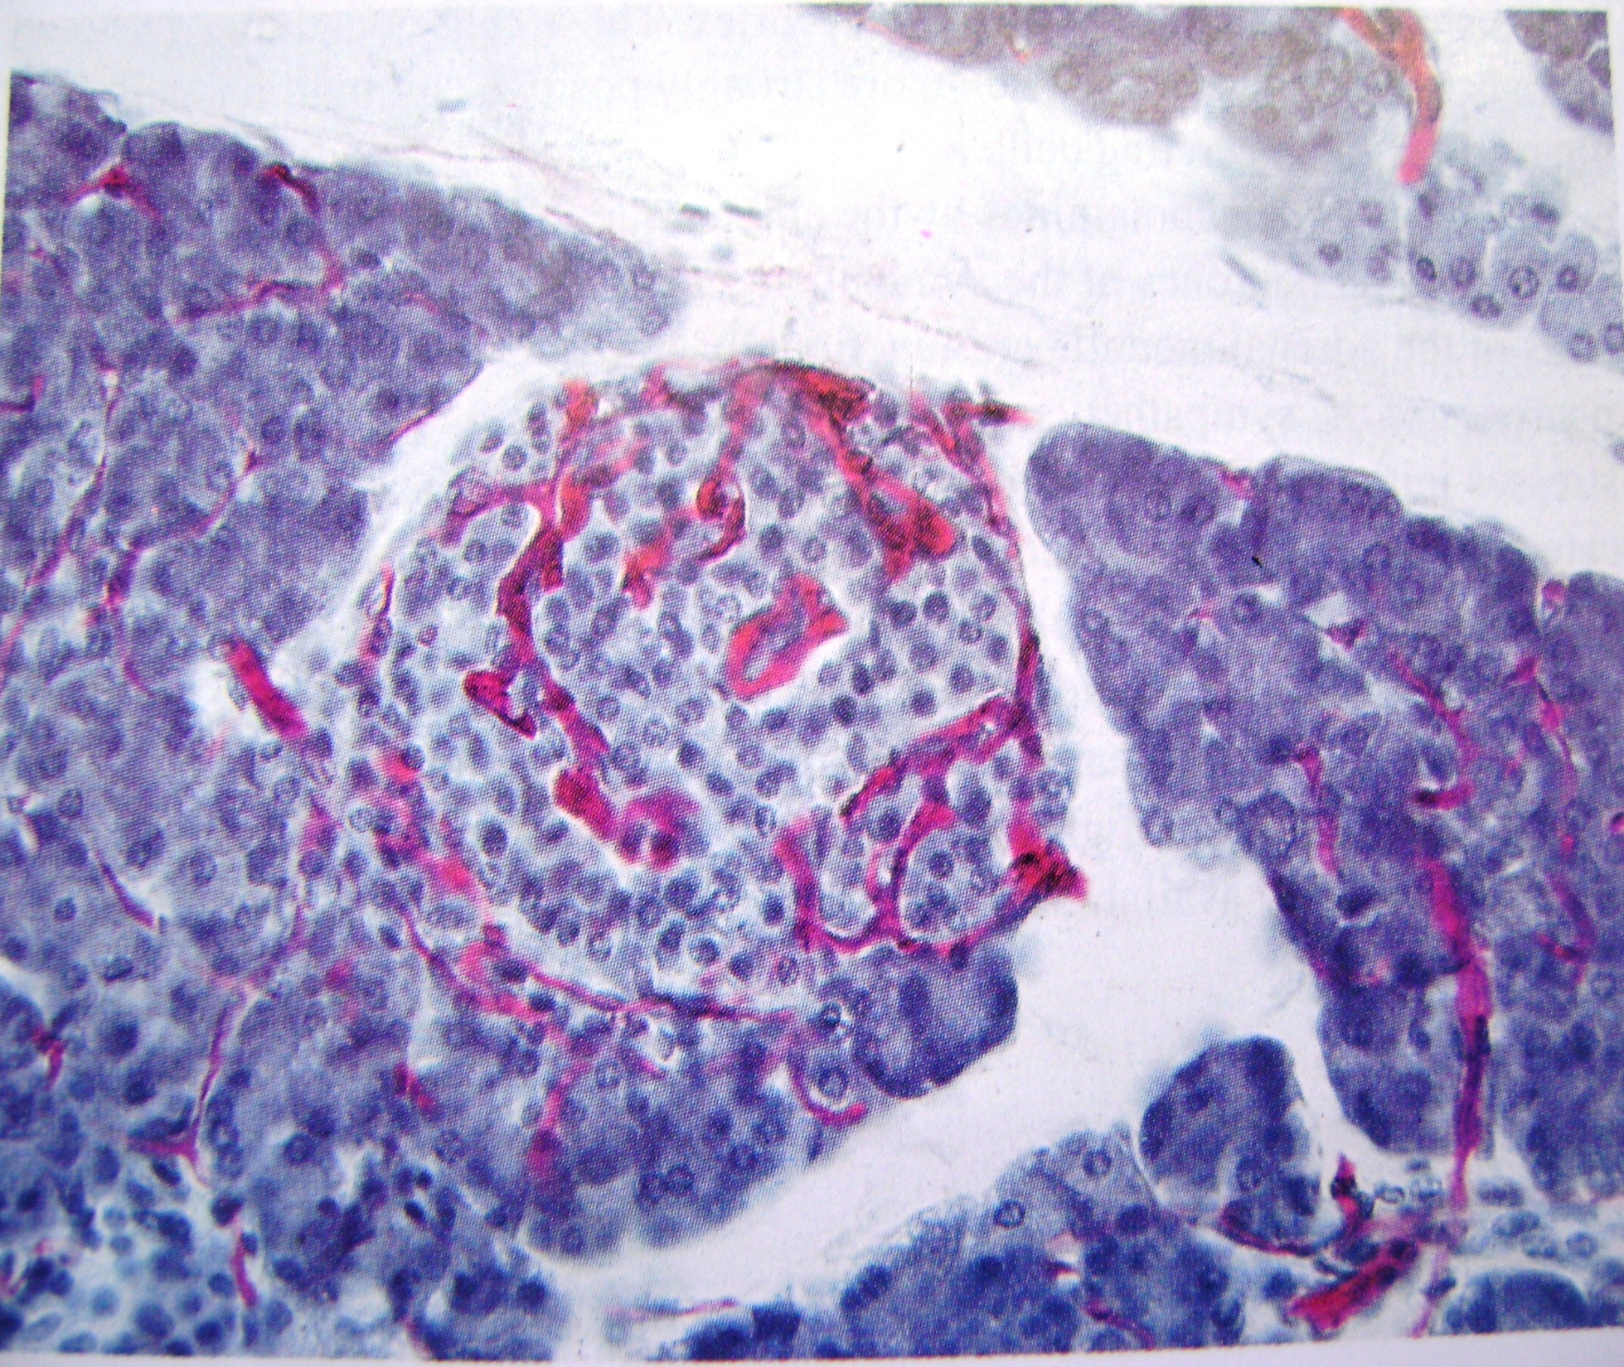
`

Slide 47
Gall bladder
Gall bladder is temporary store house of bile and concentrates it by water re-absorption
It has following layers :
Mucosa
Fibro muscular layer
Serosa

Slide 48
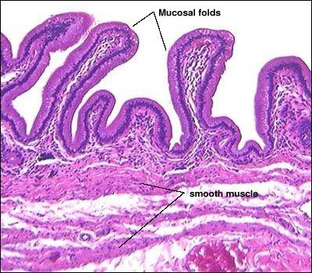
Mucosa
Simple tall columnar epithelium with microvilli.
Mucosa thrown into small folds when empty
Cells have basally placed ovoid nucleus and faintly stained eosinophilic cytoplasm

Slide 49
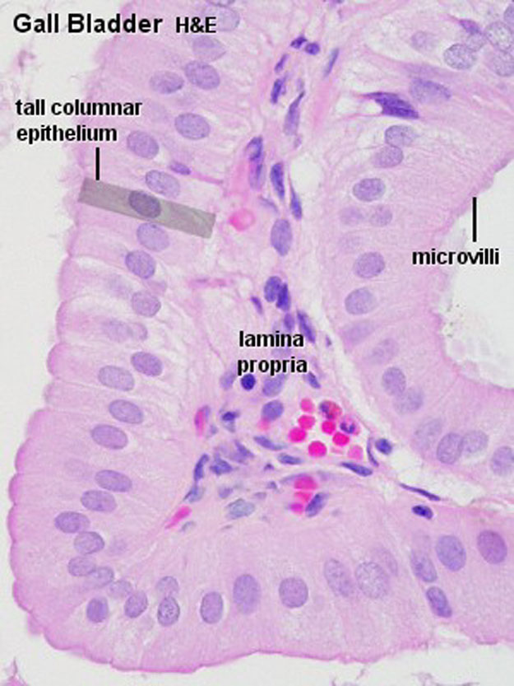
Cells are involved in absorption of water from stored bile
Lamina propria has loose connective tissue
Muscularis mucosa absent
Submucosa absent

Slide 50
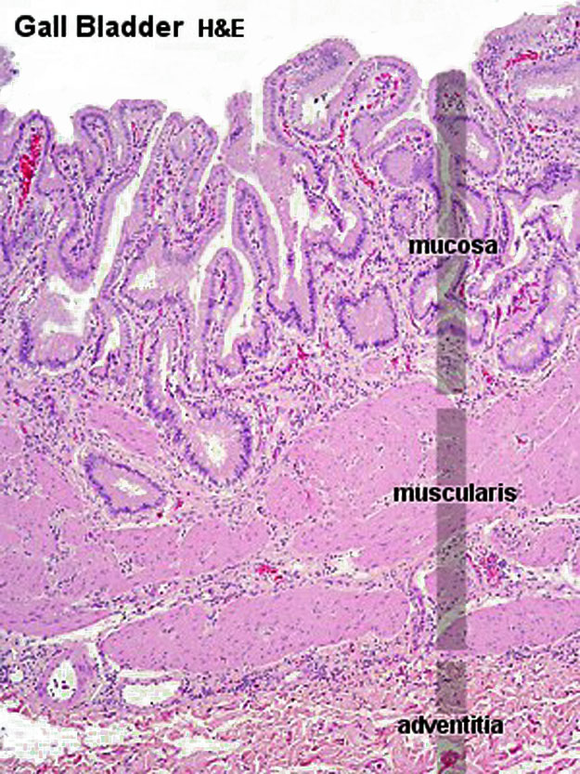
Fibro muscular layer
Randomly arranged smooth muscle fibres
In between muscle fibres are dense connective tissue rich in elastic fibres

Slide 51
Serosa / adventitia
Layer of dense connective tissue with blood vessels , nerve , lymphatics
Inferior surface is covered by serosa rest by adventitia

Slide 52
Histology of liver…….continued

Slide 53
Portal lobule
Triangular area
Nutritional lobule

Slide 54
Liver Acinus of Rapaport
Structural and functional unit
Diamond shaped

Slide 55
3 zones
Zone 1-
Good nutrition
Good oxygenation
Less metabolic waste
Glycogenesis & plasma protein synthesis
Zone 2
Intermediate zone
Zone 3-
Less nutrition
Poor oxygenation
Cytotoxic wastes

Slide 57
Liver - Functions
Processing and storage of food
Bile production & excretion
Synthesis of proteins
Detoxification of lipid soluble drugs
Degradation of hormones
Removal of waste from blood
Storage of vitamins and their Modification

