Slide 1
Digital Locker System
(DigiLocker)
Government of India Initiative
Under Digital India Programme

Slide 2
Need of Digital Locker System
Documents mostly prevalent in physical form, leading to huge administrative overhead
Challenge to residents in submitting multiple physical copies of the documents
Challenge of verifying the authenticity of the documents
To overcome these challenges, Govt. of India has released Beta version of Digital Locker System.

Slide 3
Objectives
Enable digital empowerment of residents by providing them with Digital Locker on the cloud
Enable e-Signing of documents and make them available electronically and online
Minimize the use of physical documents
Ensure Authenticity of the e-documents and thereby eliminating usage of fake documents
Secure access to Govt. issued documents through a web portal and mobile application for residents
Reduce administrative overhead of Govt. departments and agencies and make it easy for the residents to receive services
Anytime, anywhere access to the documents by the resident
Open and interoperable standards based architecture
Architecture to support a well-structured standard document format to support easy sharing of documents across departments and agencies
Ensure privacy and authorized access to residents’ data.

Slide 4
Digital Locker System
Stakeholders
Components
Issuer
Entity issuing e-documents to individuals in a standard format and making them electronically available e.g. CBSE, Registrar Office, Income Tax department, etc.
Requester
Entity requesting secure access to a particular e-document stored in the repository (e.g. University, Passport Office, Regional Transport Office, etc.)
Resident
An individual who uses the Digital Locker service based on Aadhaar and OTP (One Time Password) authentication.
Repository
Collection of e-documents and exposing a standard API for secure real-time access.
Access Gateway
Online mechanism for requesters to access an e-document in a uniform way from various repositories in real-time
Digital Locker
Dedicated personal storage space, linked to each resident’s Aadhaar
To securely store e-documents
To store URI link of e-documents
eSign online service to digitally sign documents
Digital Locker Portal
Digital Locker directory list of registered Issuers, repositories, gateways, policies, guidelines and forms
Dashboard for providing real time transaction volumes of the e-documents accessed

Slide 5
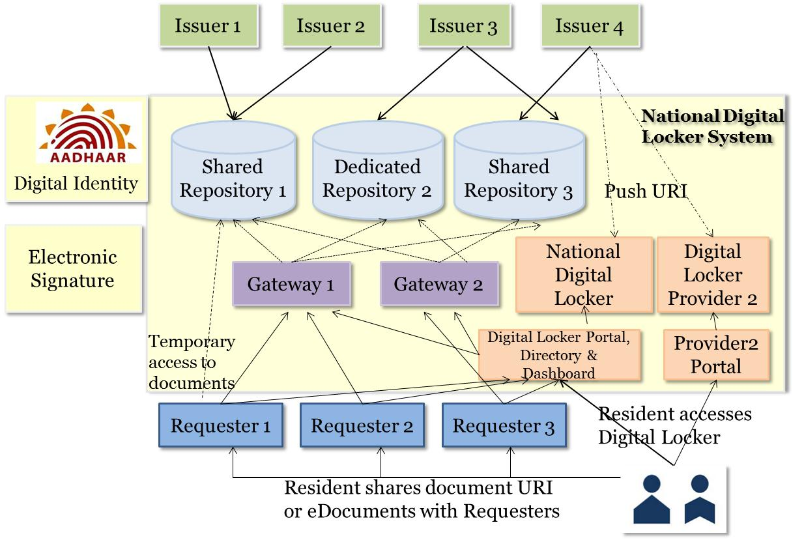
DLTS Architecture

Slide 6
How to Use Digital Locker
For Residents
Aadhaar number and Aadhaar linked mobile number required to sign up for Digital Locker
To login one need to enter the Aadhaar number on the login field.
A One Time Password (OTP) will be sent on UIDAI registered mobile number.
Enter the OTP in the field and an e-Know Your Customer (e-KYC) will be done with UIDAI.
Once e-KYC is successful, residents can view the URIs of e-Documents which have been uploaded into the Digital Locker by various issuers.
Resident can also upload e-documents in their Digital Locker and eSign them.
Residents can share private documents with requesters by sharing a link to the e-Document to the email address of the requester.
For Issuers
An Issuer needs to register on Digital Locker System to get a unique Issuer ID.
Once an ID is assigned, Issuer can upload the documents in a standard XML format in the designated repository using repository service provider API.
Each document uploaded in the repository will have unique URI comprising of Issuer ID, Document Type and Document ID. The document URI will be pushed to the concerned resident’s Digital Locker based on his/her Aadhaar number.
For Requesters
A Requester needs to first register with an access gateway to onboard Digital Locker system.
A Requester can use document URIs to securely retrieve the documents from the repository through an access gateway

Slide 7
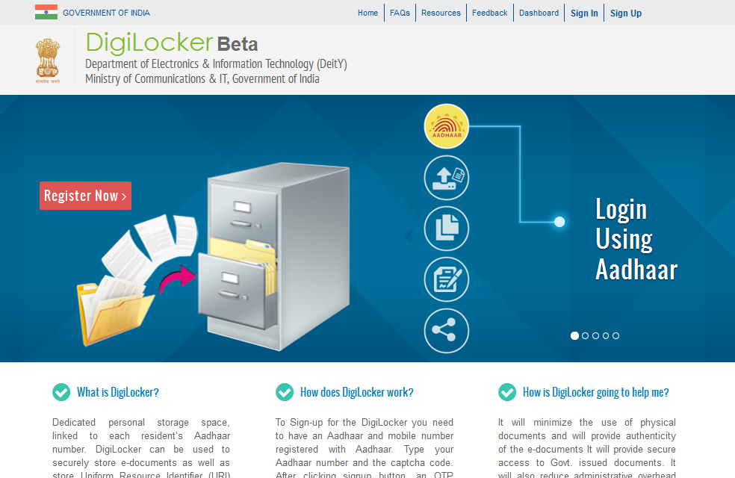
Web Login (https://digitallocker.gov.in) Beta version released on 10th February

Slide 8
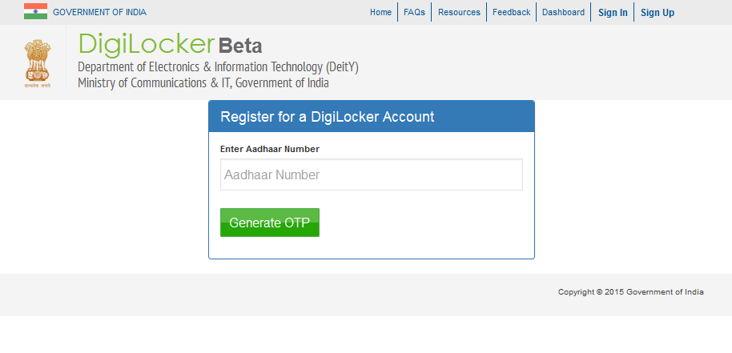
DigiLocker Registration

Slide 9
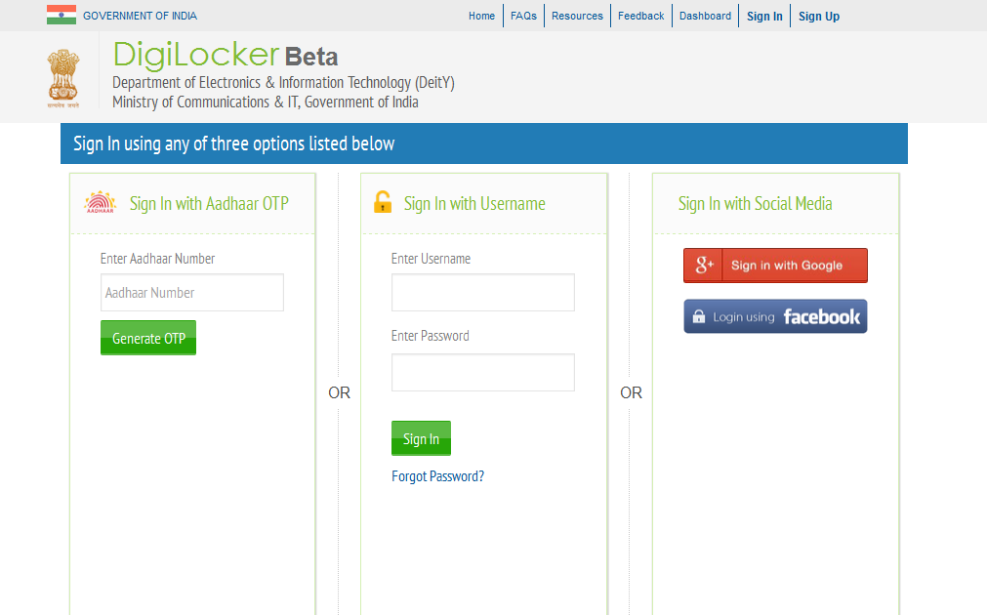
DigiLocker Sign In

Slide 10
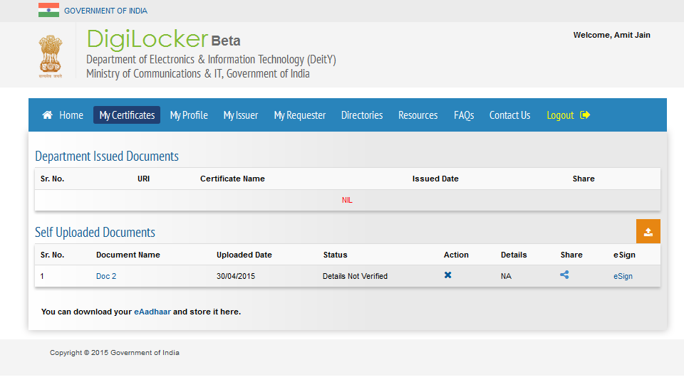
DigiLocker – Documents List

Slide 11
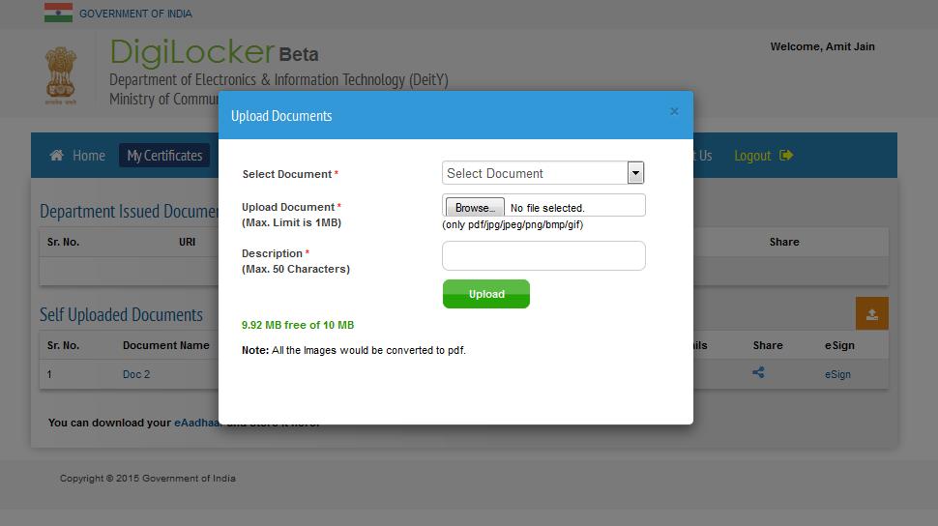
DigiLocker – Upload Documents

Slide 12
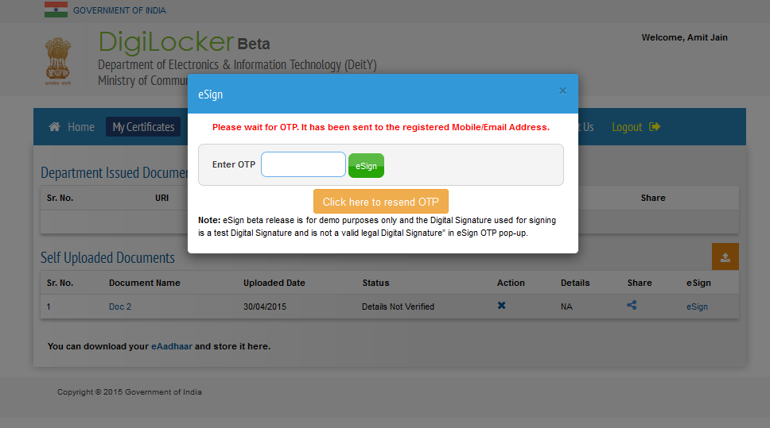
DigiLocker - eSign

Slide 13
Status Update
Activities Underway
Way Forward
DLTS and Digital Locker Implementation Strategy completed & Detailed DLTS specification document is under progress
Beta version released on 10th Feb 2015
e-Sign integration using OTP is completed and is available for test purpose . Implementation of e-Sign with respect to other authentication factors is under progress.
Onboarding of issuer and requester departments
Discussions with multiple Govt. departments to explore their readiness for onboarding on Digital Locker System
National rollout of Digital Locker System
Identification of Govt. agencies and Departments to be on boarded on Digital Locker System
Setup of Apex committee, Core group, Digital Locker Management Office (DLMO) and Programme Management Unit as a part of governance structure
Identification of implementation agency or agencies for architecture, implementation and operations of Digital Locker System
Develop self-sustaining business models for Digital Locker System

Slide 14
THANK YOU

