Slide 1
ANTIVIRAL DRUGS
DR K. K. MISHRA
ASSISTANT PROFESSOR
PHARMACOLOGY
S.K.M.C.H

Slide 2
INTRODUCTION
Viral infections are usually self limiting , but sometimes it may be fatal .
Vidarabine was the first synthetic antiviral agent used .
Viruses are obligate parasite .
The survival of virus outside host is only for very short time.

Slide 3
STRUCTURE OF VIRUS
Viruses are small infecting agent containing nucleic acid either DNA or RNA .
Nucleic acid surrounded by protein called capsid .
Viruses contains enzyme responsible for replication in host cell.

Slide 4
DNA VIRUSES
POX VIRUS – small pox
HERPES VIRUS – herpes simplex , chicken pox
ADENO VIRUS – sore throat , conjunctivitis .
HEPATITIS B VIRUS
PAPILLOMA VIRUS - warts

Slide 5
RNA VIRUSES
INFLUENZA VIRUS
RETRO VIRUS – AIDS
PARAMYXO VIRUS – measles , mumps
ARBO VIRUS – yellow fever , encephalitis
CORONA VIRUS
SARS VIRUS
MERS VIRUS

Slide 6
PROBLEMS IN ANTIVIERAL THERAPY
Obligate intracellular parasite
Area of growth and multiplication
Frequent structural changes in viruses
Latent virus not responding
Alter effect in vitro and in vivo
Drugs are effective during rapid multiplication

Slide 7
LIFE CYCLE OF VIRUS
VIRUS
ATTACHMENT TO HOST CELL
PENETRATION
PACKAGING AND ASSEMBLY
UNCOATING
EARLLY PROTEIN SYNTHESIS
NUCLEIC ACID SYNTHESIS
PROTEIN SYNTHESIS AND PROCESSING
RELEASE OF PROGENY VIRUS

Slide 8
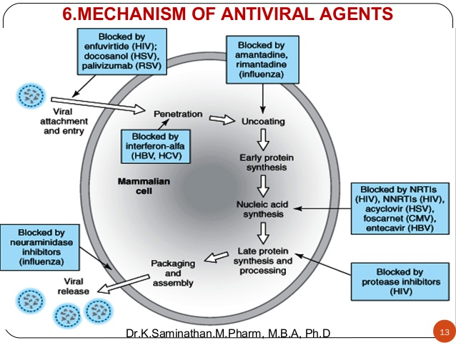

Slide 9
PROPERTIES OF IDEAL ANTI VIRAL DRUGS
Greater selectivity
L0w toxicity to host
In vivo stability
Should kill latent virus as well

Slide 10
CLASSIFICATION OF ANTI VIRALS
A. BASED ON MECHANISM OF ACTION
1. Inhibition of attachment /penetration:- Enfuviritide, Docosanol ,Palivizumab
2. Inhibition of uncoating:- Amantadine, Rimantadine
3. Nucleic acid synthesis inhibitor:- Acyclovir, Ribavirin, Idoxuridine
4. Protease inhibitor:- Ritonavir
5. Inhibition of release of progeny virus:- Oseltamivir, Zanamivir
6. Inhibitors of reverse transcriptase:- Zidovudine, Stavudine
7. Others :- Interferron , Globulin, Monoclonal antibody

Slide 11
CLASSIFICATION OF ANTIVIRALS
B. BASED ON TYPE Of VIRUS:
1. Drugs for Herpes simplex and Varicella zoster:- Acyclovir , Valacyclovir , Famciclovir, Penciclovir , Trifloridine , Foscarnet , Vidarabine , Idoxuridine
2, Drugs for cytomegalo virus :-
cytosine analogue – Cidofovir
guanine analogue – Ganciclovir,
Valganciclovir
others - Foscarnet

Slide 12
CLASSIFICATION Cont.
3. Drugs for influenza : - Amantadine , Rimantadine , Zanamivir , Oseltamivir , Ribavirin
4. Drugs for hepatitis : -
HBV : - Lamivudine , Adefovir , Entecavir ,
Tenovir
HCV : - Ribavirin , Interferon
5. Drug for retro virus : -Zidovudine ,
Stavudine , Lamivudine
6. Others :- Interferons , Globulins , Monoclonal
antibody.

Slide 13
DRUG FOR HSV , VZV
1. ACYCLOVIR
A guanine derivative prodrug 30 times more affinity for viral thymidine kinase .
MECHANISM OF ACTION:-
Acyclovir converted into Acyclovir mono phosphate by viral thymidine kinase .
AMP converted into Acyclovir tri phosphate by host cell enzyme .
ATP inhibits DNA polymerase and lengthening of DNA strand .

Slide 14
ACYCLOVIR cont.
PHARMACOKINETICS: -
t1/2=3 hour
Action last upto 20 h0ur
Oral absorption 20%
Can be used i.v.
Widely distributed in body fluid , csf
Eliminated unchanged in urine

Slide 15
ACYCLOVIR cont.
USES :- A.HERPES SIMPLEX VIRUS:--
1. GENITAL HERPES (primary or recurrent): - treatment = ointment 5% 5 to 6 times daily with oral 400 mg thrice daily
Prophylaxis of recurrent genital herpes = oral 400 mg twice daly to start then gradually reduced to 400 mg once daily for one year.

Slide 16
2. MUCOCUTAEOUS HERPES:- Acyclovir 5mg /kg/dose thirce daily for 7 days
3. KERATOCONJUNCTIVITIS:- eye ointment along with oral drug.
4.HSV MENINGITIS OR ENCEPHALITIS:- dose is 10mg/kg/dose intra venous for 10 days

Slide 17
B.VARICELLA ZOSTER VIRUS:-
1. CHICKEN POX:- *treatment should started within 24 hour of eruption . dose is 800 mg twice daily. *Neonatal varicella infection or in immuno compromised patient i.v. dose is 5 to 10 mg/kg/dose thrice daily for 7 days

Slide 18
2. HERPES ZOSTER:- given in severe cases or immuno compromised patients dose is 800mg 5 times daily . Locally 5% oint. can also be used .
C. PROPHYLACTIC USES:- organ transplant patient or patient taking immuno suppressant drug prevent reactivation of HSV . Dose 200mg thrice daily or 400mg twice daily.

Slide 19
ADVERSE EFFECT: -
Topical – stinging , burning sensation
Oral – headache , nausea , malaise , diarrhoea , effects are mild and well tolerated
Intra venous – rash , sweating , and hypotension
Dose dependent renal ysfunction in form of decrease GFR may occur reversible on discontinuation of drug.
Reversible neurotxicity tremmor delirium convulsion may occur .

Slide 20
2.VALACYCLOVIR
Prodrug , rapidly converted into acyclovir in body
oral bioavailability more than 50%
achieved plasma concn.4 times of acyclovir
USES – More effective than acyclovir for all the indication of it. More effective on CMV.used as prevention of cmv in organ transplant pt.
Dose -500 mg two to three times daily .

Slide 21
PENCICLOVIR
Property similar to acyclovir
Mainly used as 1% cream for herpes labialis in immuno compromised .

Slide 22
FAMCICLOVIR
Pro drug of penciclovir
Used clinically as alternative to acyclovir
Used as alternative to Lamivudine for treatment of HBV infection
Dose- 250mg thrice daily for 5 days

Slide 23
TRIFLURIDINE
Not used oral or iv as equal effect on viral and host DNA so toxic on systemic administration.
Topically used for kerato conjunctivitis caused by HSV-1 .

