Slide 1
HISTOLOGICAL ASPECTS OF SPLEEN
DR BINOD KUMAR
ASSOCIATE PROFESSOR
& HOD
ANATOMY DEPARTMENT
SRI KRISHNA MEDICAL COLLEGE
MUZAFFARPUR

Slide 2
SPLEEN
General features :-
Largest lymphoid organ of the body present in upper left quadrant of abdominal cavity.
Blood-forming organ in foetal life and blood-destroying organ in post natal life (so also known as graveyard of RBCs).
Only lymphatic organ which does not filter the lymph but it filters blood from blood-borne antigens and microorganisms.
Except at the hilum, the surface of the spleen is covered by a layer of peritoneum. Deep to the serous layer the organ is covered by a capsule

Slide 3
Components :-
1. Connective tissue frame work –
(i) Capsule –
> covers the spleen completely under the serous layer.
> formed by dense collagenous connective tissue and few smooth muscle fibres. (In some mammals it contain much smooth muscle fibres and contraction of these muscle fibres causes pumping of blood from the spleen into the circulation so spleen act as reservoir of blood).

Slide 4
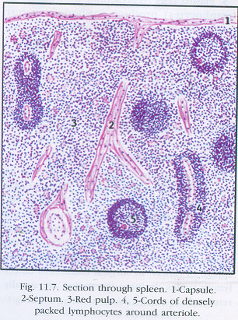
(b) Trabeculae –
> given off from the capsule into the substance of spleen.
> they are thick and carry trabecular vessels which are branches of splenic vessels.
(c) Reticular stroma –
> made of reticular fibres and associated phagocytic reticular cells, forming a meshwork and supports the cells of parenchyma.
2. Parenchyma –
> With the naked eye examinaion, the interior of spleen shows rounded white areas known as White pulp, surrounded by red matrix known as Red pulp.

Slide 6
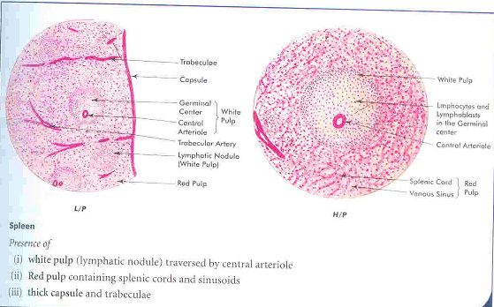
White Pulp –
> It is made of aggregation of lymphoid tissue around a arteriole. The arteriole is a branch of trabecular artery that leaves the trabeculum and enters the pulp.
> There is cord like aggregation of lymphocytes that follow the branching pattern of the arterioles.
> At places cords are thicker and contain lymphatic nodules (as seen in lymph nodes) called as malpighian bodies.
> Each nodule has a
germinal centre and a
surrounding cuff of
densely packed
lymphocytes.

Slide 7
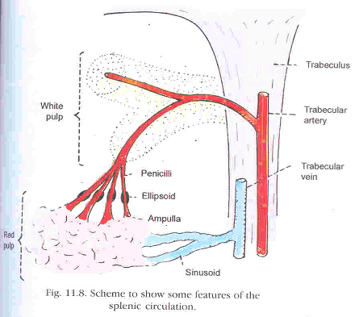
The nodules are easily distinguished from those of lymph node because of the presence of an arteriole in each of them.
The arteriole is placed eccentrically at the margin of the germinal centre (still called the central artery).
Most of the lymphocytes in white pulp are T-lymphocytes while lymphatic nodule of the white pulp are aggregations of B-lymphocytes.
The arterioles (central artery) leave the lymphatic sheath of white pulp and enters the red pulp where it divides to form straight penicillar arterioles.
Some of the penicillar arterioles may show thickening of the wall due to aggregation of macrophages, reticular cells and lymphoid cells known as ellipsoids.

Slide 8
The pencilli terminate as arterial capillaries that open into sinusoids of red pulp.
The white pulp are surrounded by an immunological active zone containing many macrophages, few T-lymphocytes and blood sinuses. This functional zone between the white and red pulp is called marginal zone.
Red pulp –
Red pulp is a modified lymphoid tissue, heavily infiltrated with all type of blood cells giving a dark red colour to the tissue.
It is composed of cells arranged as a cord known as splenic cord of Billroth and broad splenic venous sinuses in between the cords.

Slide 9
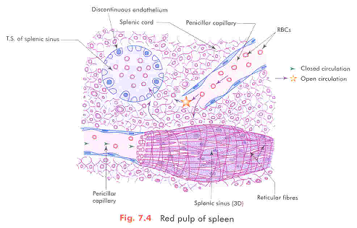
The splenic cord consists of spongy network of reticular fibres infiltrated with reticular cells, lymphocytes, macrophages, plasma cells and all elements of the circulating blood.
The splenic venous sinuses are lined by spindle shaped endothelial cells which lie parallel to long axis of the sinuses on a discontinuous basement membrane.
The structure of the venous sinuses can be compared to tall wooden barrels with both end open and the

Slide 10
the endothelial cells being represented by the wooden staves, hence are described as stave cells.
Externally the sinuses are encircled by reticular fibres in a transverse direction like the steel bands holding together the staves of the wooden barrel.
Since the spaces between endothelial cells of the splenic sinuses are 2-3 µm in diameter, only the flexible cells are able to pass easily to and from the cord and sinuses. After 120 days there is reduction of flexibility of erythrocytes and so can’t pass through and destroyed by macrophages present in the cord.

Slide 11
Splenic circulation –
Enter the spleen through hilum Splenic artery divides into branches (about five) Each divides and subdivides and run along the trabecular network
Leave the trabeculum and loose their adventitia to enter the reticulum of the spleen Enter the white pulp and is surrounded by a dense sheath of lymphocytes The arteriole then divides into a number of straight vessels called penicilli Each penicilli is surrounded by reticuloendothelial cells and macrophages giving the artery an ellipsoid outline called the ellipsoids Divide into precapillary arteriole Open into sinusoids Veins in the trabeculae Splenic vein.
This is called the closed theory of splenic circulation.

Slide 12
About 90% of the blood passes through very rapidly, (in a few seconds), in a closed circulation through a capillary bed.
Open theory of splenic circulation – According to this theory, blood passes from the arterial capillaries of penicilli into cords of Billroth and from there into the sinuses through the spaces between endothelial cells. In this process the nonflexible old erythrocytes are retained in the cord and are engulfed by macrophages
About 9.6% of the blood takes minutes, and a small amount (1.6%) takes an hour or more.
Some says that both type of circulation take place in the spleen. This is called the Compromise theory of splenic circulation.

Slide 14
Functions of the Spleen –
Phagocytoses, immune responses, cytopoiesis, and blood storage.
In the fetus it is an important site of haemopoiesis.
Postnatally it may become haemopoietic in certain pathological conditions.
It is not absolutely essential organ of the body as its functions can be performed by the liver and by other lymphoid tissue, if the spleen is removed.
In patients suffering from diseases like malaria and other hemolytic diseases, which involve chronic breakdown of erythrocytes, the splenic tissues may be permanently hypertrophied and the spleen greatly enlarged called as splenomegaly.

