Slide 1
Malaria
Dr. Vijay Kumar Yadawa
Tutor
Community Medicine
S.K.M.C, Muzaffarpur

Slide 2
Introduction
Malaria is a protozoal disease caused by infection with parasites of the genus plasmodium and transmitted to man by certain species of infected female Anopheline mosquito.
A typical attack comprises three distinct stages:
Cold stage
Hot stage
Sweating stage
The clinical feature of malaria vary from mild to severe, and complicated according to:
Species of parasite present
The patient’s state of immunity
The intensity of the infection

Slide 3
Problem statement
WORLD:
In 2015, there were 214 million cases of malaria with 438,000 deaths.
Between 2000-2015, malaria incidence among population at risk decreased by 37% globally; during the same period malaria mortality rates among population at risk decreased by 60%.
Approximately half of the world’s population is at the risk of malaria.
Most malaria cases and deaths occur in sub-Saharan Africa. However, Asia, Latin America and parts of Europe are also affected.
Malaria affects mainly poor, underserved and marginalized population in remote area which are characterized by inadequate control measure and limited access to health care.

Slide 4
INDIA
In India, about 21.98% population lives in malaria high transmission(≥ 1 case/1000 population) areas and about 67% in low transmission(0-1 case/1000 population) area.
About 91% of malaria cases and 99% of deaths due to malaria is reported from North- eastern states, Chhattisgarh, Jharkhand, MP, Odisha, Andhra- Pradesh, Maharashtra, Gujarat, Rajasthan, West Bengal and Karnataka.
During the period 2000 to 2015, cases declined by 44% from 2.03 million to 1.13 million and death declined by 69% from 932 to 287 annually.
The Pf percentage remained around 50% from 2000 to 2013, but rose to 65.6% in 2014 and 67.1% in 2015, contributed by increased Pf detection by widespread use of RDTs by trained ASHAs.
India is predominantly characterized by unstable malaria transmission. Transmission is seasonal with increased intensity related to rains.

Slide 5
Epidemiological type of malaria in India
Tribal Malaria
Rural Malaria
Urban Malaria
Malaria in project areas
Border Malaria
Forest Malaria
Floods and Malaria

Slide 6
Epidemiological determinants
Agent Factors
1) AGENT:
Malaria in man is caused by four distinct species of the malaria parasites:-
Plasmodium Vivax
Plasmodium Falciparum
Plasmodium Malariae
Plasmodium Ovale
Plasmodium vivax has the widest geographic distribution throughout the world.
In India, about 50% of the infections are reported to be due to P. falciparum, 4-8% are due to mixed infection and rest are due to P. vivax.
Plasmodium Malariae has a restricted distribution and said to be responsible for less than 1% of infection in India

Slide 7
Life history
The malaria parasite undergoes 2 cycles of development:
The human cycle( asexual cycle )
The mosquito cycle( sexual cycle )
Man – Intermediate host
Mosquito- Definitive host

Slide 8
Human cycle(Asexual cycle)
The asexual cycle begins when an infected mosquito bites a person and injects sporozoites.
There are four phases in human cycle:
1. Pre-erythrocytic schizogony
2. Erythrocytic Schizogony
3 .Gametogony
4 .Exo-erythrocytic schizogony

Slide 9
Pre erythrocytic cycle:
Sprozoites undergo developmental phase in the liver cell
Multiple nuclear divisions develop to Schizonts
A Schizont contains 20,000 – 50,000 merozoites
A single P. falciparum sporozoites may form as many as 40,000 merozoites, whereas sporozoites from other species of plasmodium produces only 2,000 to 15,000 merozoites.
Period of Pre erythrocytic cycle:
P.vivax: 8 days
P.falciparum: 6 days
P.malariae:13-16 days,
P.ovale: 9 days
On maturation, Liver cells ruputure and Liberate Merozoites into blood stream

Slide 10
Erythrocytic cycle:
Merozoites released in the blood stream invade red cells through receptor present on RBC and pass through the stages of trophozoite and schizont.
The erythrocytic phase ends with the liberation of merozoites, which infect fresh red blood cells. The cycle is repeated over and over again until it is slowed down by the immune response of the host.
Duration of erythrocytic cycle:
48 hours: P. falciparum, P. vivax, P. ovale
72 hours: P. malariae
P. vivax : infects young erythrocytes
P. malariae: Infects old erythrocytes
P. falciparum: infects RBC of all ages

Slide 11
Exo-erythrocytic (tissue) phase:
P. malariae or P. falciparum sporozoites do not form hypnotizes, develop directly into pre-erythrocytic schizonts in the liver
In the case of P. falciparum, the intrahepatic Schizonts rupture almost simultaneously and there is no persistent tissue phase, releasing merozoites which invade red blood cells (RBC) in liver
On the contrary, the intrahepatic schizonts of the other plasmodia do not burst all at same time
Some hepatic form persist and remain dormant in the hepatocytes for considerable periods before they begin to grow and undergo pre-erythrocytic schizogony, thus liberating merozoites into the blood stream causing relapses of the infections

Slide 12
Gametogony:
In all species of malaria, some Merozoites do not divide and differentiate into Male and female gametocytes
They develop in the red cells
Found in the peripheral blood smears
Microgametocyte of all species are similar in size
Macro gametocytes are larger in size.
These are the sexual forms of the parasite which are infective to mosquito.

Slide 14
Mosquito cycle(sexual cycle)
Sexual cycle will be initiated in the Humans by the formation of Gametocytes
Develop further in the female Anopheles Mosquito
Fertilization occurs when a Microgametocyte penetrate into Macro gametocyte
Zygote is formed which is at first a motionless body, but within 18-24 hours, it becomes motile. This is known as Ookinete.
Ookinete penetrates the stomach wall of the mosquito and develops into an Oocyst on the outer surface of the stomach
The Oocyst grows rapidly and develops within it numerous sporozoites. When mature, the oocyst burst and liberates sporozoites into the body cavity
Many of the sporozoites migrates to the salivery gland of the mosquito , and the mosquito now becomes infective to man

Slide 15
2) RESERVOIR OF INFECTION:
A human reservoir is one who harbours the sexual forms
(gametocyte) of the parasites. Certain conditions must be met before a person can serve as a reservoir:
The person must harbour both sexes of the gametocyte in his blood
The gametocytes must be mature; immature forms do not undergo further development
The gametocytes must be viable
The gametocytes must be present in sufficient density to infect mosquitoes

Slide 16
3) PERIOD OF COMMUNUCABILITY:
Malaria is communicable as long as mature, viable gametocytes exit in the circulating blood in sufficient density to infect vector mosquitoes.
In vivax infections, gametocytes appear in blood 4-5 days after the appearance of the asexual parasites.
In falciparum infections, they do not appear until 10-12 days after the first appearance of asexual parasites.
Gametocytes are the most numerous during the early stages of the infection when their density may exceed 1,000 per cubic mm of blood.

Slide 17
Host factors
1) AGE: malaria affects all ages
2) SEX: Males are more frequently exposed to the risk of acquiring malaria than females because of the outdoor life they lead
3) RACE:
Individuals with AS haemoglobin(sickle-cell trait) have a milder illness with falciparum infection than do those with normal(AA) haemoglobin
Person whose red blood cells are “ Duffy negative” ( a genetic trait) are resistant to p. vivax infection
4) PREGNANCY: Pregnancy increases the risk of malaria in women. Malaria during pregnancy may cause intrauterine death of the foetus
5) SOCIO-ECONOMIC DEVELOPMENT: Malaria more common in low socio-economic groups

Slide 18
6) HOUSING: The ill-ventilated and ill-lighted houses provide ideal indoor resting places for mosquitoes
7) POPULATION MOBILITY:
People migrate from one reason or other from one country to another or from one part of a country to another
They may import malaria parasites in their blood and reintroduce malaria into area where has been controlled or eliminated
8)OCCUPATION: Malaria is predominantly a rural disease and is closely related to agriculture practices
9)HUMAN HABITS: Sleeping out of doors,nomadism, refusal to accept spraying of houses, not using measure of personal protection(e.g. bed nets)
10)IMMUNITY: The epidemic of malaria is influenced by the immune status of the population

Slide 19
Environmental factors
SEASON: The maximum prevalence is from July to November
TEMPERATURE: The optimum temperature for the development of the malaria parasite in the insect vector is between 20 to 30 deg.C.
HUMIDITY: A relative humidity of 60% is considered necessary for mosquitoes to live their normal span of life
RAINFALL: Rain in general provides opportunities for the breeding of mosquitoes and may give rise to epidemics of malaria.
ALTITUDE: Anophelines are not found at altitudes above 2000-2500 metres, due to unfavourable climatic condition
MAN-MADE MALARIA: Burrow pits, garden pools,irrigation channels and engineering project like construction of hydroelectric dams, roads, bridges have led to the breeding of mosquitoes and an increase in malaria.

Slide 20
Vector of malaria
There are six primary vectors of malaria in India:
An. culicifacies: The main vector of rural and peri-urban areas and is widespread in peninsular India. It is found in a variety of natural and man-made breeding sites
An. Stephensi: Responsible for malaria in urban and industrial areas
An. fluviatilis: Main vector in hilly areas, forest and forest fringes in many states, especially in the east
An. minimus: Vector in the foot hills of North-Eastern states
An. dirus: An important forest vector in the North-East
An. epiroctus: It is now restricted to the Andaman and Nicobar Islands

Slide 21
Mode of transmission
1) VECTOR TRANSMISSION:
Malaria is transmitted by the bite of certain species of infected, female, anopheline mosquitoes. A single infected vector, during her life time, may infect several persons.
The mosquitoes is not effective unless the sporozoites are present in its salivary glands
2) DIRECT TRANSMISSION:
Malaria may be induced accidentally by hypodermic intramuscular and intravenous injection of blood or plasma, e.g., blood transfusion, malaria in drug addicts.
Blood transfusion poses a problem because the parasites keep their infective activity for at least 14 days in bottled stored at – 4 deg.C
3) CONGENITAL MALARIA: Congenital infection of the newborn from an infected mother may also occur, but it is comparatively rare

Slide 22
Incubation period
This is the length of time between the infective mosquito bite and the first appearance of clinical signs. This period is usually not less than 10 days
The duration of the incubation period varies with the species of the parasite:
Falciparum malaria: 12 (9-14) days
Vivax malaria: 14 (8-17) days
Quartan malaria: 28 (18-40) days
Ovale malaria: 17 (16-18) days

Slide 23
Clinical features
The primary fever is marked by paroxysms which correspond to development of the parasites in the red blood cells. The peaks of the fever coincides with the release into the blood stream of successive broods of merozoites
The typical attack comprises three distinct stages, i.e., the cold stage, the hot stage and the sweating stage. These are followed by an afebrile period in which the patient feels greatly relieved
1) COLD STAGE
The onset is with lassitude, headache, nausea and chilly sensation followed by rigors
The temperatures rises rapidly to 39-41 Deg.C
Headache is often severe and commonly there is vomiting
Parasites are usually demonstrable in the blood
This stage lasts for 15 min – 1 hour

Slide 24
2) HOT STAGE
The patient feels burning hot and casts off his clothes
The skin is hot and dry to touch
Headache is intense but nausea commonly diminishes
The pulse is full and respiration rapid
This stage lasts for 2 to 6 hours
3) SWEATING STAGE
Fever comes down with profuse sweating
The temperature drops rapidly to normal and skin is cool and moist
The pulse rate becomes slower, patient feels relieved and often falls asleep
This stage lasts for 2-4 hours

Slide 26
Severe complicated malaria
Impaired consciousness/coma
Cerebral malaria
Repeated generalized convulsions
Shock (circulatory collapse, septicaemia)
Metabolic acidosis
Pulmonary oedema/ acute respiratory distress syndrome
Abnormal bleeding (Disseminated Intravascular coagulopathy)
Jaundice(Serum Bilirubin > 3 mg/dl)
Haemoglobinuria (black water fever)
Renal failure – (Serum creatinine > 3 mg/dl)
Severe anemia (Haemoglobin < 5g/dl or Haematocrit < 15%)
Hyperthermia ( Temperature > 106 deg. F or 42 deg. C)
Hypoglycaemia (plasma glucose < 40 mg/dl)
Hyperparasitaemia (<5% parasitized in low endemic and > 10% in hyperendemic areas

Slide 27
Cerebral Malaria:
Malignant malaria can affect the brain and the rest of the central nervous system. It is characterized by changes in the level of consciousness, convulsions and paralysis.
Cerebral Malaria Present with:
Hyperpyrexia
Can lead to Coma
Paralysis and other complications.
Brain appears congested
Pathogenesis of Cerebral malaria :
High cytokine levels could be toxic on their own
High levels of cytokine also enhance the second process thought to be responsible for cerebral malaria: sequestration of infected RBCs

Slide 28
LABORATORY DIAGNOSIS OF MALARIA
1) Microscopy:
Two type of blood films are useful in searching for and identification of malaria parasite. The “thin film” and the “thick film“
It is recommended that both types of film be prepared on a single microscope slide
The thick film is more reliable in searching for parasite, as large volume of blood is examined under each microscope field
The thin slide is more valuable for identifying the species of the parasite present
Advantage:
The sensitivity is high
It is possible to detect malarial parasite at low density
It also helps to quantify the parasite load

Slide 29
2) Serological test:
The malarial fluorescent antibody test usually becomes positive two weeks or more after primary infection, by which time the infection may have been cured
The test is of the greatest value in epidemiological studies and in determining whether a person has had malaria in the past
3)Rapid diagnosis test(RDT):
Various test kits are available to detect antigens derived from malaria parasites and provide results in 2-15 minutes
These "Rapid Diagnostic Tests" (RDTs). Rapid diagnostic tests (RDTs) are immunochromatographic tests based on detection of specific parasite antigens.
Tests which detect histidine-rich protein 2 (HRP2) are specific for P.falciparum while those that detect parasite lactate dehydrogenase (pLDH)-OptiMAL

Slide 31
Guideline for diagnosis and treatment of malaria
Treatment of P. vivax and P. ovale infection:
Chloroquine 25 mg base/kg body weight divided over 3 days, combined with primaquine 0.25 mg base/kg body weight, taken with food once daily for 14 days is the treatment of choice for chloroquine-sensitive infections
In Oceania and south-east Asia, the dose of primaquine should be 0.5 mg/kg body weight
ACTs combined with primaquine for chloroquine-resistant vivax malaria
Primaquine is contraindicated in G6PD deficient patients, infant and pregnant women

Slide 32
Treatment of uncomplicated P. falciparum infection:
Artemisinin combination Therapy(ACT) (Artesunate 3 days+ sulphadoxine-pyrimethamine 1 day) should be given to all confirmed P. falciparum cases.
This is accompanied by a single dose of primaquine(0.75 mg/kg body weight) on day 2
Treatment of mixed infections:
Mixed infections with P. falciparum should be treated as P. falciparum malaria
Treatment of malaria in Pregnancy:
ACT should be given for treatment of P. falciparum malaria in second and third trimesters of pregnancy, while quinine is recommended in first trimester
P. Vivax malaria can be treated with chloroquine
Primaquine is contraindicated in pregnant women

Slide 35
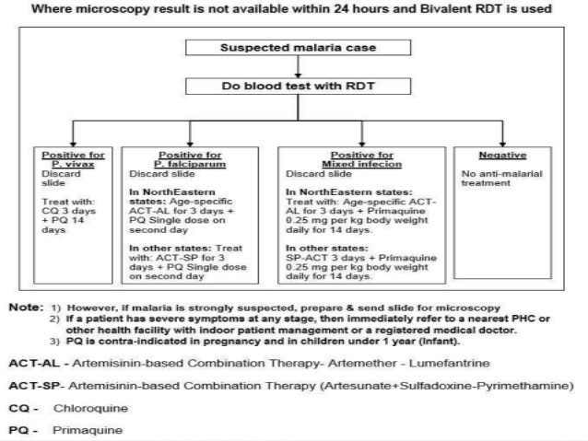

Slide 36
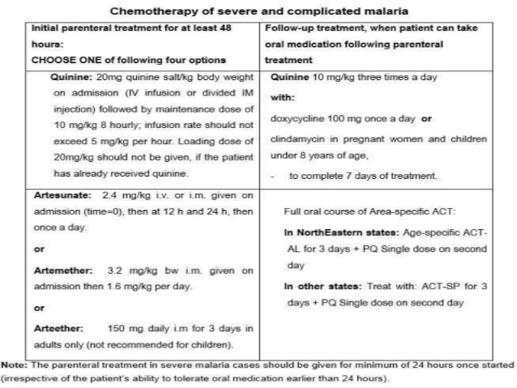

Slide 37
Chemoprophylaxis
Chemoprophylaxis is recommended for travellers from non-endemic areas and, as a short term measure for soldiers, police and labour forces serving in highly endemic areas
1) Short term chemoprophylaxis( < 6 weeks):
Doxycycline 100 mg daily for adults and 1.5 mg/ kg once daily for children( contraindicated in children below 8 years)
The Drug should be started 2 day before travel, continued during stay and 4 weeks after leaving the malarious area
2) Long term chemoprophylaxis( > 6 weeks)
Mefloquine 250 mg weekly for adults and should be administered 2 weeks before, during and 4 weeks after leaving the malarious area

Slide 38
PREVENTION
a)Anti-adult measures:
1)Residual spraying:
The spraying of the indoor surfaces of houses with residual insecticides( e.g., DDT, Malathion, Fenitrothion) is still the most effective measure to kill the adult mosquito
2) Space application:
This is a major anti-epidemic measure in mosquito-borne diseases
It involves the application of pesticides in the form of fog or mist using special equipment
3) Individual protection:
Use of the repellents, protective clothing
Bed–nets ( preferably impregnated with long repellent insecticides)
Mosquito coils, screening of houses

Slide 39
b) Anti- larval measures:
1) Larvicides:
Oiling the collection of standing water or dusting them with Paris green effectively controlled malaria
Modern larvicides such as tempehos which confer long effect with low toxicity are more widely used
2) Source reduction:
Technique to reduce mosquito breeding sites
It includes drainage or filling, deepening or flushing, management of water level, changing the salt content of water and intermittent irrigation
3) Integrated control:
Integrated vector control methodology which includes bioenvironmental and personal protection measure
This approach is important because there is no single and simple method that would ensure control of transmission

Slide 40
Thank you

