Slide 1
MID BRAIN
Dr Rakesh Ranjan
Assistant Professor
Anatomy Dept
Sri Krishna Medical college, Muz

Slide 2
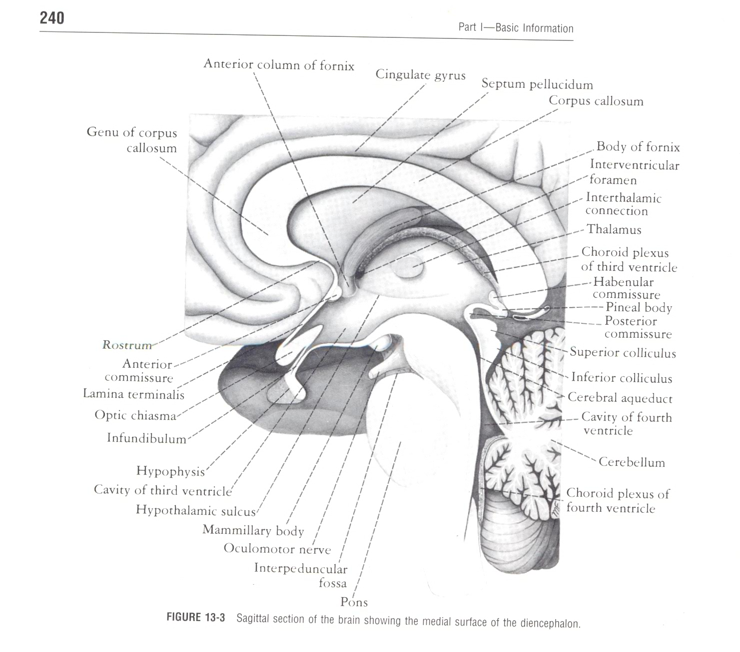
Mid brain
It is a part of the brain stem
Connects the fore-brain with the hind brain
It is a short stout stem like structure
It is lodged in the Tentorial notch
Length 2.5cm
Breadth 2.5cm

Slide 3
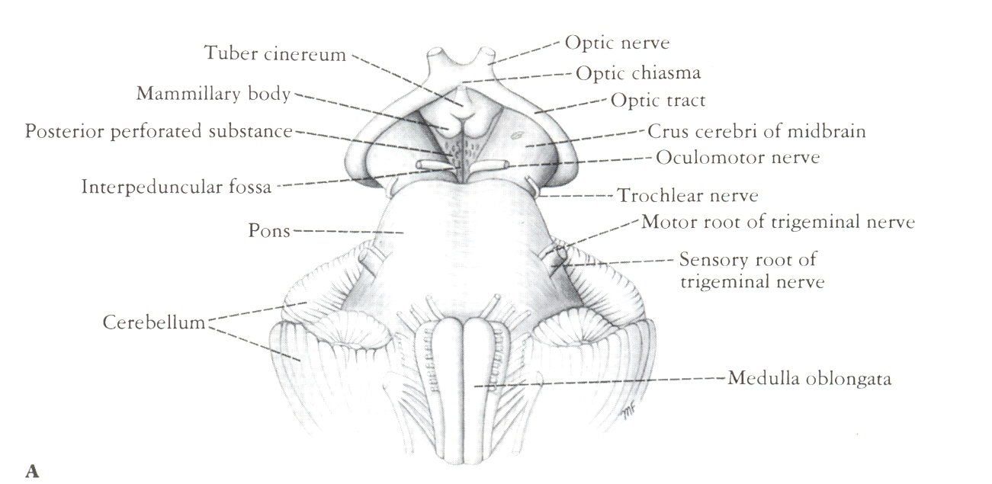
Anterior aspect of Midbrain
Interpeduncular fossa
- Boundary

Slide 4
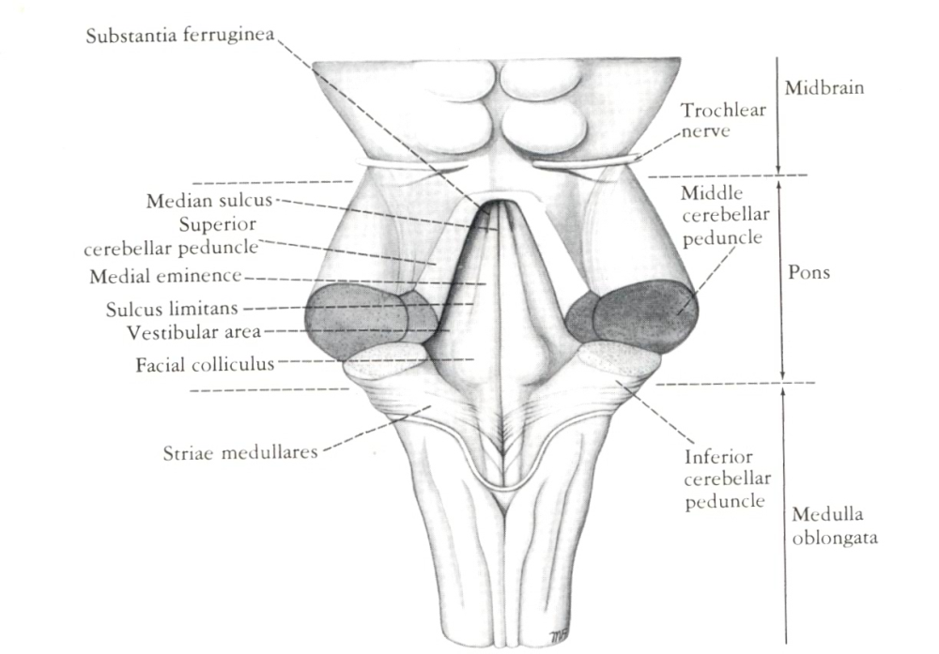
Midbrain
Posterior surface
Four Colliculi (Corpora quadrigemina)
Superior Colliculi(for Visual reflexes )
Inferior Colliculi(lower Auditory centers)
Trochlear Nerves

Slide 5
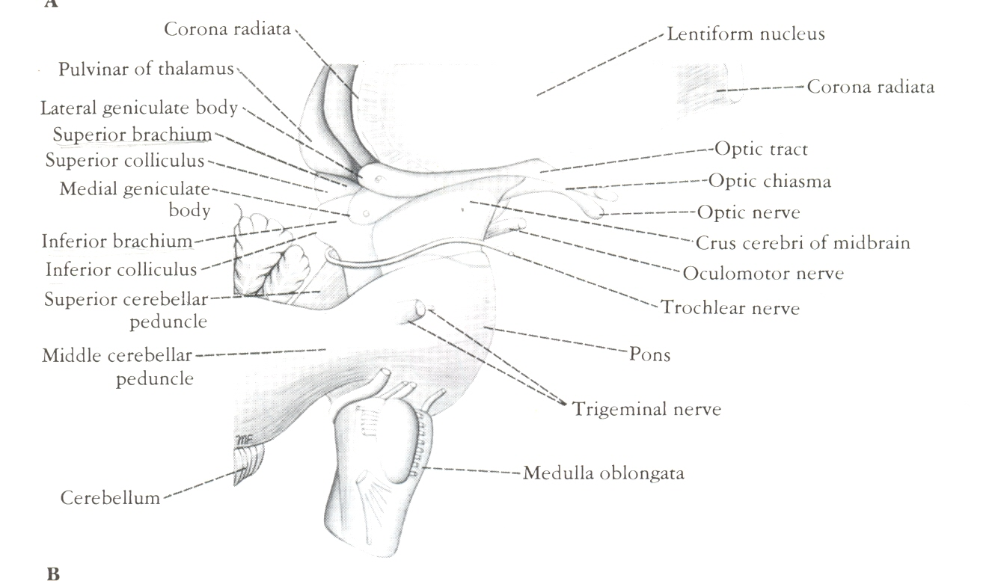
Midbrain
Lateral aspect –
Superior Brachia
Inferior Brachia

Slide 6
INFERIOR VEIW OF BRAIN

Slide 7
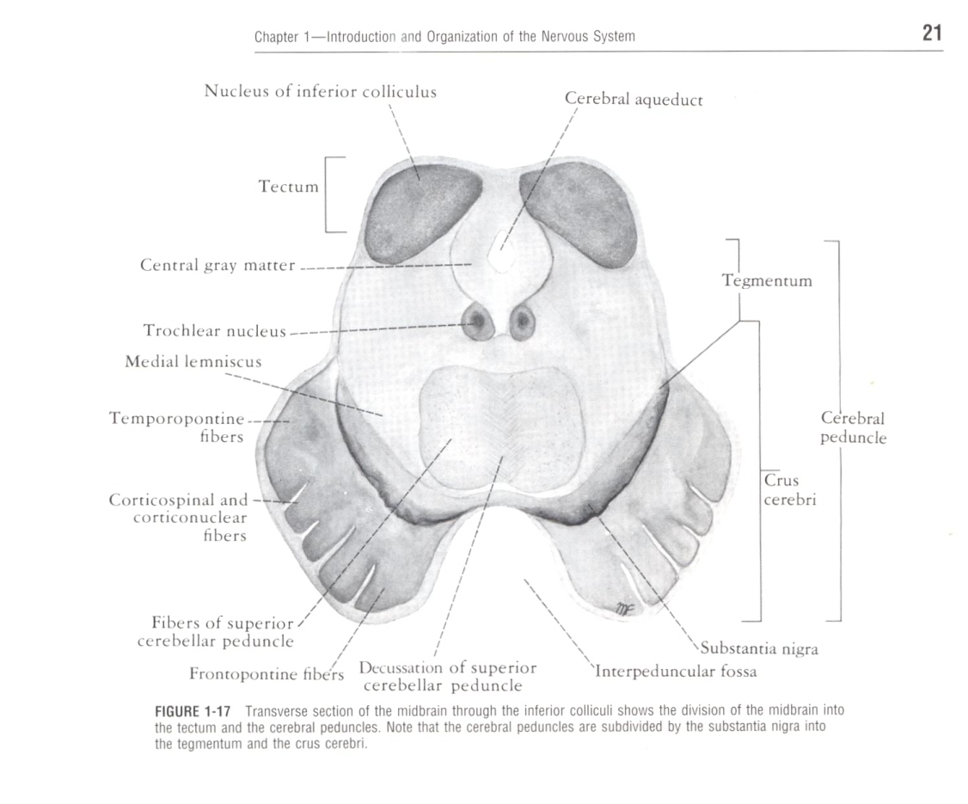
Internal Structure of Midbrain
Consists of two lateral halves called Cerebral peduncles
Anterior Crus Cerebri
Posterior Tegmentum
Tectum
United in their dorsal parts
Separated by a notch ventrally

Slide 8
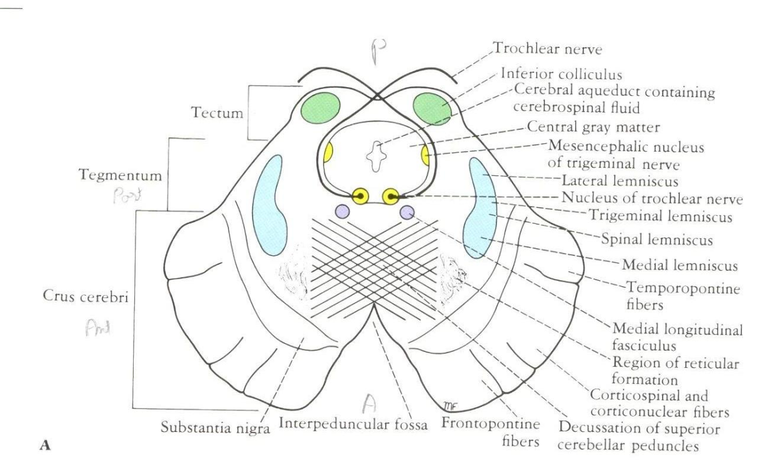
Transverse Section at Level of Inferior Colliculi
Inferior Colliculus
- Receives many terminal fibers of Lat. Lemniscus
Trochlear N.
Medial Longitudinal fasciculus
Mesencephalic N. of Trigeminal Nerve

Slide 9
Transverse Section at Level of Inferior Colliculi
Decussation of Superior Cerebellar peduncles
Reticular Formation
Medial Lemniscus
Spinal & Trigeminal Lemniscus
Lateral Lemniscus

Slide 10
Transverse Section at Level of Inferior Colliculi
Substantia Nigra
Large Motor Nucleus
Composed of Medium-size Multipolar neurons
Possess – Inclusion granules of Melanin pigment
Concerned with Muscle tone
Connected to – cerebral cortex , spinal cord, Hypothalamus & Basal Nuclei

Slide 11
Transverse Section at Level of Inferior Colliculi
Crus Cerebri contains
Corticospinal
Corticonuclear
Fronto-pontine
Temporopontine

Slide 12
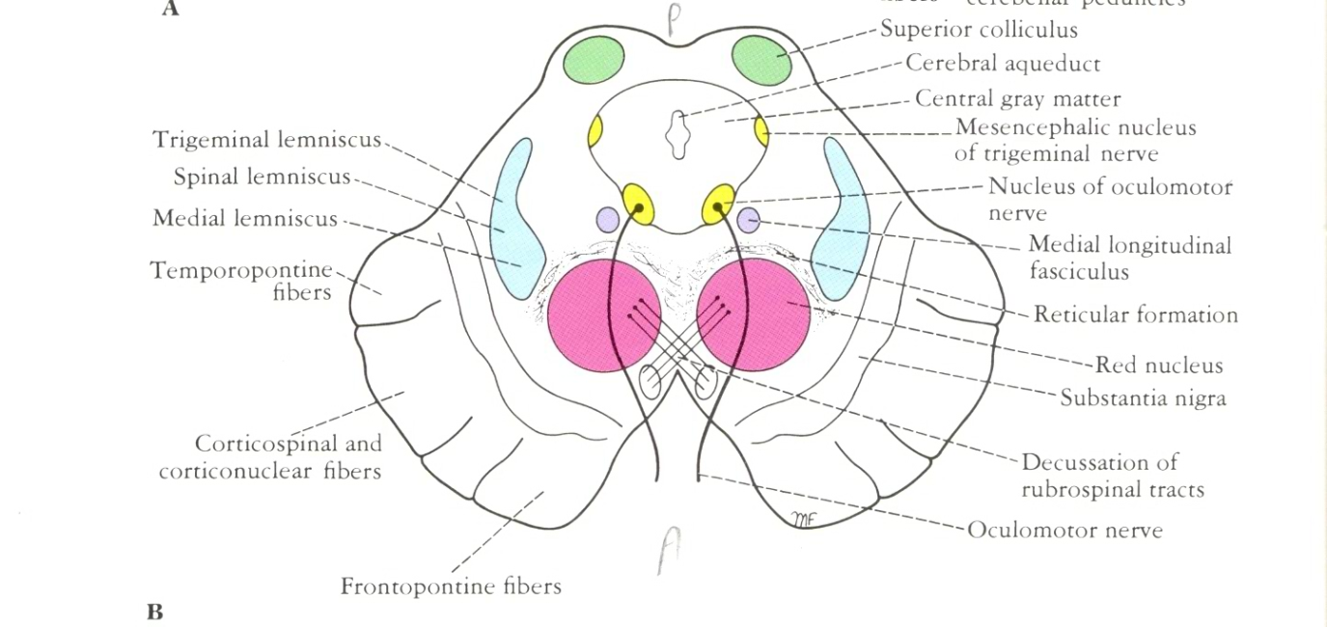
Transverse Section at Level of Superior Colliculi
Superior Colliculi
Forms Visual reflexes
Connected to Lateral Geniculate body by Superior Brachium
Receives afferent from Optic nerve, Visual cortex &Spinotectal tract

Slide 13
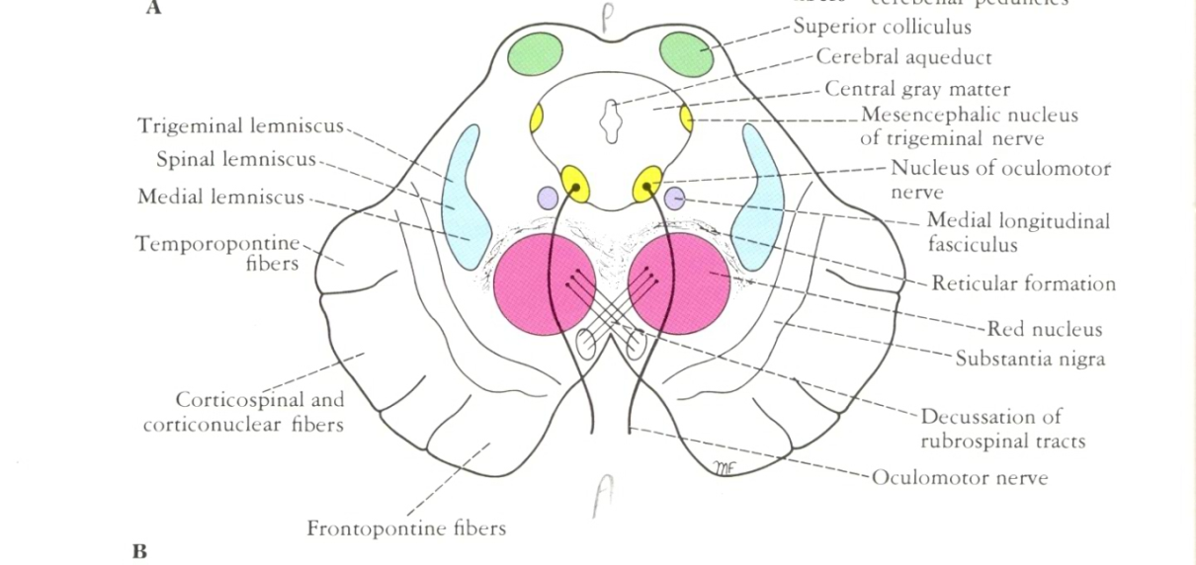
Transverse Section at Level of Superior Colliculi
Superior Colliculi
The Efferent are Tectospinal & Tectobulbar tracts
Responsible for reflex movement of Eye,Head & Neck in response to visual stimuli
The afferent pathway for Light reflex ends in Pretectal Nucleus to Parasympathetic nucleus of Oculomotor nerve(Edinger-Westphal nucleus)

Slide 14
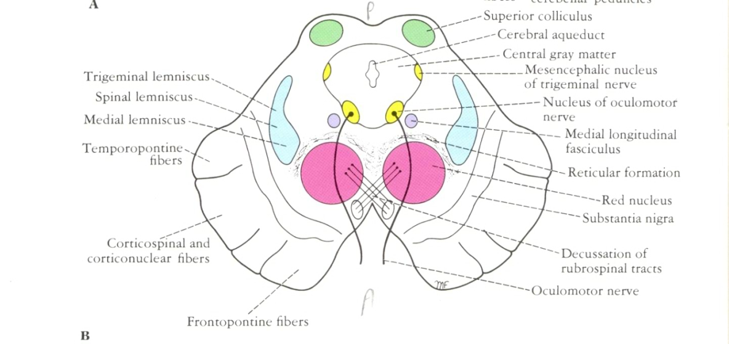
Transverse Section at Level of Superior Colliculi
Oculomotor Nucleus
Medial Longitudinal Fasciculus
Medial ,Spinal & Trigeminal Lemnisci
Red Nucleus
Due to its Vascularity & presence of iron-containing pigment
Afferent from
Corticospinal
Superior cerebellar peduncle
Lentiform,Subthalamic, Hypothalamic, substantia nigra& Spinal cord

Slide 15
Transverse Section at Level of Superior Colliculi
Red Nucleus
Efferent
Spinal cord(Rubrospinal)
Rubroreticular
Thalamus
Substantia nigra

Slide 16
Blood supply of Midbrain
Posterior Cerebral A.
Superior Cerebellar A.
Basilar A.

Slide 17
Applied Anatomy
Trauma of Midbrain
Involvement of oculomotor – Malfunction of parasympathetic nucleus of Oculomotor nerve produces dilated pupil
Involvement if Trochlear
Blockage of Cerebral Aqueduct
Vascular Lesions of the Midbrain
Weber’s Syndrome
Benedikt’s Syndrome

Slide 18
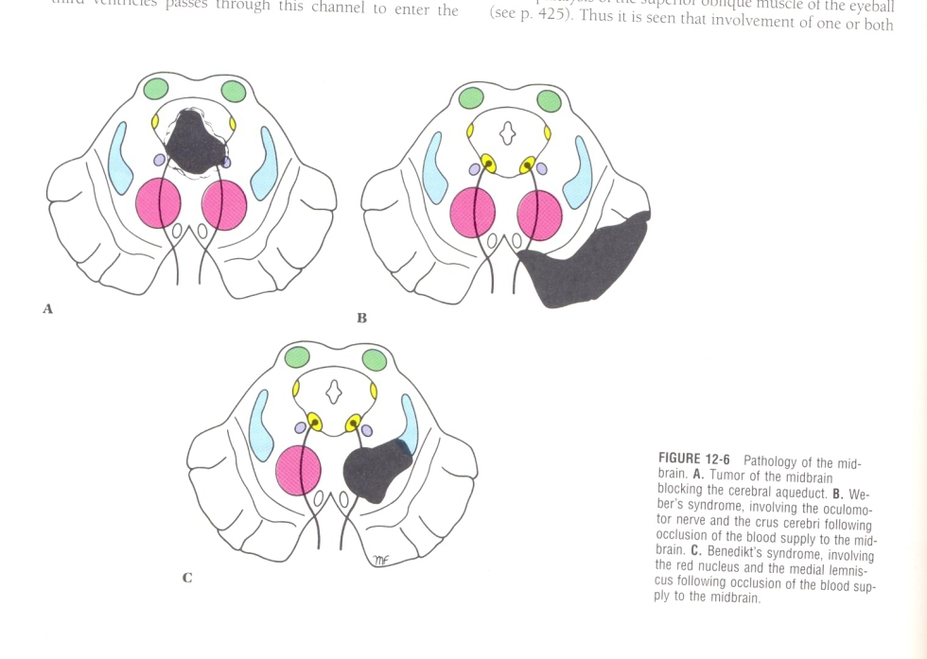
Applied Anatomy
Vascular Lesions of the Midbrain
Weber’s Syndrome – produced by occlusion of branch of Posterior Cerebral A. Necrosis involving Oculomotor N. & Crus Cerebri sign & Symptons - Ipsilateral Ophthalmoplegia & Contralateral paralysis of lower part of Face, Tongue & Arm Leg, Eyeball deviated to lateral side(Medial Rectus), Drooping of upper eye lid(Ptosis), Pupil is dileted & fixed
Benedikt’s Syndrome

Slide 19
Applied Anatomy
Vascular Lesions of the Midbrain
Benedikt’s Syndrome –Necrosis involves the Medial Lemniscus & Red Nucleus
- Sign & Symptoms – Contralateral Hemianesthesia & involuntary movements of Limbs of the Opposite side

Slide 20
Cerebral peduncle consists of
Crus cerebri ventrally
Substantia nigra –a plate of darkly pigmented grey matter in the middle
Tegmentum dorsally
Part dorsal to aqueduct of Sylvius is called the tectum of mid-brain

Slide 22
External features
Dorsal aspect [tectum]
There are four spherical swellings called superior and inferior pairs of corpora quadrigemina
Separated from each other by a cruciform sulcus
Upper end of the vertical limb of the sulcus leads to pit where the pineal stalk is attached

Slide 23
LATERAL VEIW OF MIDBRAIN

Slide 24
contd
The lower limb of the sulcus is continuous with median ridge called frenulum veli on the superior medullary velum
Superior medullary velum stretches between the two superior cerebellar peduncles
Trochlear nerve emrges out and curves around the superior cerebellar peduncle to reach the ventral side

Slide 25
Transverse limb of the cruciform sulcus is continuous with the superior brachium
Superior brachium runs from the superior colliculus to the lateral geniculate body
Inferior brachium connects the inferior colliculus wit the medial geniculate body

Slide 26
Ventral aspect
Cerebral peduncles are separated on the ventral aspect by a notch the posterior part of inter-peduncular fossa
Each peduncle is crossed by sup.cerebellar and post.cerebral arteries medio-laterally
Optic tract winds backwards around it
Occulomotor nerve emerges out from the medial ide of the peduncle
Lateral side the lateral lemniscus comes near the surface

Slide 27
Midbrain consists of crus cerebri ,substantia nigra and tegmentum

Slide 30
Internal structures
T.S.of mid-brain
Crus cerebri or basis pedunculi
Consists of fibres descending from the cerebral cortex
Fronto-pontine fibres occupy medial one sixth
From areas 4and six of frontal cortex
Temporo-pontine fibres lateral one sixth

Slide 32
Parieto-pontine and occipito pontine fibres descend just medial to the tempro-pontine tracts
Cortico-spinal and cortico-nuclear lie in the middle 2/3rd of the crus

Slide 33
Substantia nigra
Is a lamina of darkly pigmented[neuro melanin] grey matter situated between the crus cerebri and the tegmentum
Extending from the upper end of pons to the sub-thalamic region
Its medial end is traversed by the fibres of 3rd nerve
Dorsal pars compacta
Ventral pars reticulris

Slide 35
Tegmentum at the inferior collicular level
Inferior colliculus large mass of grey matter in the the tectum
Concerned with reflexes involving auditory stimuli
Trochlear nucleus lies in the ventral part of the central grey matter
Fibres run dorsally and decussate in superior medullary velum

Slide 37
Mesencepalic nucleus
Lies lateral to peri-aqueductal grey
It contains groups of large ovoid unipolar cells
Receives proprioceptive fibres from muscles of mastication,teeth,ocular and facial muscles
Reticular formation lies ventro-lateral to mesencephalic nucleus

Slide 38
Superior cerebellar peduncle
Enters the doso-lateral part of tegmentum and passes ventro- medially and decussate with corresponding fibres of opposite side
Medial lemniscus,trigeminal and lateral lemnisci and lateral spinothlamic tract lies as curved band dorsal and lateral to substantia nigra

Slide 39
Tegmentum at the superior colliculi level
Two large masses of grey matter –superio colliculuin the tectum and red nucleus in the tegmentum
Superior colliculus is a centre connected with visual reflexes
Red nucleus lies in the anterior part of tegmentum
It is red in color due to the iron pibment in its neuron

Slide 40
T.S. AT INFERIOR COOLICULUS LEVEL

Slide 41
Oculomotor nucleus lies ventral to central grey matter
Edinger Westphal nucleus supplies sphincter pupillae and ciliaris muscle is a part of oculomotor nucleus
Pre tectal nucleus near the cranial part of superior colliculs and related with pupillary light reflex

Slide 42
Trigeminal lemniscus
Spinal lemniscus all these 3 lies more dorsally
Lateral lemniscus not seen at this level
Dorsal tegmental decussation fibres originating from superior colliculs cross to opposite side to descend as tectospinal tract

Slide 43
Ventral tegmental decussation fibres originate from red nucleus and decussate to form the rubro spinal tract

Slide 44
Connections of red nucleus
Red nucleus consists of cranial parvicellular part and caudal magno cellular part
It receives afferents from
Cerebral cortex
Cerebelum [dentate, emboliform and globus nuclei ]

Slide 45
Efferents
Rubrospinal [red nucleus to spinal cord]
Rubrobulbar [red nucleus to the motor cranial nuclei of 3rd ,4th ,5th sixth and7th nerve]
Rubro reticular
Rubro-olivary
Rubro-cerebellar
Red nucleus to inferior colliculus through central tegmental fasciculus

Slide 46
Connections of red nucleus

Slide 47
Inferior colliculus
It is an important relay centre in the auditory path way
Receives fibres of the lateral lemniscus arising in the superior colliculus

Slide 48
Connections

Slide 49
Superior colliculus
Afferents are from retina
Efferents are
Tectospinal
Tecto nuclear
And to retina

Slide 50
Connections of superior colliculus

Slide 51
Connections of substantia

Slide 52
APPLIED ANTOMY
Argyll- Robertson pupil
It is a condition where light reflex is lost but the accomodation reflex remains intact
This is due to lesion in the pretectal nucleus
Causes are tertiary syphilis,diabetes,and encephalitis

Slide 53
Lesions of tegmentum may involve
3rd nerve leading to paralysis of extraocular muscles
Sensory tracts resulting in loss of sensations
Substantia nigra and red nucleus leading to involuntary movements
Weber’s syndrome-lesion in the cerebral peduncles leads to oculomotor paralysis of same side but hemiplegia of opposite side

