Slide 2
s

Slide 3
Semispinalis capitis

Slide 9
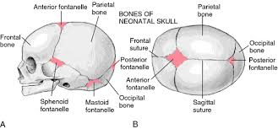

Slide 14
Ellipsoid joint

Slide 16
