Slide 1
VITAMIN - K

Slide 2
VITAMIN K

Slide 3
Properties of Vitamin K

Slide 4
Chemistry of Vitamin K

Slide 5
Comparison of types of Vitamin K

Slide 6
Dietary sources of Vitamin K for vegetarians

Slide 7
Metabolism : Absorption and transport of Vitamin K

Slide 8
The coagulation cascade

Slide 9
MORAWITZ THEORY OF BLOOD COAGULATION

Slide 10
Factors of blood coagulation dependent on VITAMIN K

Slide 12
Osteocalcin and Vitamin K

Slide 14
Organ dependent on calcium binding protein & Vitamin K

Slide 15
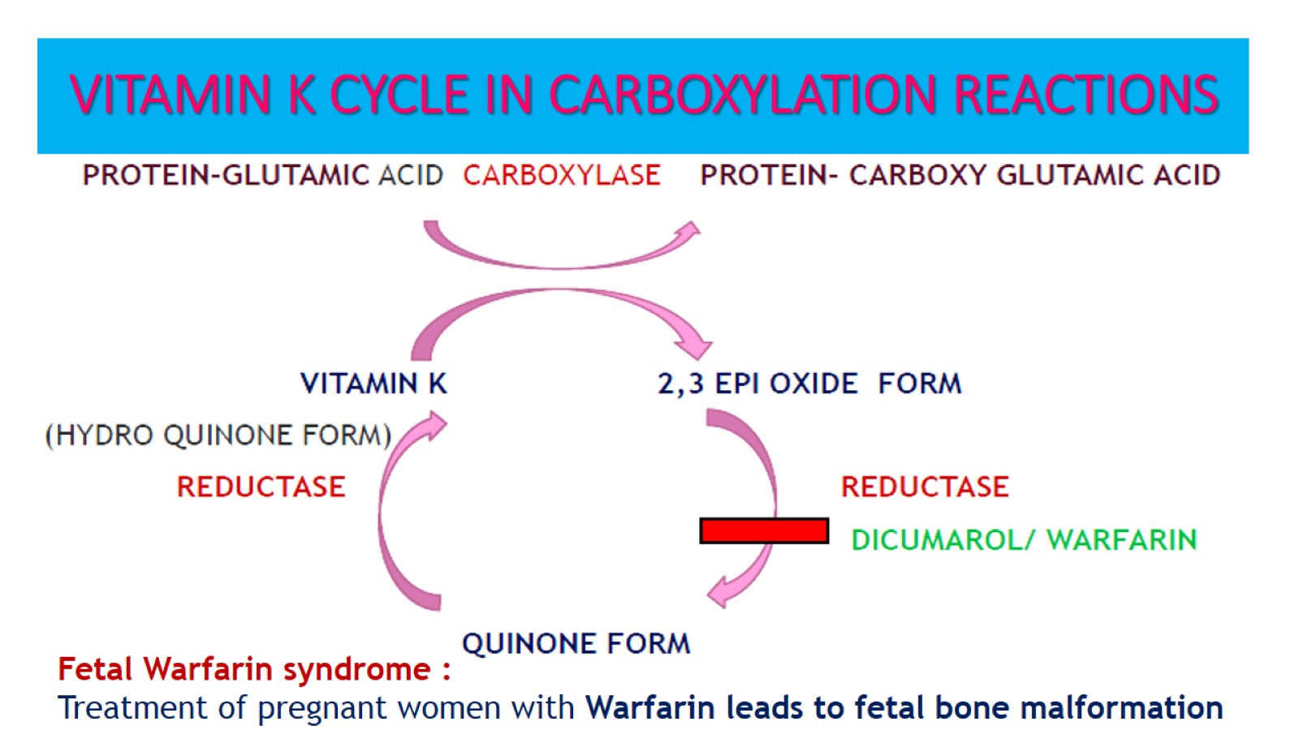
VITAMIN K CYCLE IN CARBOXYLATION REACTIONS

Slide 16
Role of Vitamin K and Warfarin

Slide 17
Mechanism of action of Vitamin K and Warfarin in coagulation

Slide 18
Causes of Deficiency of vitamin K

Slide 19
Hemorrhagic disease of newborns and Deficiency of vitamin K

Slide 20
Clinical manifestation of Deficiency of Vitamin K

Slide 21
Antagonists of Vitamin K

Slide 23
Uses of Vitamin K

Slide 24
Management of Deficiency of Vitamin K

Slide 25
Adverse effects of Vitamin K

