Slide 1
MEDICOLEGAL ASPECTS OF DEATH INVESTIGATION
DR KUNAL ANIMESH
MBBS, MD

Slide 2
Postmortem Changes
Changes after death or signs of death
Immediate changes
Early Changes
Late changes
Immediate Changes:
Unconsciousness
Loss of reflexes
Permanent cessation of circulation
Permanent cessation of respiration

Slide 3
Postmortem Changes
Early Changes:
Changes in skin
Changes in the eye
Primary flaccidity of muscles
Cooling of the body
Post mortem staining
Rigor mortis
Late changes:
Putrefaction
Adipocere formation
Mummification

Slide 4
Immediate Changes
Unconsciousness & loss of reflexes:
Complete loss of response to sensation, i.e. touch, pain, temperature, etc.
Loss of voluntary power to move.
They can also lead to error, as they are found in conditions as:
Prolonged fainting attack, epilepsy, vagal inhibition, narcosis, trance, electrocution etc.
Test for confirmation:
A flat EEG or loss of EEG rhythm

Slide 5
Immediate Changes
Permanent Cessation of Respiration:
Complete stoppage of respiration for more than 3 minutes.
However it may also be observed in conditions as
Voluntary acts of breath holdings,
Cheyne-Stoke,
Breathing in apparently drowned,
Newborn infants.

Slide 6
Tests for Confirming Respiratory Arrest:
Auscultation for breath sounds by a stethoscope- recommended method
No audible breath sounds on continuous auscultation of upper part of chest and in front of or on the larynx for minimum of 5 minutes, confirms cessation of breathing.
Other tests of historical interest:
Feather test: movement of a feather held in front of the nose.
Mirror test: mirror held in front of the nose does not turn dim due to any moisture of breath.
Winslow’s test: no movement of surface of water in bowl kept on the chest.

Slide 7
Immediate Changes
Permanent cessation of Circulation:
Complete absence of heart sounds for more than 3 to 5 minutes.
Test for confirming cessation of circulation:
The recommended method is again thorough auscultation for heart sounds by stethoscope.
No audible heart sounds on continuous auscultation on precordial area of chest for a minimum of 5 minutes is suggestive of cessation of circulation.
A flat ECG recording for 5 minutes confirms this.

Slide 8
Immediate Changes
Tests of Historical Interest:
Magnus’s test (Ligature test): fingers fail to show congestion distal to a ligature applied at their base.
Diaphanous test (Transillumination test): Failure to show redness in the web space between the fingers on transillumination from behind.
I card’s test: fluorescent dye on being injected at a given site in a dead body fails to produces any discoloration.
Fingernail test: no blanching and filling of blood in the fingernail on application of pressure and release.

Slide 9
Suspended Animation (Apparent Death)
This is a death like state in which vital functions of body are at such a low pitch that they can not be detected by ordinary method of clinical examination.
The metabolic rate is greatly reduced so that the requirement of the individual cell for O₂ is satisfied through the dissolved oxygen in body fluids.
It lasts for seconds to hours.
The patient can be resuscitated by cardiac massage or electric stimulator & artificial respirator.

Slide 10
Voluntarily:
Seen in practitioners of Yoga or in Trance
Involuntarily:
Severe shock
Electrocution
Freezing of body & Heatstroke
Poisoning with Barbiturates or Opiates
Newborns
Drowning
Epilepsy
Cholera & hysteria
Death certificate should not be issued without an ECG or EEG record

Slide 11
Early Changes
Changes in the Skin:
Facial pallor
Skin becomes dull, waxy Pale & ashy white due to stoppage of peripheral circulation and drainage of blood from the capillaries & small vessels.
Loss of elasticity with decrease in the facial creases
The lips appear brownish, dry and hard due to drying.

Slide 12
Early Changes
Changes in the Eyes:
Eyeballs softened.
In cornea: * Loss of corneal reflex
* Loss of luster
*Opacity of cornea- due to drying
- within 15 minute.
The rise in temperature & humidity hastens the process whereas closed eyes delays it.
But cornea becomes permanently hazy after about 10-12 hrs of death, due to decomposition.

Slide 13
In Sclera:“Tache Noires” de la sclerotiques
It is an early & important sign of death
If the eyelids are open for a few hrs after death,
a film of cell debris & mucus forms an yellow triangle of desiccated discoloration on sclera at each side of the iris.
It becomes brown & black within 3-4 hrs.

Slide 14
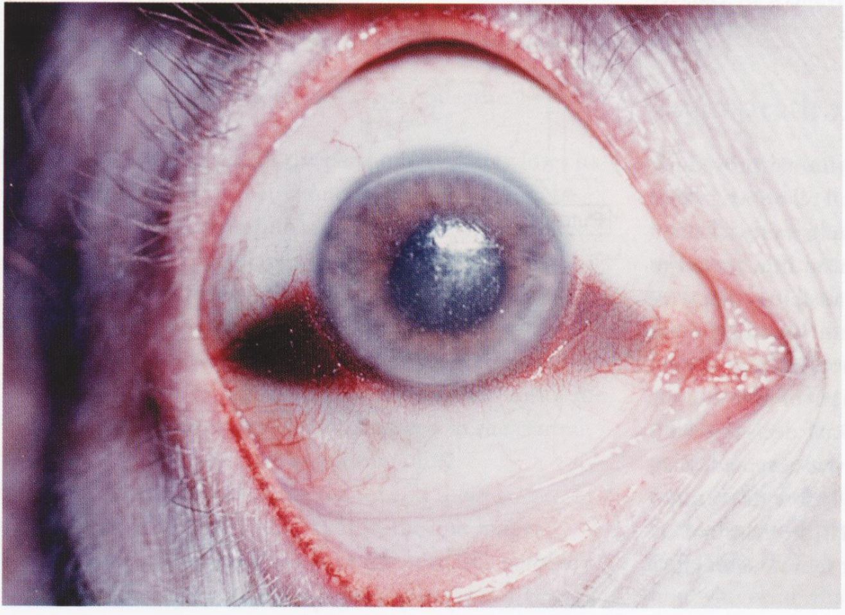
Tache Noires” de la sclerotiques

Slide 15
Pupils:
Are in mid-dilated position.
Normally, they are circular. But after death the shape can be changed due to loss of tone & elasticity of ciliary muscles.
Moreover, size & shape of the pupils of the two sides may be different.
The pupils react to atropine & eserine for about an hour after death, but they do not react to strong light.
Intraocular Tension(IOT):
Eyes looks sunken, soften within minutes due to fall in IOT.
During life 14 -25 gm 12 gm 3 gm
(soon after death) (½ hrs)
Nil at the end of 2hrs.

Slide 16
Retinal Vessels:
Fragmentation or segmentation (cattle trucking or shunting) of the blood columns appear within 10 seconds after death.
It persists for about an hour. (Kevorkian sign)
** This is considered a most reliable sign of death.
Retina pale – 2 hrs.
Optic disc blurred – 7-10 hrs
Chemical Changes:
K⁺ in vitreous humour up to 100 hrs after death.
Changes in the eyes other than those in retina & vitreous humour are less important for estimation of time since death

Slide 17
Early Changes
Primary Flaccidity of Muscles:
All the muscles of the body loose their tonicity, begin to relax soon after death.
During this stage, death is only somatic.
It lasts for 2-3 hrs.
Lower jaw falls, loose tension, When we lift the hand it falls flat and flab and joints are flexible.
The sphincters relax and can cause defecation and urination, seminal emission and so on.

Slide 18
Body flattens over areas which are in contact with the surface on which it rests. (contact flattening).
This relaxation due to high ATP content which permits splitting of Actin – myosin cross-bridges.
Muscular irritability .
Response to mechanical or electrical stimuli persist.
Pupils – react to atropine or physiostigmine.
Muscle protoplasm is slightly alkaline.

