Slide 1
General histology of alimentary canal.
Dr. Anjali Prasad
Assistant Professor
SKMCH MUZ.

Slide 2
General Structure of the Digestive Tract

Slide 3
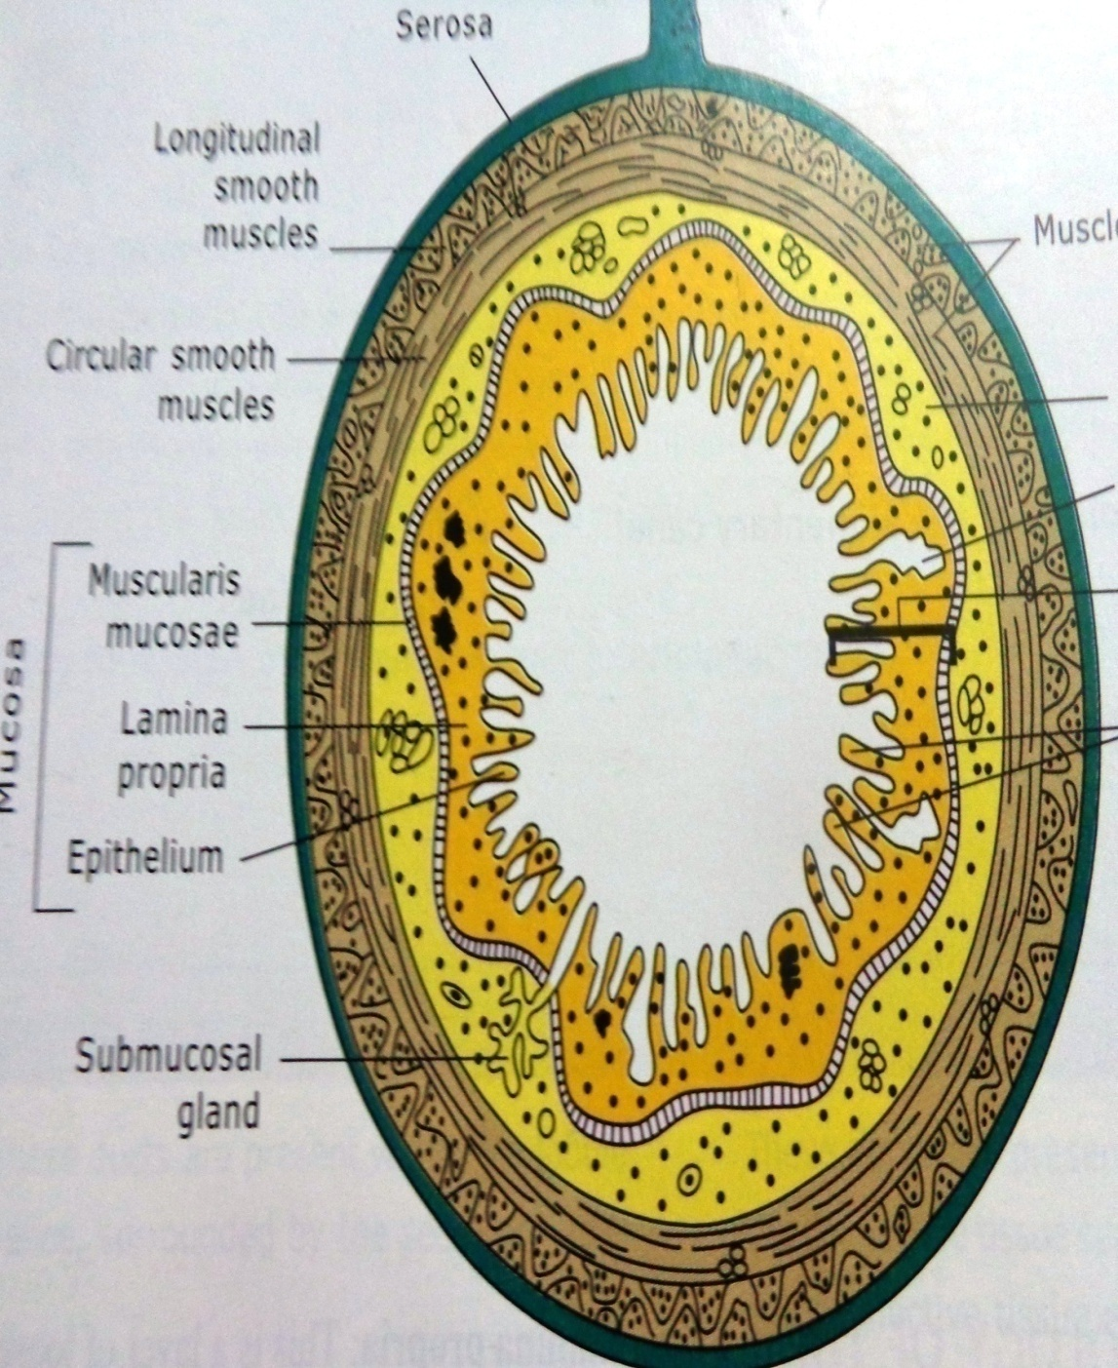
Histology of git
From within outside-
Mucosa
Submucosa
Muscularis externa
Serosa/ adventitia

Slide 4
Mucosa
The mucosa comprises :
An Epithelial lining;
An underlying Lamina Propria of loose connective tissue rich in blood vessels, lymphatics, lymphocytes and also contains glands
A thin layer of Smooth Muscle called the muscularis mucosae.
The mucosa is frequently called as mucous membrane.

Slide 5
Submucosa
The submucosa contains dense irregular connective tissue with many blood and lymph vessels and the submucosal plexus of autonomic nerves.
It may also contain glands and lymphoid tissue
In submucosa ,the network of unmylinated nerve fibers & ganglion cells constitute the SUBMUCOSAL PLEXUX (Meissner`s plexux)

Slide 6
Muscle layer/ Muscularis externa
Inner circular-(Spiral)
Outer longitudinal
Myenteric plexux (Auerbach`s plexus)
Contraction of Muscle layer, mix & propel the contents of the digestive tract.

Slide 7
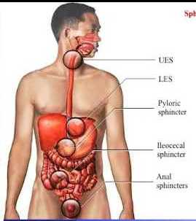
Circular smooth muscle layer forms sphincters at specific locations-
pharyngoesophageal sphincter
pyloric sphincter
Ileocecal valve
Internal anal sphincter

Slide 8
Serosa & adventitia
The serosa is a thin layer of loose connective tissue, rich in blood vessels, lymphatics, and adipose tissue, with a simple squamous covering epithelium (mesothelium).
In places where the digestive tract is not suspended in a cavity but bound to other structures, such as in the esophagus , the serosa is replaced by a thick adventitia, consisting of areolar connective tissue containing vessels and nerves, lacking mesothelium.

Slide 9
Histology of the Mucosa
Organ | Epithelium
Mouth | Nonkeratinized Stratified Squamous
Pharynx | Nonkeratinized Stratified Squamous
Esophagus | Nonkeratinized Stratified Squamous
Stomach | Simple Columnar
Small Intestine | Simple Columnar
Large Intestine | Simple Columnar
Anus | Nonkeratinized Stratified Squamous

Slide 10
Histology of the Mucosa
Organ | Folds of the epithelium
Esophagus | Star shaped lumen
Stomach | L: Rugae,
Small Intestine | L: Villi
Large Intestine | L: Haustra

Slide 11
Folds of mucosa and submucosa

Slide 12
Histology of the Submucosa
Organ | Specialized structures
Esophagus | Submucosal mucous glands
Stomach | None
Duodenum | Brunner’s glands
Ileum | Peyer’s Patches
Large Intestine | None

Slide 13
Histology of the Serosa
Organ | Serosa
Esophagus | Adventitia due to the fact that the esophagus is not in a cavity
Stomach | Visceral Peritoneum
Small Intestine | Visceral Peritoneum
Large Intestine | Visceral Peritoneum
Anus | Adventitia

Slide 14
oesophagus
4 layers are-
Mucosa-
lining epithelium
lamina propria
Muscularis mucosa
Submucosa
Mus. Externa
Serosa/ Adventitia

Slide 15
Esophagus

Slide 16
Mucosa
Epithelium :
Non keratinised stratified squamous
Lamina propria :
Loose connective tissue
Muscularis mucosae :
Thicker
Single layer of longitudinal smooth muscle

Slide 17
Submucosa
Moderately dense irregular connective tissue
Composed of bundle of collagen and elastic fibres
Due to elastic fibres the submucosa is thrown into folds and lumen appears star shaped

Slide 18
Muscularis externa
In upper 1/3rd :
Skeletal muscle
Middle 1/3rd :
Smooth and Skeletal
Lower 1/3rd :
Purely Smooth

Slide 19
SEROSA/ ADVENTITIA
Loose areolar connective tissue
Merges with the connective tissue of the surrounding structure
Surrounds most of the oesophagus except lowest 1 inch where it is covered by serosa

Slide 20
Cardio-oesophageal junction

Slide 21
Stomach

Slide 22
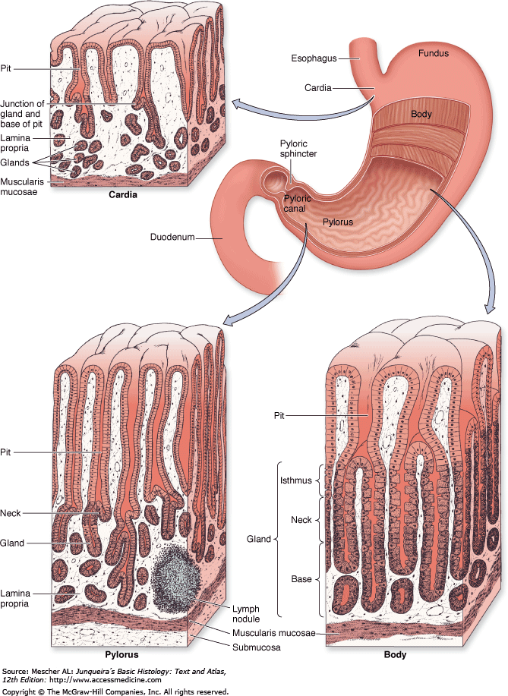

Slide 23
Stomach
4 layers –
Mucosa
Submucosa
Muscularis externa
serosa
Notes:
Rugae
Gastric pits and glands

Slide 24
Cardiac region
Mucosa
Submucosa
Muscularis externa
Serosa
Notes:
At co junction : epithelium changes from stratified sqm to simple columnar
Simple columnar ep has basal oval nuclei and involved in secretion of mucus and called mucous surface cells , goblet cells are not present

Slide 25
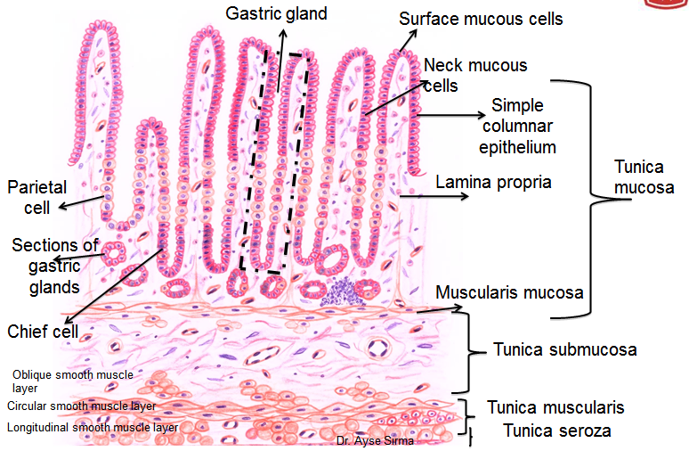
Mucosa:
Simple columnar epithelium has basal , oval nuclei and involved in secretion of mucus and called mucous surface cells , goblet cells are not present.
Lamina propria : small tubular gland opens into pits
Muscularis externa : has 3 layers, inner oblique , middle circular and outer longitudinal

Slide 26
CARDIAC GLANDS
Cardiac glands are heavily branched tubular glands which contain mainly mucus-producing cells.
Shallow Gastric Pits
Short glands

Slide 27
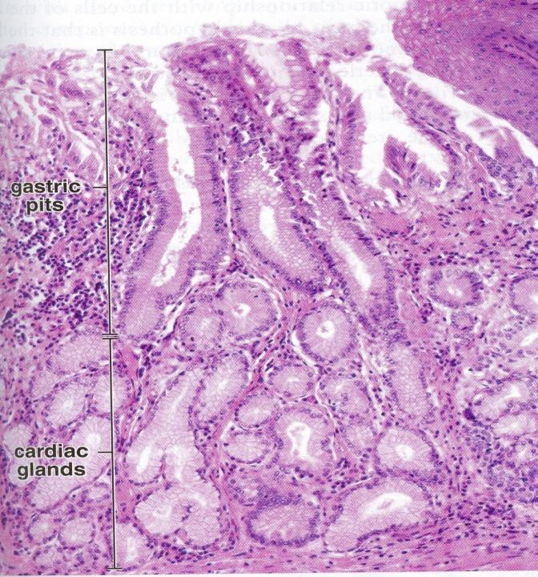

Slide 28
Fundic or Body region
Mucosa
Lininig epithelium
Lamina propria
Muscularis mucosae

Slide 29
MUCOSA

Slide 30
Mucosa
Lining epithelium- Simple columnar epithelium, involve in secretion of mucous.
Lamina Propria - simple tubular gland present – C/as gastric/fundic glands.
Muscularis mucosae -

Slide 31
PRINCIPAL or FUNDIC GLANDS
Each glandular tubule consists of three parts:
deep body,
intermediary neck
upper isthmus.

Slide 32
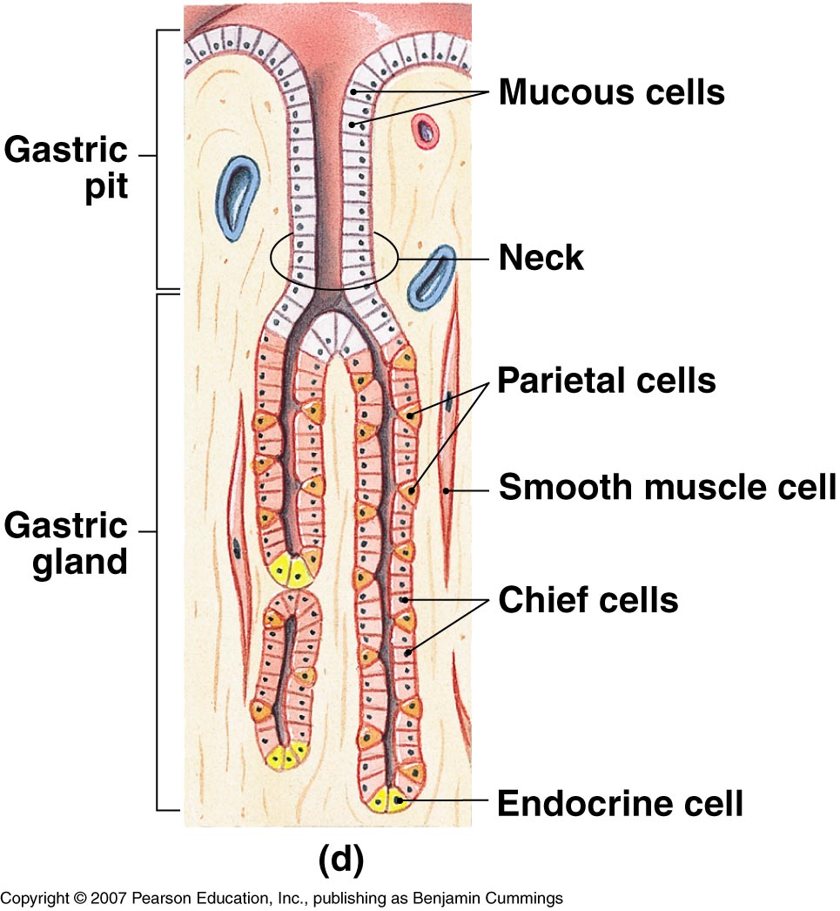
GASTRIC GLANDS cells
Entero-

Slide 34
Mucous neck cells
Located just below the gastric pit.
Columnar in shape and have mucinogen granules.
Nuclei basally situated.
Secrete mucus to protect epithelial cells from enzymes & acid

Slide 35
Parietal/oxyntic cells
Large acidophilic cells.
secrete the hydrochloric acid of the gastric juice. Aside from activating the pepsinogen
Parietal cell also secrete intrinsic factor, which is necessary for the resorption of vitamin B12

Slide 36
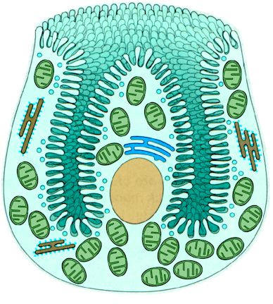
Electron microscopy of parietal cells
Presence of deep infoldings of apical membrane – forming intracellular canaliculus into which project many microvilli.
Cytoplasm contains Tubulovesicular structure .
These tubulovesicular structures are involved in HCl secretion.

Slide 37
Chief cells/ Zymogenic cells
Located in lower third of gastric glands.
Are stained basophilic.

Slide 38
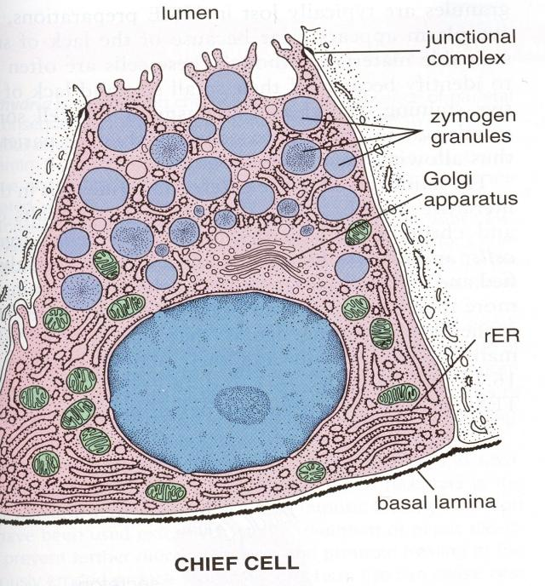
Chief cells (or zymogenic cells)
contain Zymogens granules
Abundant RER give the cell Basophilic stain
most numerous of the four types. They occur primarily in the body of the glands.
produce pepsinogen, which is a precursor of the proteolytic enzyme pepsin.

Slide 39
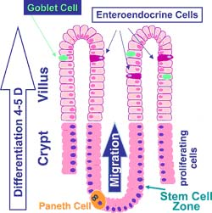
ENTEROENDOCRINE CELLS
Scattered between the epithelial cells of the gastric mucosa and their basement membrane.
Demonstrated by Electron microscope or by Immunological technique.On light microscopy they appear clear.
Secretion is released in the lamina propria and distributed by blood vessels.
Notes:
39

Slide 40
Endocrine cells
The best characterized endocrine cells in the gastric mucosa are gastrin-producing cells (G cells) and somatostatin-producing cells (D cells). G cells are most frequent in the middle third of the glands. They stimulate the secretion of acid and pepsinogen. G cell function is stimulated by nervous input, the distension of the stomach.
D cells are found mainly in glands of the pyloric antrum. They inhibit G cells and thereby acid production. D cell function is stimulated by acid in the lumen of the stomach and duodenum.

Slide 41
Mucous neck cells: - Secrete mucus to protect epithelial cells from enzymes & acid
Parietal or oxyntic cells : - Secrete HCl (for protein digestion) & intrinsic factor (for B12 absorption
Chief or zymogenic cells: Secrete pepsinogen which gets converted to “pepsin” when mixed with HCl; for protein digestion
Enteroendocrinal and APUD cells: Secrete gastrin to regulate stomach emptying

Slide 42
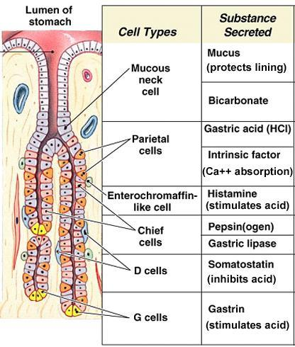

Slide 43
Pyloric region
4 layers
Mucosa
Submucosa
Muscluaris externa
Serosa

Slide 44
MUCOSA

Slide 45
PYLORIC GLANDS
Short, tortous and branched tubular glands.
Lined by one cell type, similar to mucous neck cells.
Endocrine cells, in particular gastrin-producing cells, are more frequent than in principal glands. A few parietal cells may be present but chief cells are usually absent.

Slide 47
In the pylorus, the pits extend downward to about one-half the thickness of the mucosa;
In the cardiac, and fundus, the pits occupy only one-fourth the thickness of the mucosa

Slide 49
Cell renewal
The surface epithelium is renewed approximately every third day.
The source of the new cells is the isthmus, i.e. the upper part of the neck, of the gastric glands, where cells divide and then migrate towards the surface epithelium and differentiate into mature epithelial cells

Slide 50
FUNCTIONS
Storage
Mixing
Partial Digestion
Protection
Absorption

